Slide 1
Regression Examples
Pharmaceutics, Airline Stocks, Heights and Bone Lengths, Basketball Betting Lines, Temperature Trends, US Population Trend

Slide 2
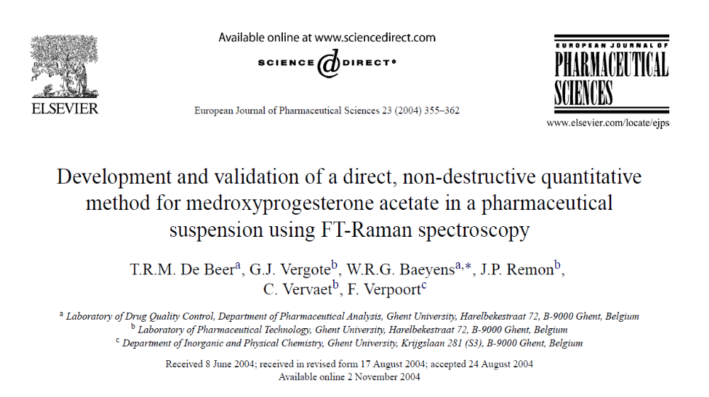

Slide 3
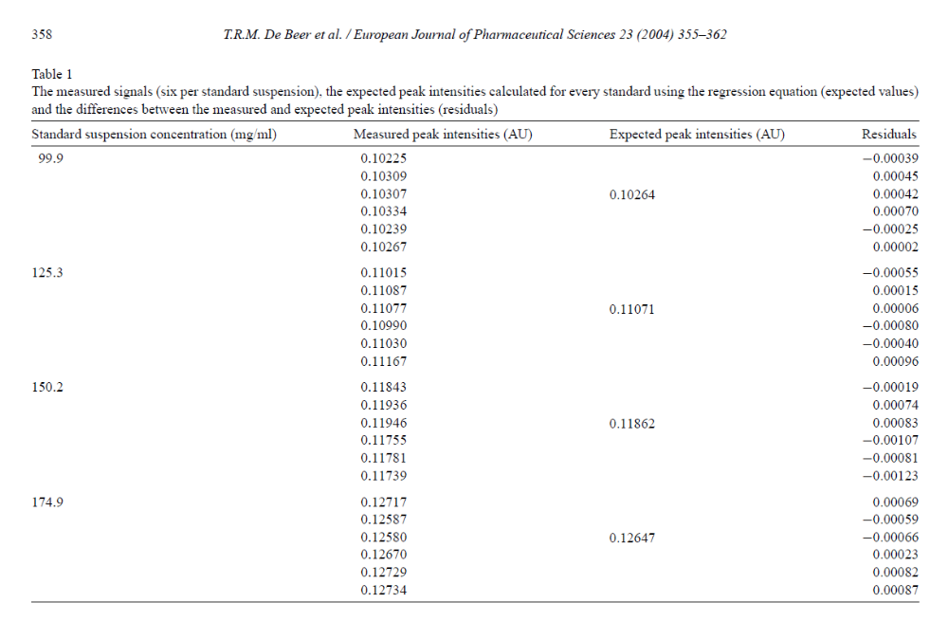

Slide 4
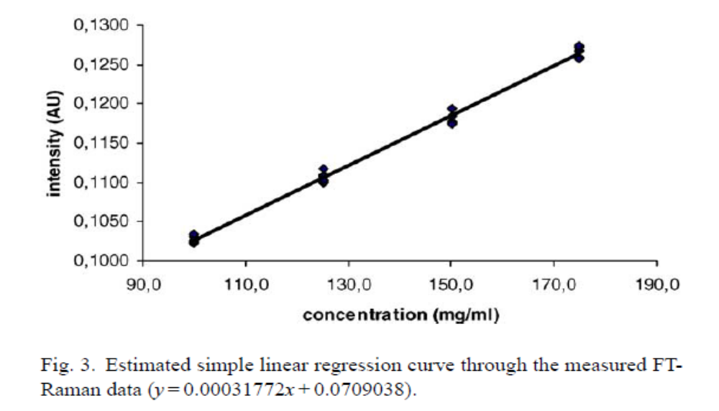

Slide 5
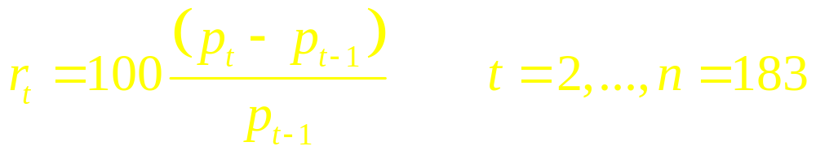
Monthly Airline Stock Returns and Adjusted Jet Fuel Prices
Monthly Data from June 2007-July 2022
Jet Fuel Price Index (Adjusted for Inflation)
Airlines: American (AAL), Delta (DAL), United (UAL) Simple Returns

Slide 6
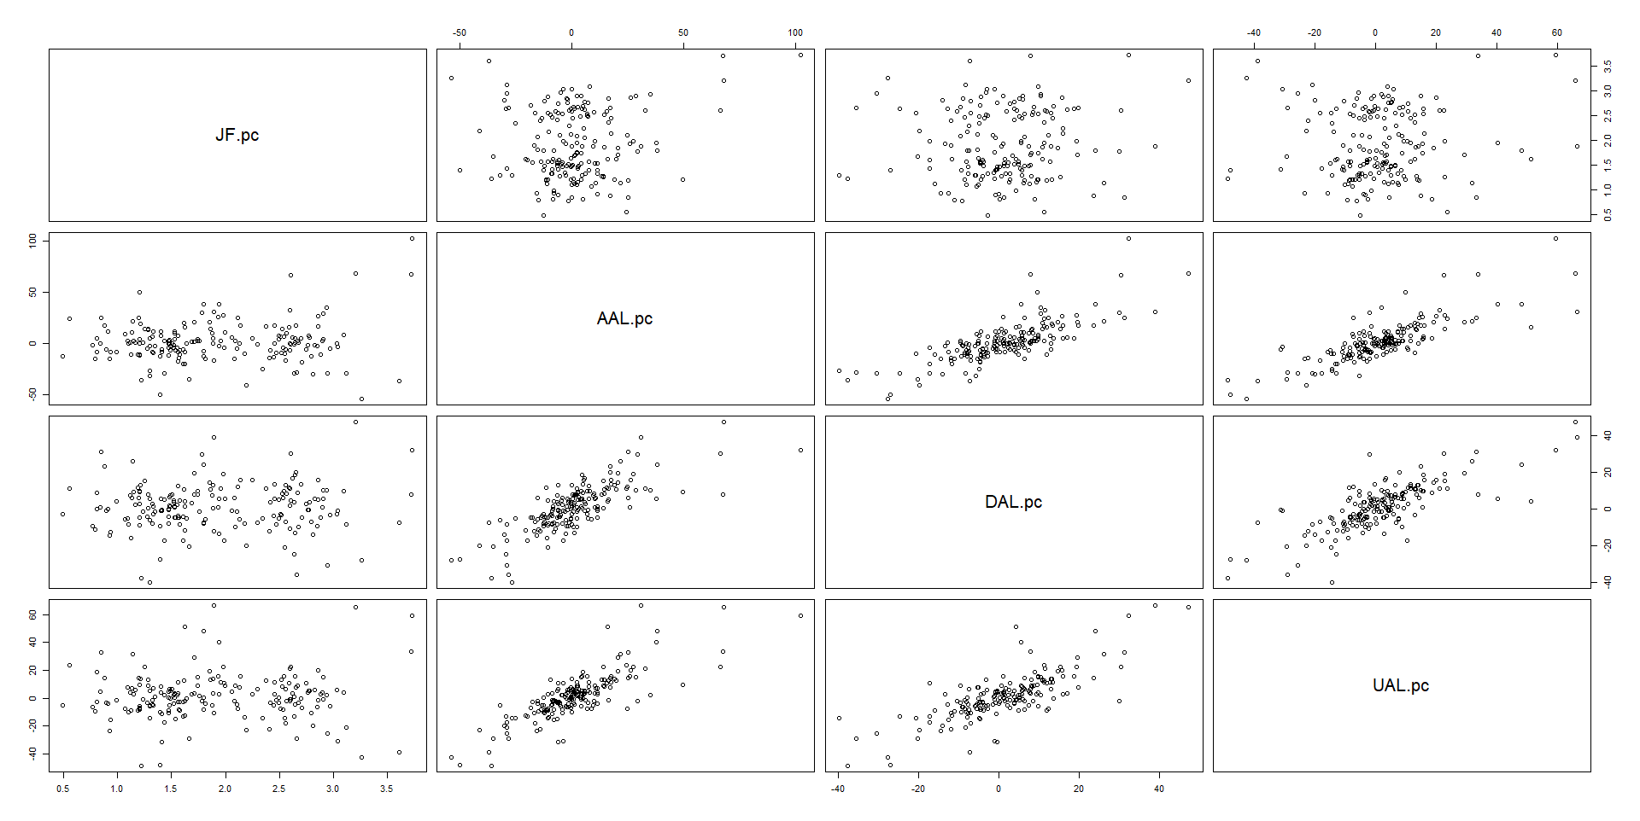
> cor(ajf.pc)
JF.pc AAL.pc DAL.pc UAL.pc
JF.pc 1.00000000 0.1201270 0.05804114 0.04254011
AAL.pc 0.12012703 1.0000000 0.77258796 0.81218130
DAL.pc 0.05804114 0.7725880 1.00000000 0.77072476
UAL.pc 0.04254011 0.8121813 0.77072476 1.00000000

Slide 7
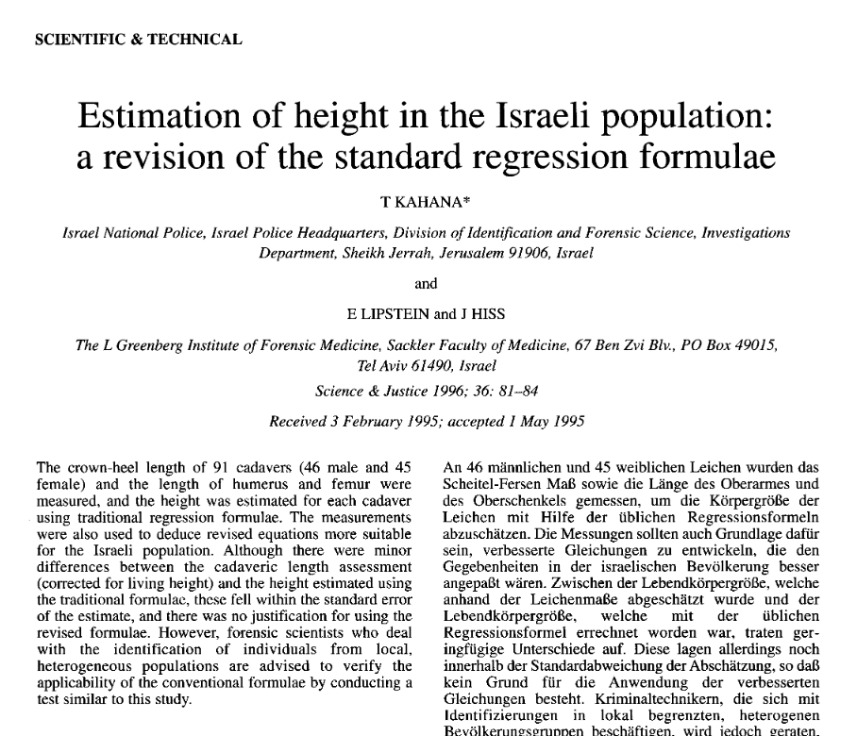

Slide 8
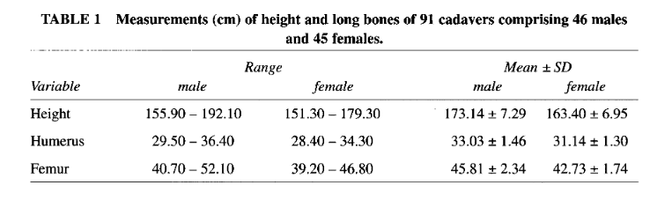
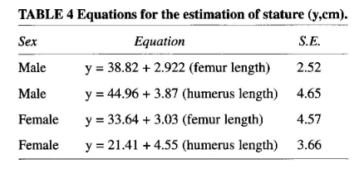

Slide 9
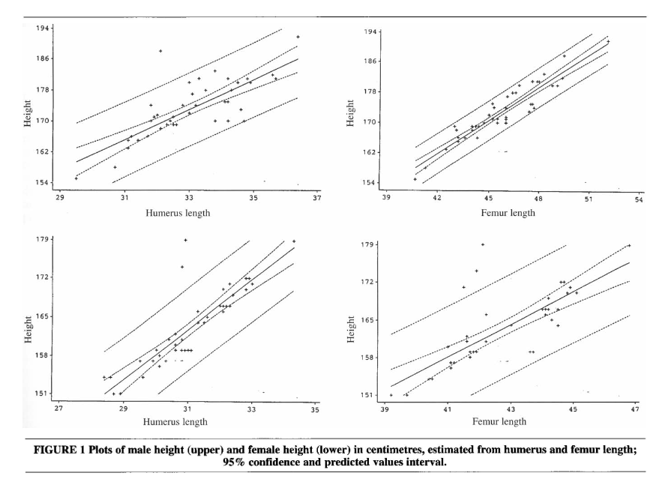

Slide 10
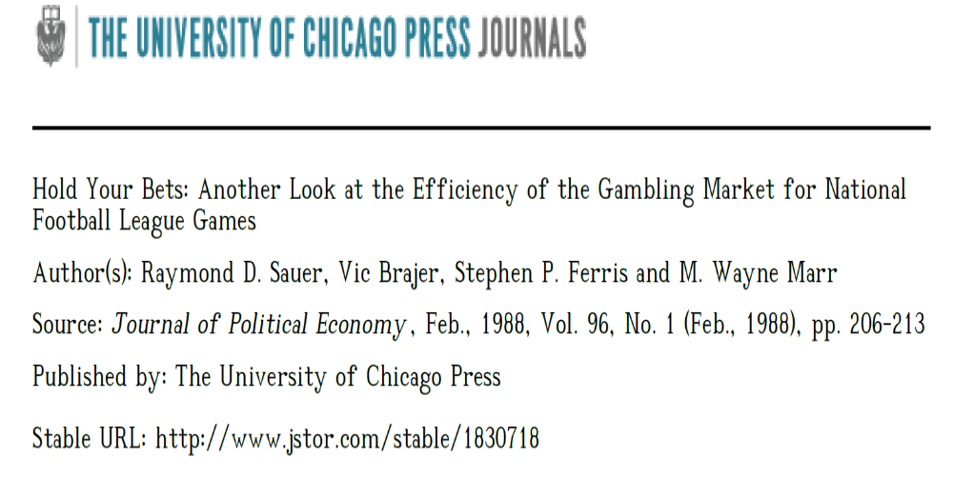

Slide 11
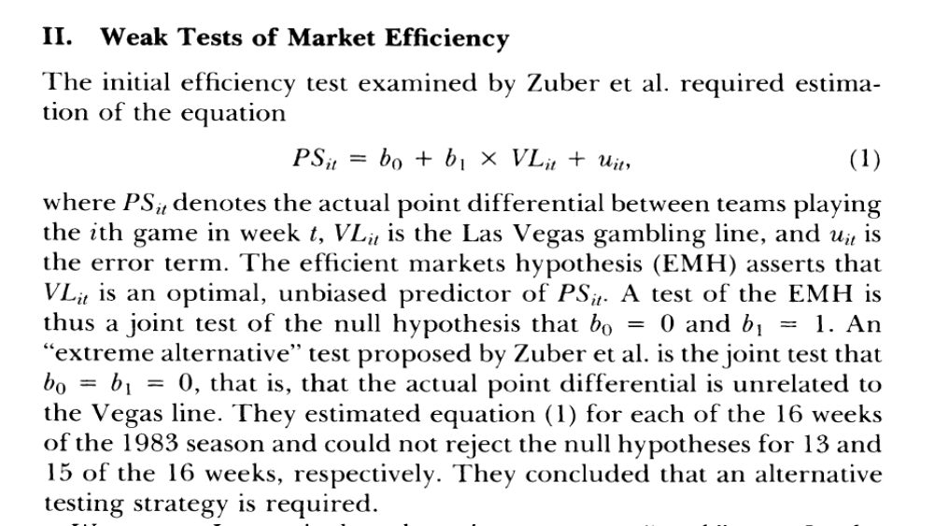

Slide 12
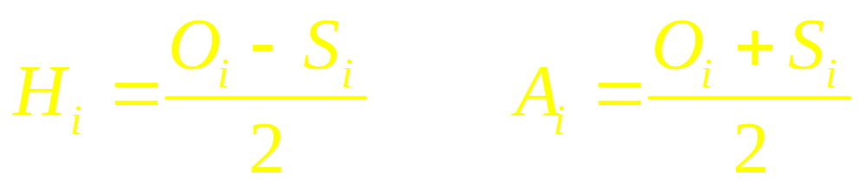
Prediction Markets – WNBA Projected Team Game Scores
Point Spread (Prior to Game Being Played): Number of Points home team is “laying” – Negative values imply home team is favored (often changed in sign for ease of analysis): S_{i}
Over/Under (Prior to Game Being Played): Number of Points predicted for combined points for the two teams: O_{i}
Predicted Number of Points for the two teams (Home and Away):

Slide 13
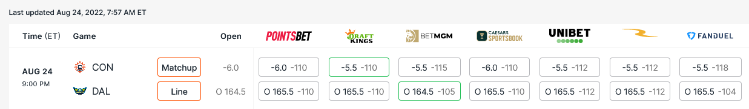

Slide 14
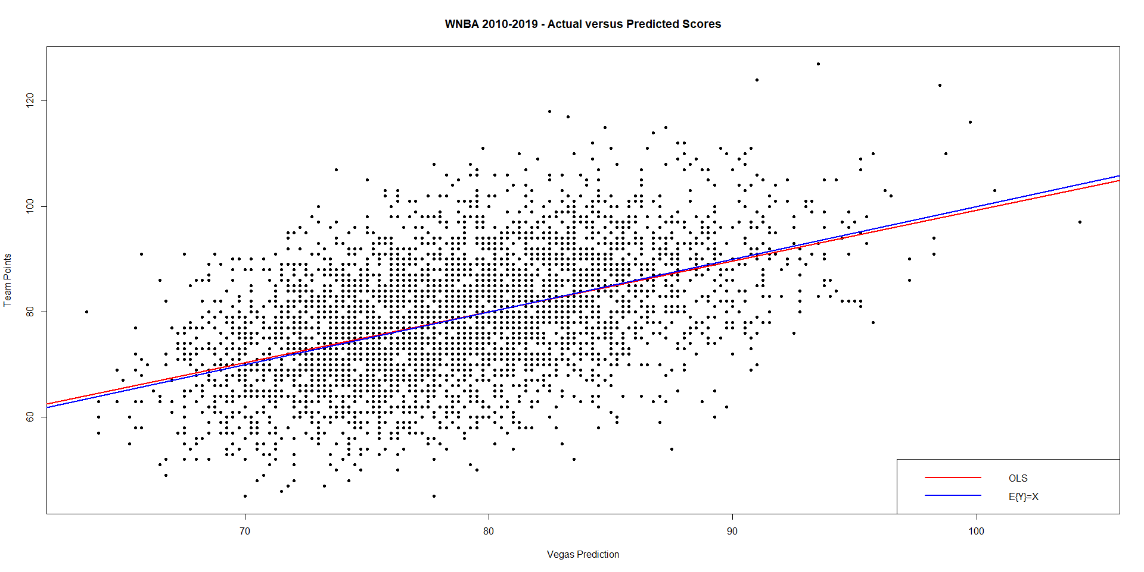

Slide 15
Regression Results
> wnba.OU <- lm(teamPts ~ teamPred)
> summary(wnba.OU)
Residuals:
Min 1Q Median 3Q Max
-33.237 -6.910 -0.032 6.749 35.5837
Coefficients:
Estimate Std. Error t value Pr(>|t|)
(Intercept) 2.88413 2.13351 1.352 0.177
teamPred 0.96404 0.02702 35.675 <2e-16 ***
Residual standard error: 10.11 on 4076 degrees of freedom
Multiple R-squared: 0.2379, Adjusted R-squared: 0.2378
F-statistic: 1273 on 1 and 4076 DF, p-value: < 2.2e-16
> anova(wnba.OU)
Analysis of Variance Table
Response: teamPts
Df Sum Sq Mean Sq F value Pr(>F)
teamPred 1 129965 129965 1272.7 < 2.2e-16 ***
Residuals 4076 416225 102

Slide 16
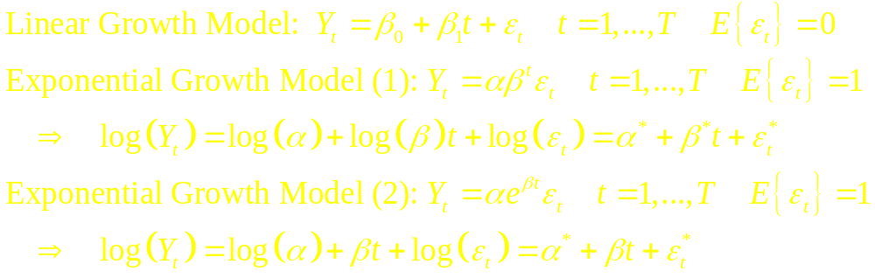
Trends in Time
Often when data are being observed in time, goal is to describe relation of pattern in time
Trend can show linear or exponential “growth”
Can also demonstrate seasonality

Slide 17
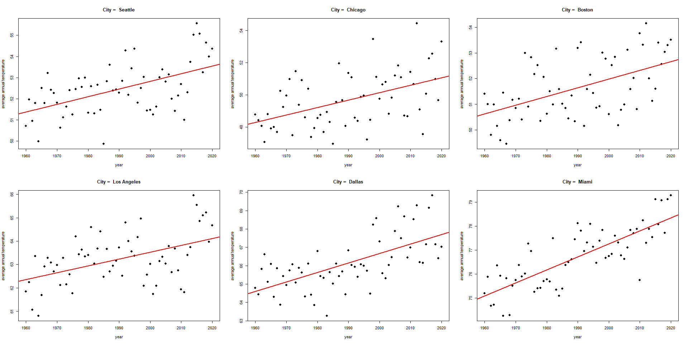
US Annual Average Temperature 1960-2020 – 6 Cities

Slide 18
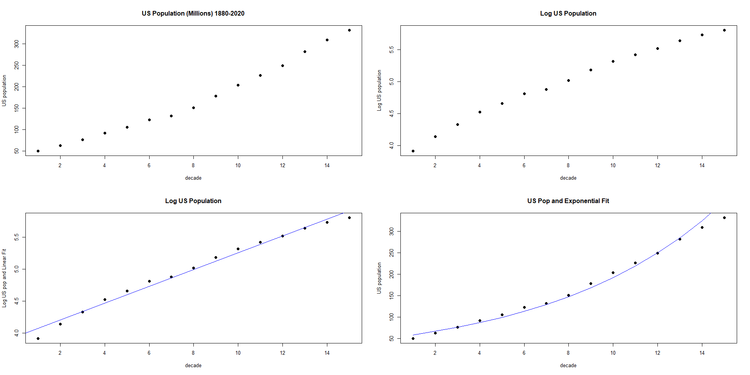
US Census Population 1880-2020

