Slide 1
Two-Factor Studies with Equal Replication
KNNL – Chapter 19

Slide 2
Two Factor Studies
Factor A @ a levels Factor B @ b levels ⇒ ab ≡ # treatments with n replicates per treatment
Controlled Experiments (CRD) – Randomize abn experimental units to the ab treatments (n units per trt)
Observational Studies – Take random samples of n units from each population/sub-population
One-Factor-at-a-Time Method – Choose 1 level of one factor (say A), and compare levels of other factor (B). Choose best level factor B levels, hold that constant and compare levels of factor A
  Not effective – Poor randomization, logistics, no interaction tests
  Better Method – Observe all combinations of factor levels

Slide 3
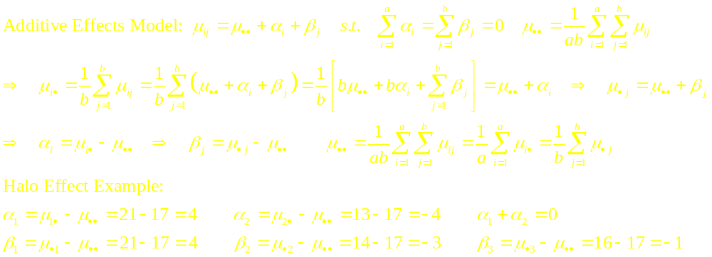
ANOVA Model Notation – Additive Model
Halo Effect Study: Factor A: Essay Quality(Good,Poor) Factor B: Photo: (Attract,Unatt,None)
A=EQ\B=Pic | j=1: Attract | j=2: Unatt | j=3: None | Row Average
i=1: Good | μ₁₁ = 25 | μ₁₂ = 18 | μ₁₃ = 20 | μ_{1●} = 21
i=2: Poor | μ₂₁ = 17 | μ₂₂ = 10 | μ₂₃ = 12 | μ_{2●} = 13
Column Average | μ_{●1} = 21 | μ_{●2} = 14 | μ_{●3} = 16 | μ●● = 17

Slide 5
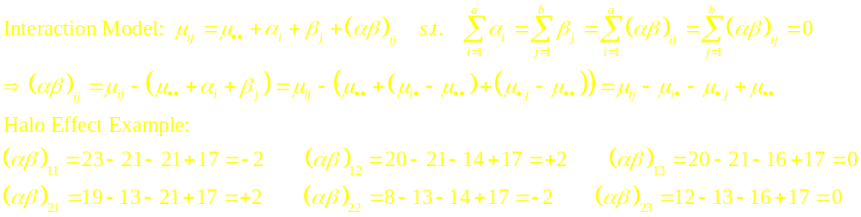
ANOVA Model Notation – Interaction Model
Halo Effect Study: Factor A: Essay Quality(Good,Poor) Factor B: Photo: (Attract,Unatt,None)
A=EQ\B=Pic | j=1: Attract | j=2: Unatt | j=3: None | Row Average
i=1: Good | μ₁₁ = 23 | μ₁₂ = 20 | μ₁₃ = 20 | μ_{1●} = 21
i=2: Poor | μ₂₁ = 19 | μ₂₂ = 8 | μ₂₃ = 12 | μ_{2●} = 13
Column Average | μ_{●1} = 21 | μ_{●2} = 14 | μ_{●3} = 16 | μ●● = 17

Slide 7
Comments on Interactions
Some interactions, while present, can be ignored and analysis of main effects can be conducted. Plots with “almost” parallel means will be present.
In some cases, a transformation can be made to remove an interaction. Typically: logarithmic, square root, square or reciprocal transformations may work
In many settings, particular interactions may be hypothesized, or observed interactions can have interesting theoretical interpretations
When factors have ordinal factor levels, we may observe antagonistic or synergistic interactions

Slide 8
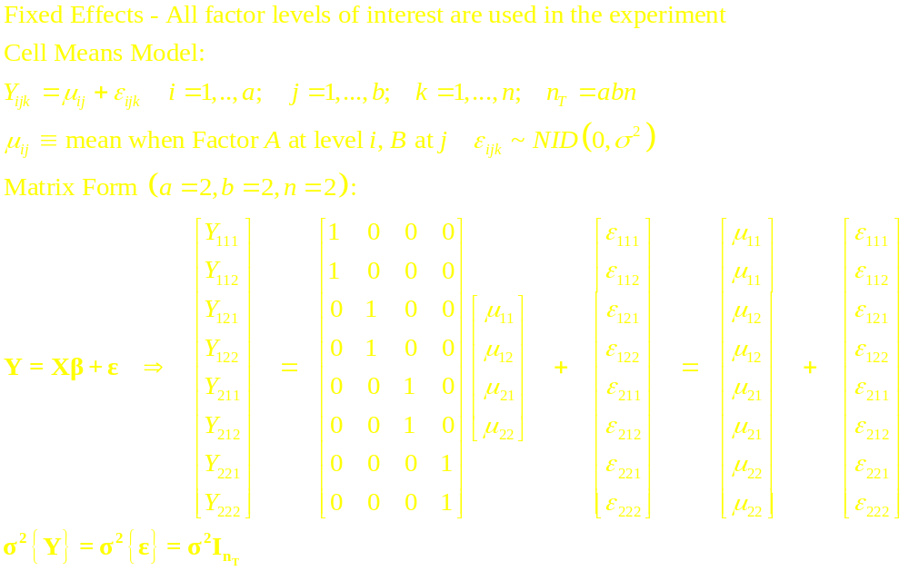
Two Factor ANOVA – Fixed Effects – Cell Means

Slide 9
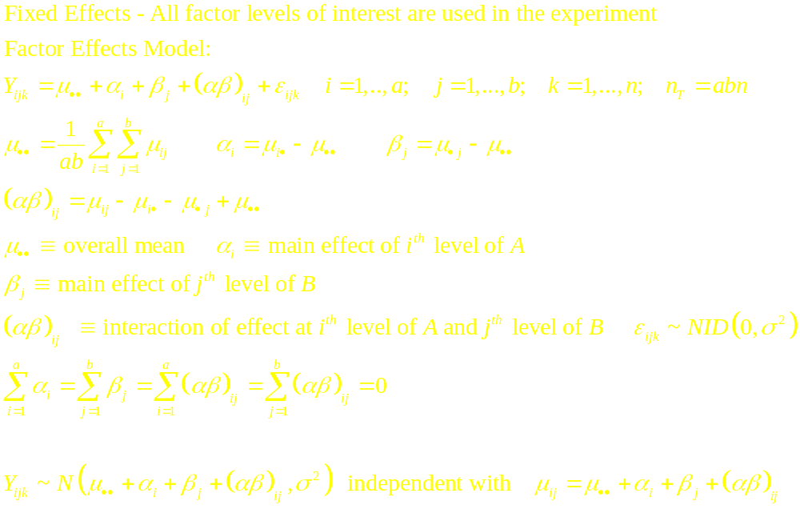
Two Factor ANOVA – Fixed Effects – Factor Effects

Slide 10
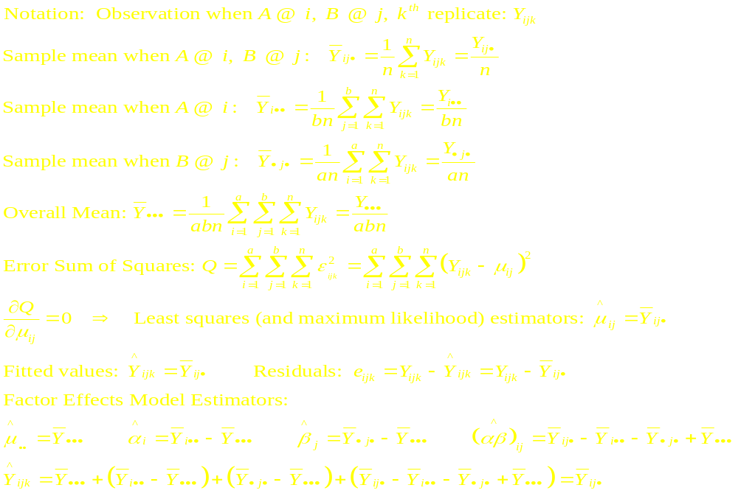
Analysis of Variance – Least Squares/ML Estimators

Slide 11
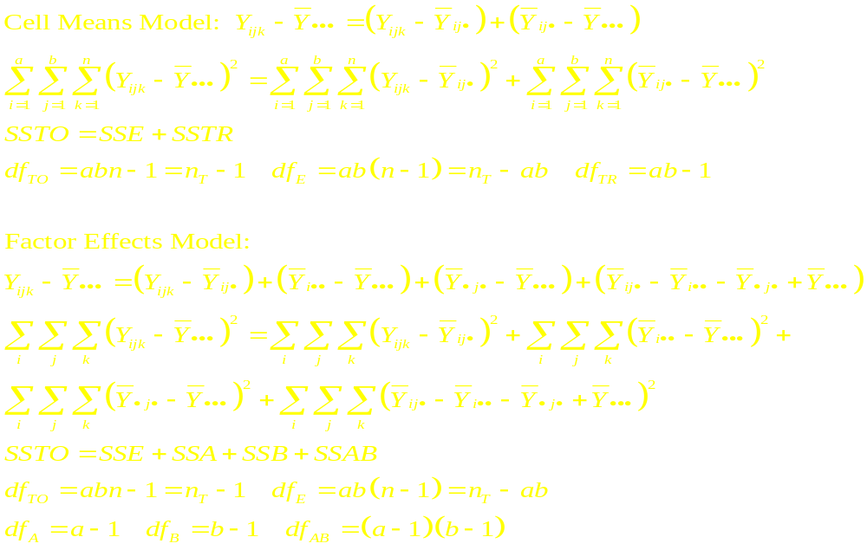
Analysis of Variance – Sums of Squares

Slide 12
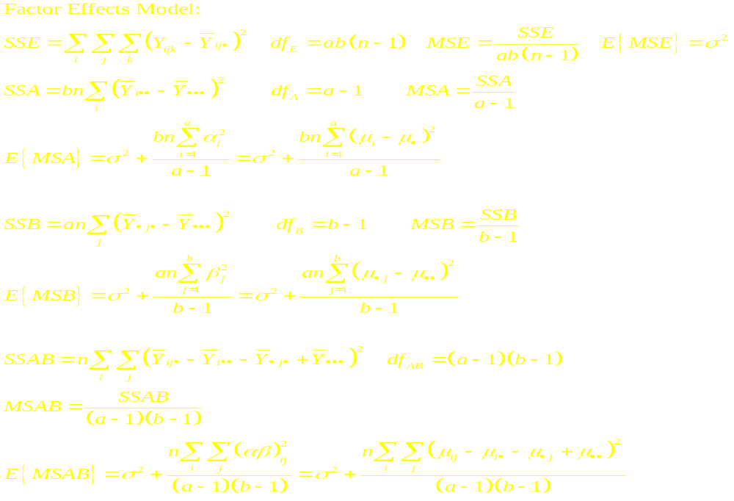
Analysis of Variance – Expected Mean Squares

Slide 13
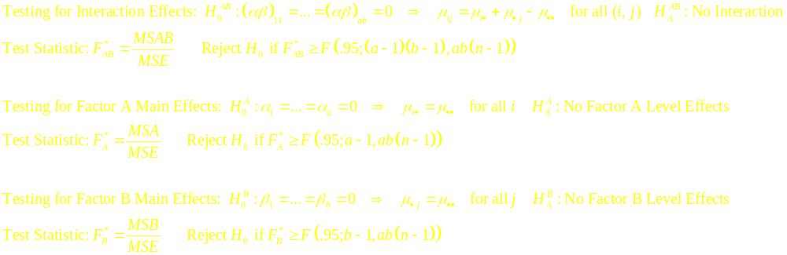
ANOVA Table – F-Tests
Source | df | SS | MS | F*
Factor A | a-1 | SSA | MSA=SSA/(a-1) | F_{A}*=MSA/MSE
Factor B | b-1 | SSB | MSB=SSB/(b-1) | F_{B}*=MSB/MSE
AB Interaction | (a-1)(b-1) | SSAB | MSAB=SSAB/[(a-1)(b-1)] | F_{AB}*=MSAB/MSE
Error | ab(n-1) | SSE | MSE=SSE/[ab(n-1)]
Total | abn-1 | SSTO

Slide 14
Testing/Modeling Strategy
Test for Interactions – Determine whether they are significant or important – If they are:
  If the primary interest is the interactions (as is often the case in behavioral research), describe the interaction in terms of cell means
  If goal is for simplicity of model, attempt simple transformations on data (log, square, square root, reciprocal)
If they are not significant or important:
  Test for significant Main Effects for Factors A and B
  Make post-hoc comparisons among levels of Factors A and B, noting that the marginal means of levels of A are based on bn cases and marginal means of levels of B are based on an cases

Slide 15
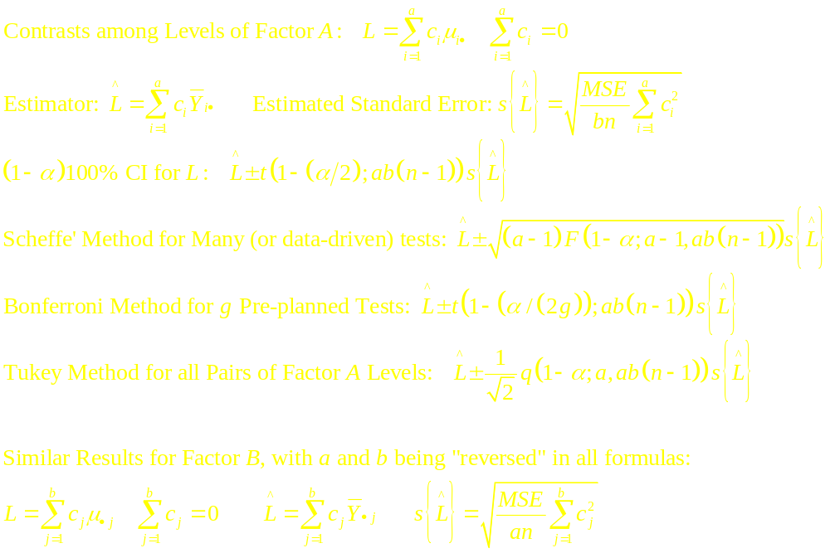
Factor Effect Contrasts when No Interaction

Slide 16
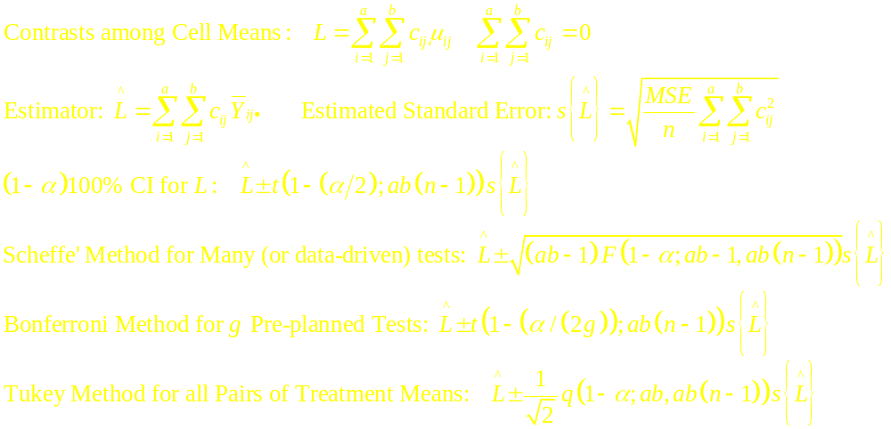
Factor Effect Contrasts when Interaction Present

