Slide 1
Section 3.1
Simple Linear Regression and Correlation

Slide 2
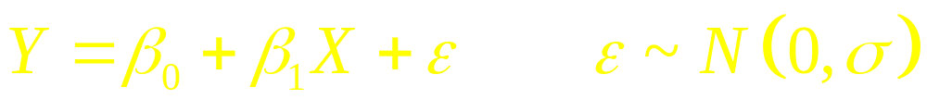
Linear Regression and Correlation
Explanatory and Response Variables are Numeric
Relationship between the mean of the response variable and the level of the explanatory variable assumed to be approximately linear (straight line)
Model (where ε represents “irreducible error”):
β₁ > 0 ⇒ Positive Association
β₁ < 0 ⇒ Negative Association
β₁ = 0 ⇒ No Association

Slide 3
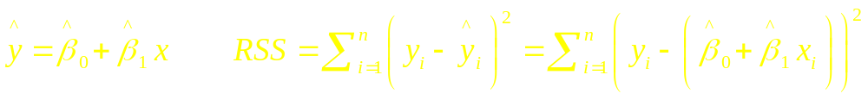
Least Squares Estimation of β₀, β₁
β₀ ≡ Mean response when x=0 (y-intercept)
β₁ ≡ Change in mean response when X increases by 1 unit (slope)
β₀, β₁ are unknown parameters
β₀+β₁X ≡ Mean response when explanatory variable takes on the value X
Goal: Choose values (estimates) that minimize the sum of squared errors (SSE) of observed values to the straight-line (where (x_{i} , y_{i}) are sample values:

Slide 4
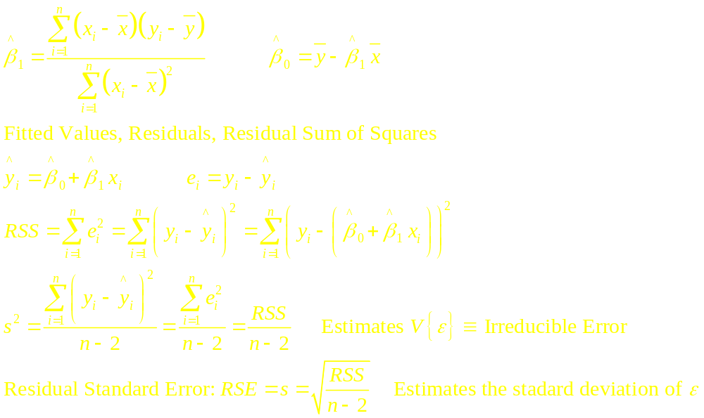
Least Squares Computations
Parameter Estimates

Slide 5
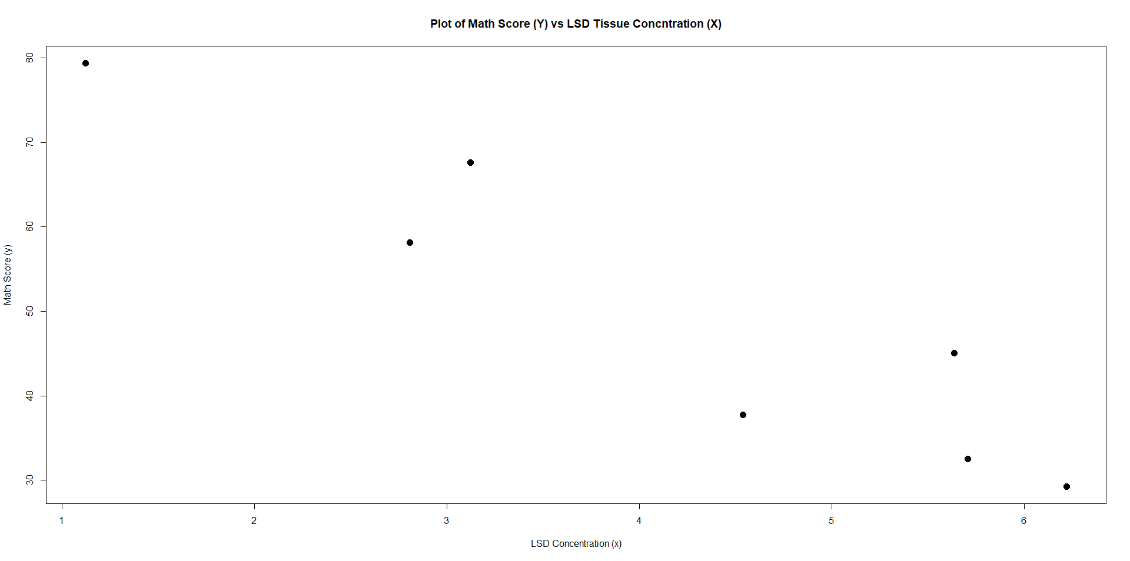
Example - Pharmacodynamics of LSD - I
Response (Y) - Math score (mean among 5 volunteers)
Predictor (X) - LSD tissue concentration (mean of 5 volunteers)
lsdConc(x) | Score (y)
1.123 | 79.376
2.807 | 58.146
3.123 | 67.608
4.538 | 37.764
5.637 | 45.043
5.708 | 32.548
6.222 | 29.272
Source: Wagner, Agahajanian, and Bing (1968). Correlation of Performance Test Scores with Tissue Concentration of Lysergic Acid Diethylamide in Human Subjects. Clinical Pharmacology and Therapeutics, Vol.9 pp635-638.

Slide 6
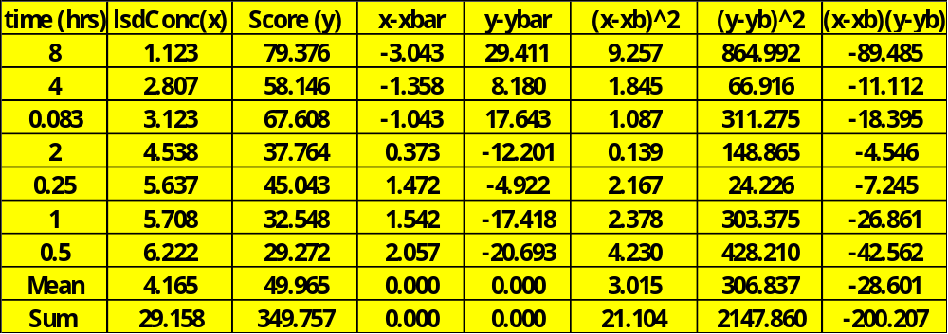
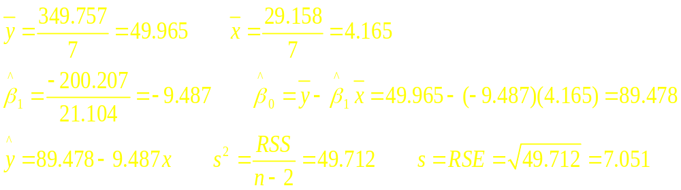
Example - Pharmacodynamics of LSD - II
(Column means and totals given in bottom rows of table)

Slide 7
R Code / Output
lsd.slr <- lm(mathScore ~ lsdConc)
summary(lsd.slr)
plot(mathScore ~ lsdConc, pch=16, cex=1.5, col="red3",
xlab="LSD Concentration (x)", ylab="Math Score (y)",
main="Regression of Math Score (Y) on LSD Tissue Concntration (X)")
abline(lsd.slr, col="darkorchid4", lwd=2)
> lsd.slr <- lm(mathScore ~ lsdConc)
> summary(lsd.slr)
Coefficients:
Estimate Std. Error t value Pr(>|t|)
(Intercept) 89.481 6.926 12.919 4.95e-05 ***
lsdConc -9.487 1.535 -6.181 0.00162 **
---
Signif. codes: 0 ‘***’ 0.001 ‘**’ 0.01 ‘*’ 0.05 ‘.’ 0.1 ‘ ’ 1
Residual standard error: 7.051 on 5 degrees of freedom
Multiple R-squared: 0.8843, Adjusted R-squared: 0.8611
F-statistic: 38.2 on 1 and 5 DF, p-value: 0.001616

Slide 8
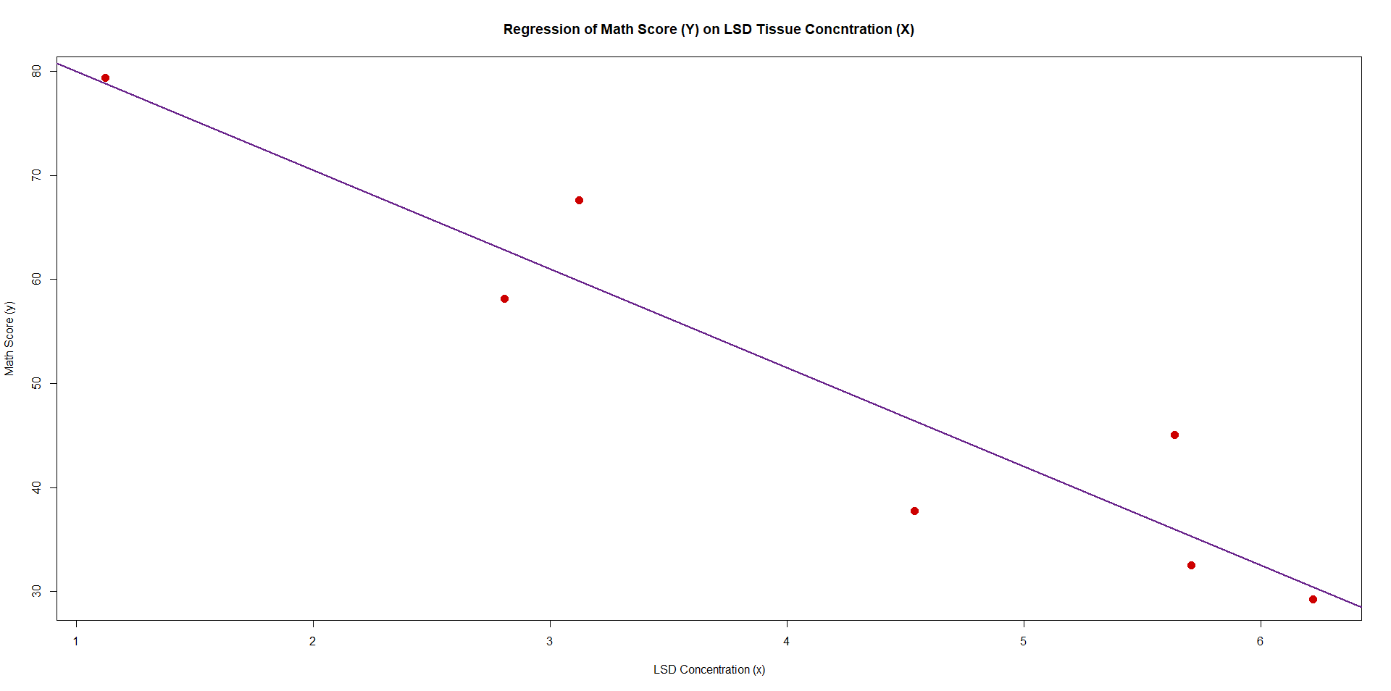
Data and Fitted Regression Equation

Slide 9
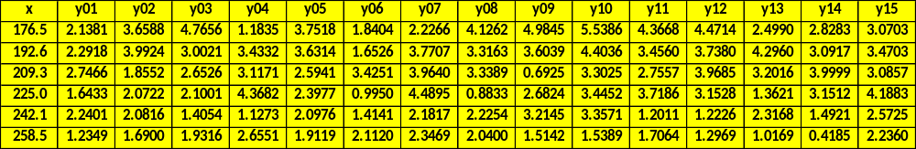
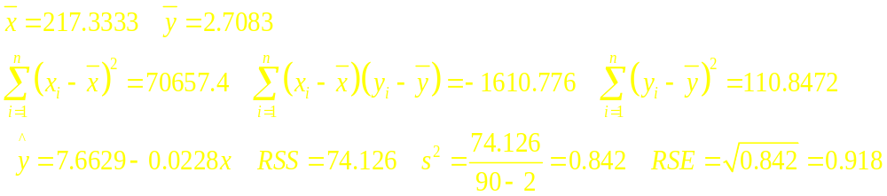
Example – Berry Chewiness and Sugar Content - I
Response Variable (Y) – Berry Chewiness (mJ)
Predictor Variable (X) – Sugar Content (grams/liter)
Sugar levels: 176.5 192.6 209.3 225.0 242.1 258.5
n_{i} = 15 replicates per sugar level: n = 6(15) = 90
Source: I. Zouid, R. Siret, F. Jourjion, E. Mehinagic, L. Rolle (2013)."Impact of Grapes Heterogeneity According to Sugar Level on Both Physical and Mechanical Berries Properties and their AnthocyaninsExtractability at Harvest," Journal of Texture Studies, Vol. 44, pp. 95-103.

Slide 10
R Program for Berry Data
berry.chewy <- read.csv("http://www.stat.ufl.edu/~winner/data/berry_sugar_chewy.csv")
attach(berry.chewy); names(berry.chewy)
## Y = chewiness X = sugar
## Plot data and simple linear regression line
plot(chewiness ~ sugar, pch=16, cex=0.8, col="red",
main="Chewiness vs Sugar Content")
abline(lm(chewiness ~ sugar), col="blue", lwd=2)
## Fit simple linear regression model, obtain estimates, t-tests, CI's
berry.mod1 <- lm(chewiness ~ sugar)
summary(berry.mod1)
confint(berry.mod1)
> summary(berry.mod1)
Coefficients:
Estimate Std. Error t value Pr(>|t|)
(Intercept) 7.662878 0.756610 10.128 < 2e-16 ***
sugar -0.022797 0.003453 -6.603 2.95e-09 ***
---
Residual standard error: 0.9178 on 88 degrees of freedom
Multiple R-squared: 0.3313, Adjusted R-squared: 0.3237
F-statistic: 43.59 on 1 and 88 DF, p-value: 2.951e-09
> confint(berry.mod1)
2.5 % 97.5 %
(Intercept) 6.15927388 9.16648152
sugar -0.02965862 -0.01593536

Slide 11
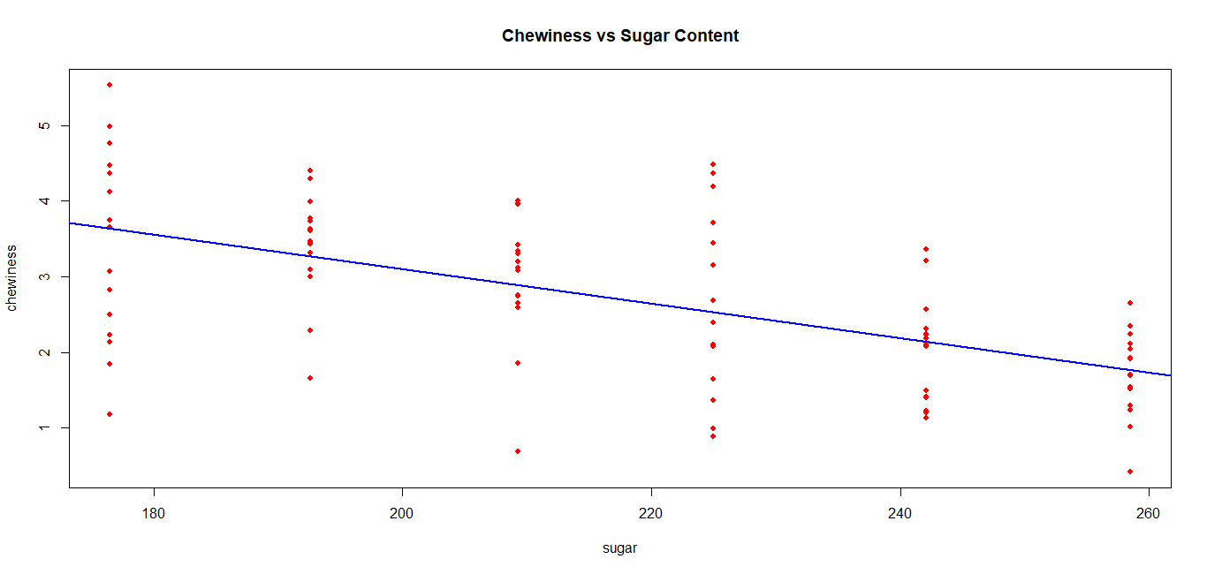

Slide 12

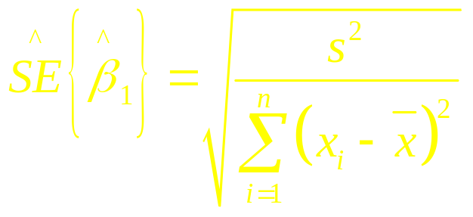
Inference Concerning the Slope (β₁)
Parameter: Slope in the population model (β₁)
Estimator: Least squares estimate:
Estimated standard error:
Methods of making inference regarding population:
  Hypothesis tests (2-sided or 1-sided)
  Confidence Intervals

Slide 13
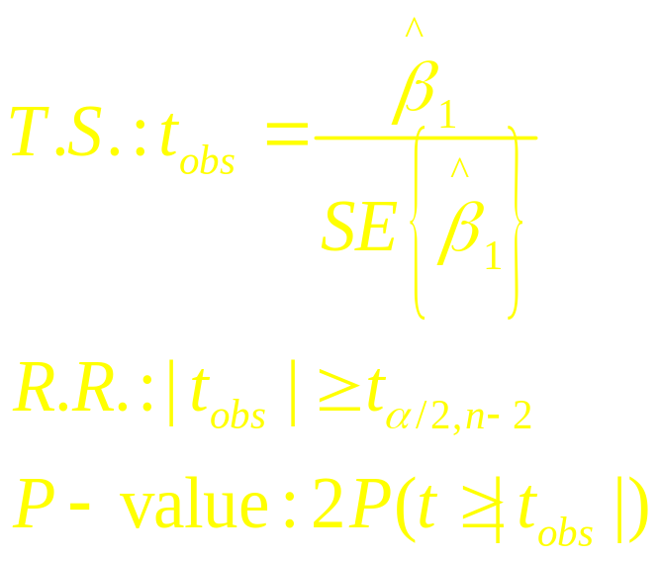
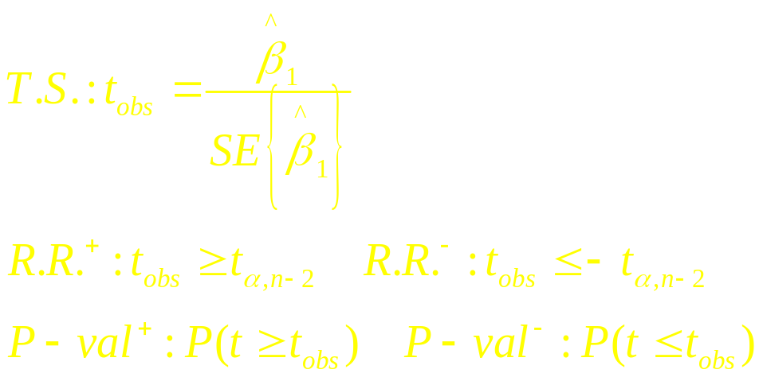
Hypothesis Test for β₁
2-Sided Test
  H₀: β₁ = 0
  H_{A}: β₁ ≠ 0
1-sided Test
  H₀: β₁ = 0
  H_{A}⁺: β₁ > 0 or
  H_{A}⁻: β₁ < 0

Slide 14
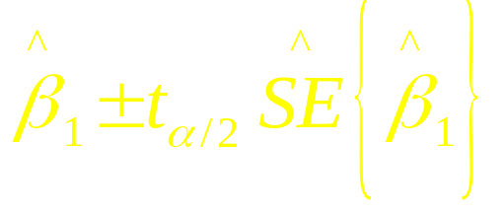
(1-α)100% Confidence Interval for β₁
Conclude positive association if entire interval above 0
Conclude negative association if entire interval below 0
Cannot conclude an association if interval contains 0
Conclusion based on interval is same as 2-sided hypothesis test

Slide 15
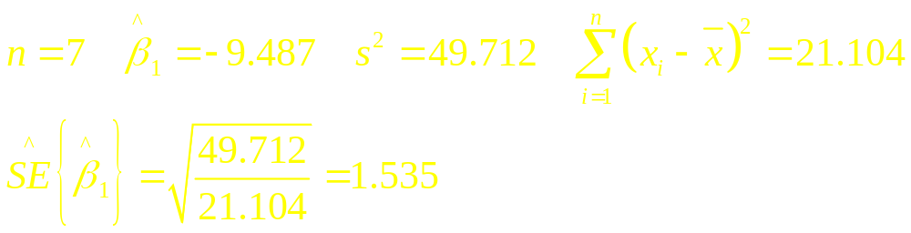
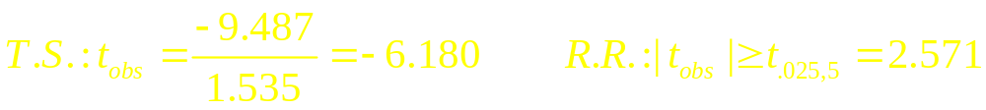
Example - Pharmacodynamics of LSD - III
Testing H₀: β₁ = 0 vs H_{A}: β₁ ≠ 0
95% Confidence Interval for β₁ :

Slide 16
R Output Estimates, t-tests, CI’s
mathlsd.reg <- lm(math ~ lsd)
summary(mathlsd.reg)
confint(mathlsd.reg)
> summary(mathlsd.reg)
Coefficients:
Estimate Std. Error t value Pr(>|t|)
(Intercept) 89.124 7.048 12.646 5.49e-05 ***
lsd -9.009 1.503 -5.994 0.00185 **
Residual standard error: 7.126 on 5 degrees of freedom
Residual standard error: 7.126 on 5 degrees of freedom
Multiple R-squared: 0.8778, Adjusted R-squared: 0.8534
F-statistic: 35.93 on 1 and 5 DF, p-value: 0.001854
> confint(mathlsd.reg)
2.5 % 97.5 %
(Intercept) 71.00758 107.240169
lsd -12.87325 -5.145685

Slide 17
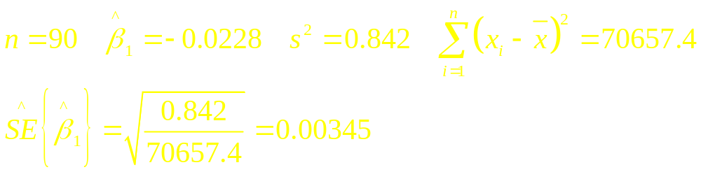
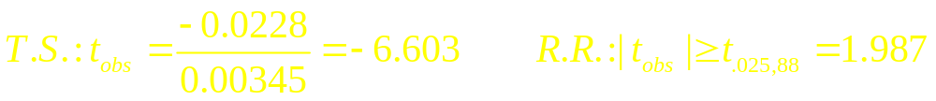
Example – Berry Chewiness and Sugar Content - II
Testing H₀: β₁ = 0 vs H_{A}: β₁ ≠ 0
95% Confidence Interval for β₁ :

Slide 18
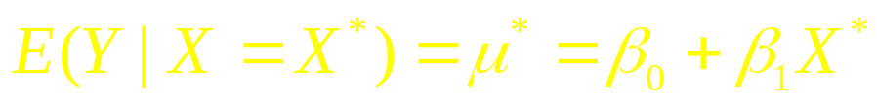
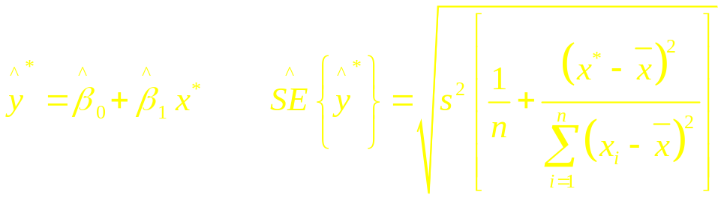
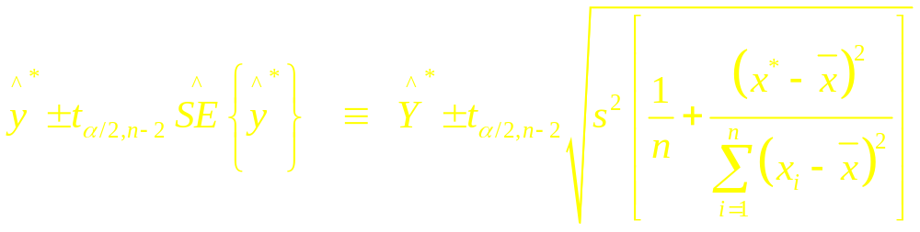
Confidence Interval for Mean When X=X*
Mean Response at a specific level X* is
Estimated Mean response and standard error (replacing unknown β₀ and β₁ with estimates):
Confidence Interval for Mean Response:

Slide 19

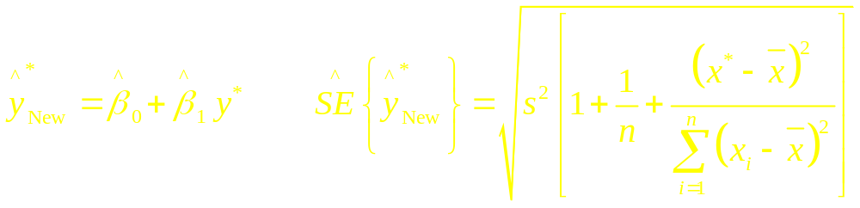
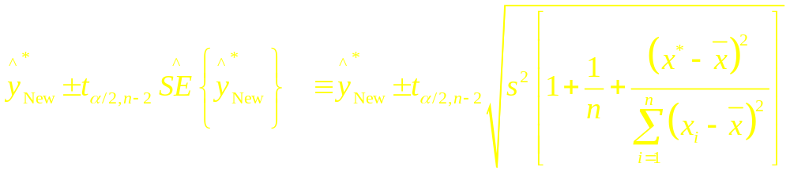
Prediction Interval of Future Response @ X=X*
Response at a specific level X* is
Estimated response and standard error (replacing unknown β₀ and β₁ with estimates):
Prediction Interval for Future Response:

Slide 20
Example – 95% CI and PI when Sugar = 215.0
R command give the 95% CI’s and PI’s when X* = 215 for berries
berry.mod1 <- lm(chewiness ~ sugar)
Xstar <- 215
predict(berry.mod1, list(sugar=Xstar), int="confidence")
predict(berry.mod1, list(sugar=Xstar), int="prediction")
> predict(berry.mod1, list(sugar=Xstar), int="confidence")
fit lwr upr
1 2.761525 2.568601 2.954449
> predict(berry.mod1, list(sugar=Xstar), int="prediction")
fit lwr upr
1 2.761525 0.9274281 4.595622

Slide 21
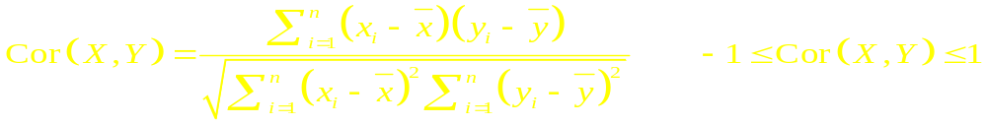
Correlation Coefficient
Measures the strength of the linear association between two variables
Takes on the same sign as the slope estimate from the linear regression
Not effected by linear transformations of Y or X
Does not distinguish between dependent and independent variable (e.g. height and weight)
Population Parameter: ρ
Pearson’s Correlation Coefficient:

Slide 22
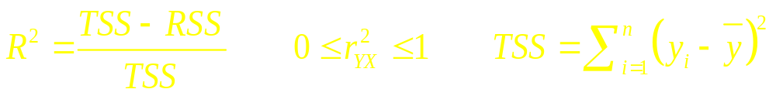
Correlation Coefficient
Values close to 1 in absolute value ⇒ strong linear association, positive or negative from sign
Values close to 0 imply little or no association
If data contain outliers (are non-normal), Spearman’s coefficient of correlation can be computed based on the ranks of the X and Y values
Test of H₀:ρ = 0 is equivalent to test of H₀:β₁=0
Coefficient of Determination (R²) - Proportion of variation in Y “explained” by the regression on X:

Slide 23
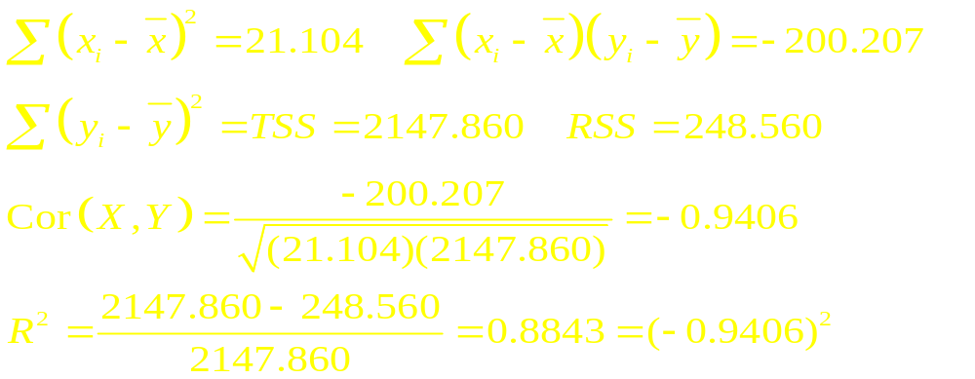
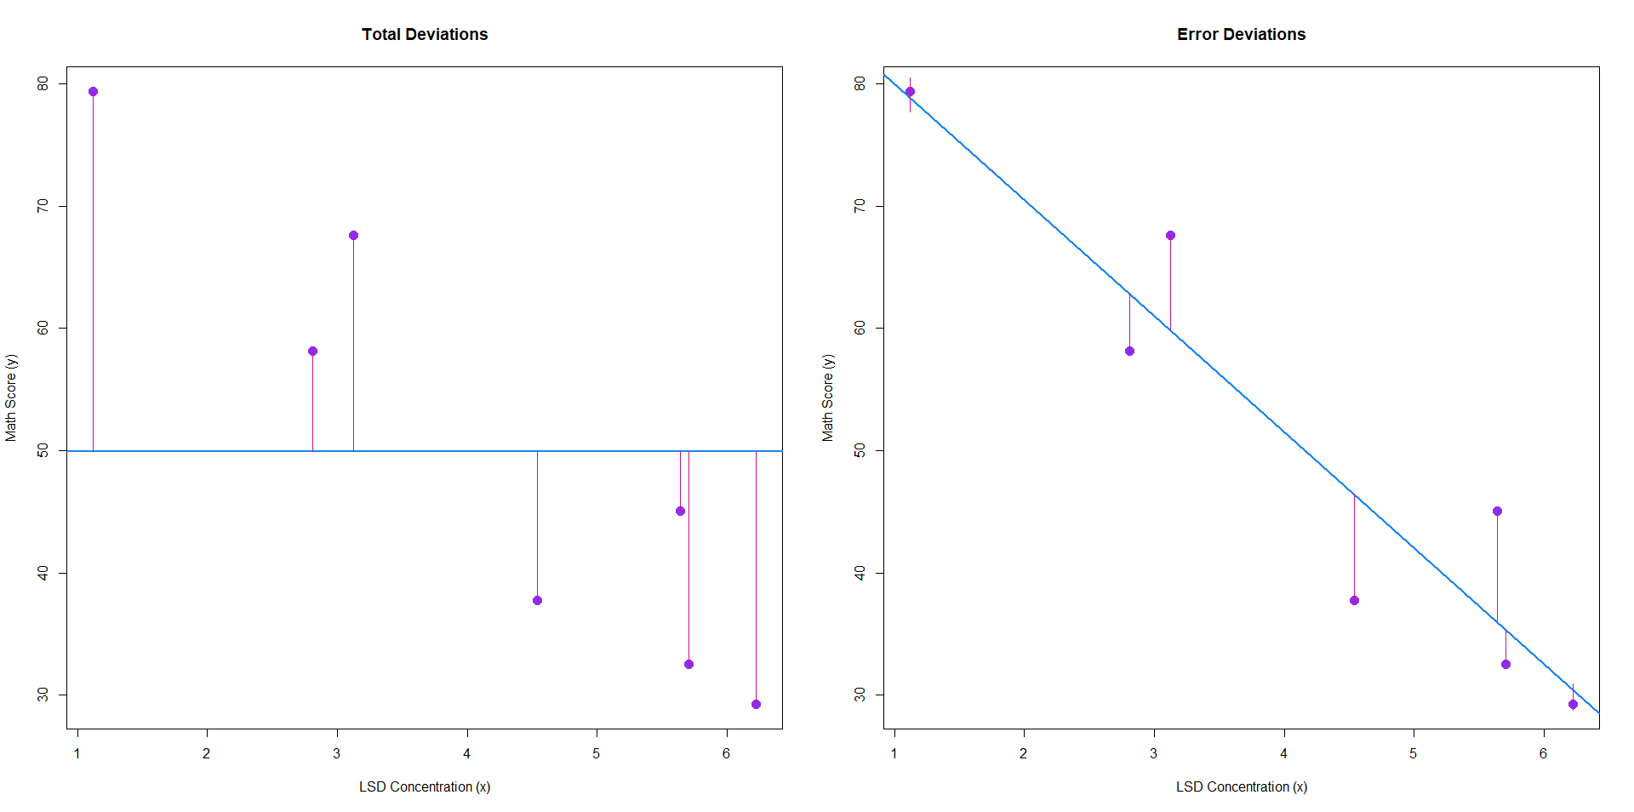
Example - Pharmacodynamics of LSD

Slide 24
R Commands and Output – Berry Data
## Pearson product moment coefficient of correlation and test of H0: rho=0
cor(chewiness, sugar)
cor.test(chewiness, sugar)
> cor(chewiness, sugar)
[1] -0.5755643
> cor.test(chewiness, sugar)
Pearson's product-moment correlation
data: chewiness and sugar
t = -6.6025, df = 88, p-value = 2.951e-09
alternative hypothesis: true correlation is not equal to 0
95 percent confidence interval:
-0.6993026 -0.4183365
sample estimates:
cor
-0.5755643

Slide 25
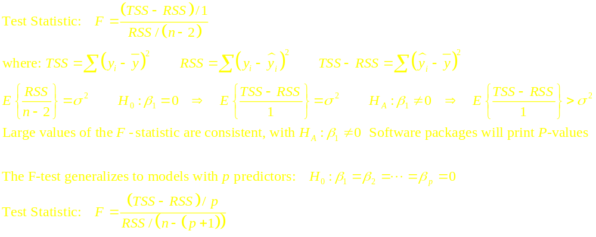
F-Test for Regression
Analysis of Variance - F-test
H₀: β₁ = 0 H_{A}: β₁ ≠ 0

Slide 26
Example - R Output – LSD Data
lsd.slr <- lm(mathScore ~ lsdConc)
anova(lsd.slr)
> anova(lsd.slr)
Analysis of Variance Table
Response: mathScore
Df Sum Sq Mean Sq F value Pr(>F)
lsdConc 1 1899.28 1899.28 38.203 0.001616 **
Residuals 5 248.58 49.72

Slide 27
Example - R Output – Berry Data
## Analysis of Variance and F-test
berry.mod1 <- lm(chewiness ~ sugar)
anova(berry.mod1)
> berry.mod1 <- lm(chewiness ~ sugar)
> anova(berry.mod1)
Analysis of Variance Table
Response: chewiness
Df Sum Sq Mean Sq F value Pr(>F)
sugar 1 36.721 36.721 43.594 2.951e-09 ***
Residuals 88 74.126 0.842

