Slide 1
Sections 3.2,3.3.1,3.3.2
Multiple Regression

Slide 2
Multiple Regression
Numeric Response variable (Y)
p Numeric predictor variables (p < n)
Model:
  Y = β₀ + β₁X₁ + ⋅⋅⋅ + β_{p} X_{p} + ε
Partial Regression Coefficients: β_{j} ≡ effect (on the mean response) of increasing the j^{th} predictor variable by 1 unit, holding all other predictors constant
Model Assumptions (Involving Error terms ε )
  Normally distributed with mean 0
  Constant Variance σ²
  Independent (Problematic when data are series in time/space)

Slide 3
Example – Energy Consumption of Hotels in Lagos
Units: n = 28 Hotels in Lagos, Nigeria
Response: Annual Energy Consumption (1000s Megawatt hours)
Predictors (p=5 explanatory variables)
  Hotel Rating Stars (X₁ -- 2,3,4,5)
  Floor Area (X₂, in 1000s of square meters)
  Age (X₃, in Years)
  Equivalent Guest Rooms (X₄ = #Rooms × Occupancy Rate)
  Employees (X₅, in 100s)
Source: P.O. Oluseyi, et al (2016). “ Assessment of Energy Consumption and Carbon Footprint from the Hotel Sector Within Lagos, Nigeria,” Energy and Buildings, Vol. 116, pp. 106-113

Slide 4
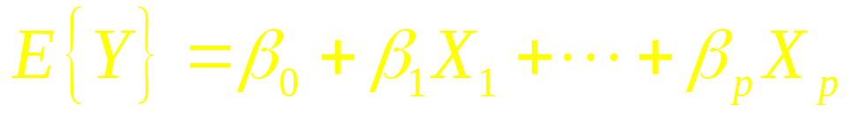
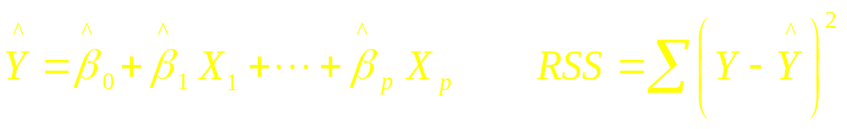
Least Squares Estimation
Population Model for mean response:
Least Squares Fitted (predicted) equation, minimizing SSE:
Statistical software packages/spreadsheets can compute least squares estimates and their standard errors

Slide 5
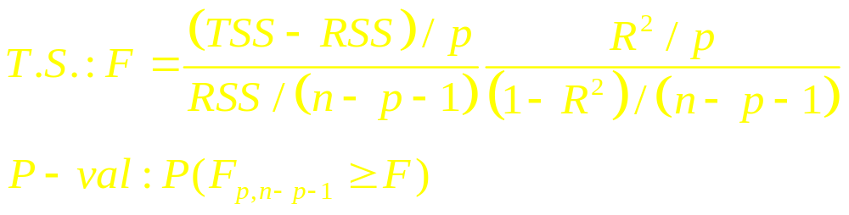
Testing for the Overall Model - F-test
Tests whether any of the explanatory variables are associated with the response
H₀: β₁=⋅⋅⋅=β_{p}=0 (None of the X^{s} associated with Y)
H_{A}: Not all β_{j} = 0

Slide 6
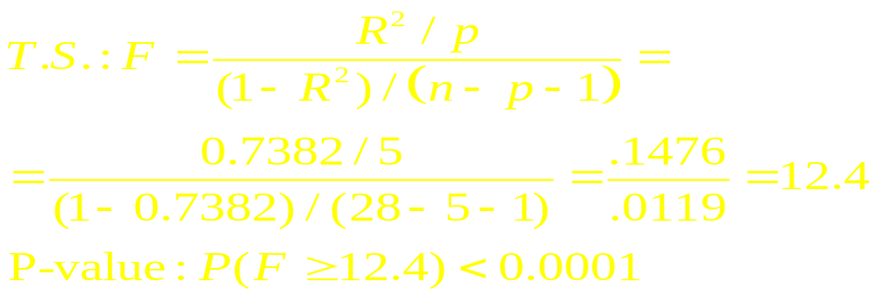
Example – Energy Consumption of Hotels in Lagos
n=28 p=5 R²=0.7382
H₀: β₁=⋅⋅⋅=β₅=0 H_{A}: Not all β_{j} = 0

Slide 7
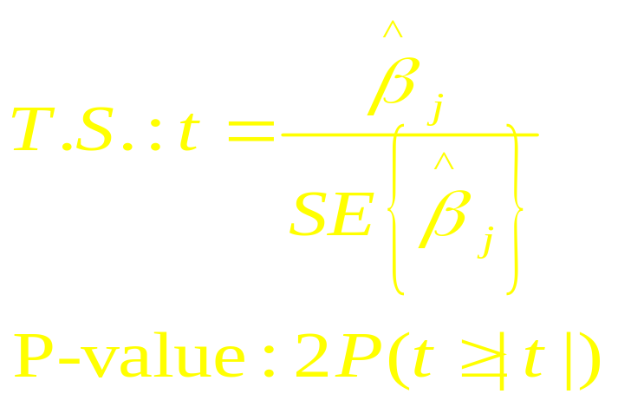
Testing Individual Partial Coefficients - t-tests
Wish to determine whether the response is associated with a single explanatory variable, after controlling for the others
H₀: β_{j} = 0 H_{A}: β_{j} ≠ 0 (2-sided alternative)

Slide 8
Example – Energy Consumption of Hotels in Lagos
Coefficients:
Estimate Std. Error t value Pr(>|t|)
(Intercept) -3.09648 2.81547 -1.100 0.2833
stars 1.45974 0.96562 1.512 0.1448
flr.area 0.14777 0.06011 2.458 0.0223 *
age 0.02115 0.03932 0.538 0.5961
equiv.gr -0.02885 0.01573 -1.834 0.0802 .
employees 1.23698 0.47758 2.590 0.0167 *
---
Signif. codes: 0 ‘***’ 0.001 ‘**’ 0.01 ‘*’ 0.05 ‘.’ 0.1 ‘ ’ 1
Residual standard error: 3.629 on 22 degrees of freedom
Multiple R-squared: 0.7382, Adjusted R-squared: 0.6786
F-statistic: 12.4 on 5 and 22 DF, p-value: 8.474e-06

Slide 9
Comparing Regression Models
Conflicting Goals: Explaining variation in Y while keeping model as simple as possible (parsimony)
We can test whether a subset of q predictors (including possibly cross-product terms) can be dropped from a model that contains the remaining p-q predictors.
H₀: β_{p−q+1}=…=β_{p} =0
  Complete Model: Contains all predictors
  Reduced Model: Eliminates the predictors from H₀
  Fit both models, obtaining sums of squares for each (or R² from each):
    Complete: RSS (R²)
    Reduced (H₀): RSS₀ (R₀²)

Slide 10
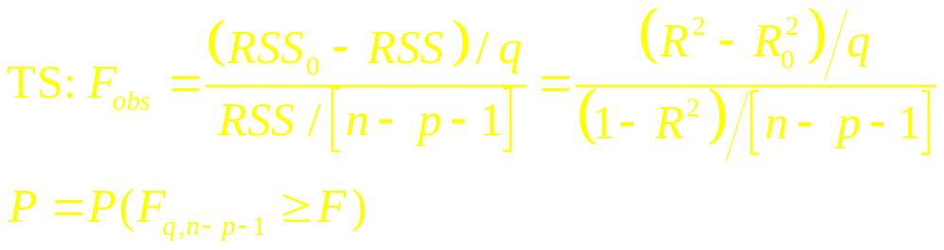
Comparing Regression Models
H₀: β_{p-q+1}=…=β_{p} = 0 (After removing the effects of X₁,…,X_{p-q}, none of other predictors are associated with Y)
H_{A}: H₀ is false
P-value based on F-distribution with q and n-p-1 d.f.

Slide 11
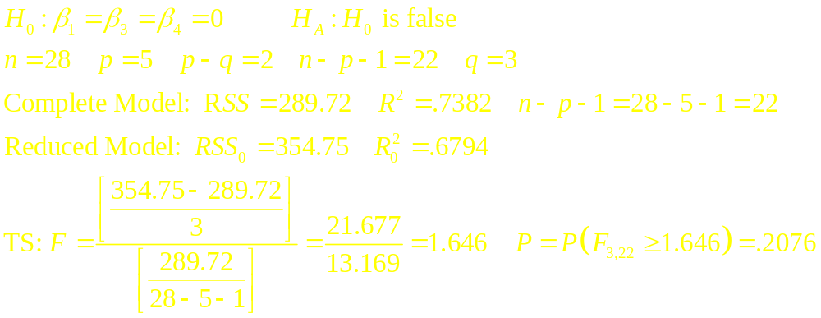
Example – Energy Consumption of Hotels in Lagos
Test whether Electricity Consumption is associated with: stars, age, and/or equivalent guest rooms, after controlling for floor area and employees

Slide 12
R Program/ Partial Output
mod1 <- lm(year.EC ~ stars + flr.area + age + equiv.gr + employees)
summary(mod1)
anova(mod1)
mod2 <- lm(year.EC ~ flr.area + employees)
summary(mod2)
anova(mod2)
anova(mod2, mod1)
> anova(mod2, mod1)
Analysis of Variance Table
Model 1: year.EC ~ flr.area + employees
Model 2: year.EC ~ stars + flr.area + age + equiv.gr + employees
Res.Df RSS Df Sum of Sq F Pr(>F)
1 25 354.75
2 22 289.72 3 65.03 1.646 0.2076

Slide 13
Models with Dummy Variables
Some models have both numeric and categorical explanatory variables
If a categorical variable has m levels, need to create m-1 dummy variables that take on the values 1 if the level of interest is present, 0 otherwise.
The baseline level of the categorical variable is the one for which all m-1 dummy variables are set to 0
The regression coefficient corresponding to a dummy variable is the difference between the mean for that level and the mean for baseline group, controlling for all numeric predictors

Slide 14
Example - Deep Cervical Infections
Subjects - Patients with deep neck infections
Response (Y) - Length of Stay in hospital
Predictors: (One numeric, 11 Dichotomous)
  Age (x₁)
  Gender (x₂=1 if female, 0 if male)
  Fever (x₃=1 if Body Temp > 38C, 0 if not)
  Neck swelling (x₄=1 if Present, 0 if absent)
  Neck Pain (x₅=1 if Present, 0 if absent)
  Trismus (x₆=1 if Present, 0 if absent)
  Underlying Disease (x₇=1 if Present, 0 if absent)
  Respiration Difficulty (x₈=1 if Present, 0 if absent)
  Complication (x₉=1 if Present, 0 if absent)
  WBC > 15000/mm³ (x₁₀=1 if Present, 0 if absent)
  CRP > 100μg/ml (x₁₁=1 if Present, 0 if absent)
Source: Wang, et al (2003)

Slide 15
Example - Weather and Spinal Patients
Subjects - Visitors to National Spinal Network in 23 cities Completing SF-36 Form
Response - Physical Function subscale (1 of 10 reported)
Predictors:
  Patient’s age (x₁)
  Gender (x₂=1 if female, 0 if male)
  High temperature on day of visit (x₃)
  Low temperature on day of visit (x₄)
  Dew point (x₅)
  Wet bulb (x₆)
  Total precipitation (x₇)
  Barometric Pressure (x₇)
  Length of sunlight (x₈)
  Moon Phase (new, wax crescent, 1st Qtr, wax gibbous, full moon, wan gibbous, last Qtr, wan crescent, => 8-1=7 dummy variables)
Source: Glaser, et al (2004). “Weather Conditions and Spinal Patients,” Spine, Vol. 29, #12, pp. 1369-1373

Slide 16
Modeling Interactions
Statistical Interaction: When the effect of one predictor (on the response) depends on the level of other predictors.
Can be modeled (and thus tested) with cross-product terms (case of 2 predictors):
  E(Y) = β₀ + β₁X₁ + β₂X₂ + β₃X₁X₂
  X₂=0 ⇒ E(Y) = β₀ + β₁X₁
  X₂=10 ⇒ E(Y) = β₀ + β₁X₁ + 10β₂ + 10β₃X₁
  = (β₀ + 10β₂) + (β₁ + 10β₃)X₁
The effect of increasing X₁ by 1 on E(Y) depends on level of X₂, unless β₃=0 (t-test)

Slide 17
Example – Hotel Energy in Lagos and Singapore
Extension of Hotel Energy Consumption to Hotels in Lagos (28 hotels) and Singapore (29 hotels) n = 57
Response: Annual energy usage (Y, in 1000s MWH)
Predictors:
  Floor Area (X₁, in 1000s of metres²)
  Employees (X₂, in 100s)
  Singapore Indicator (Dummy) variable (X₃=1 if Singapore, 0 if Lagos)

Slide 18
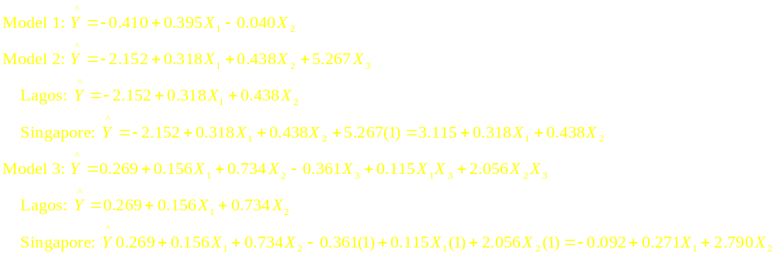
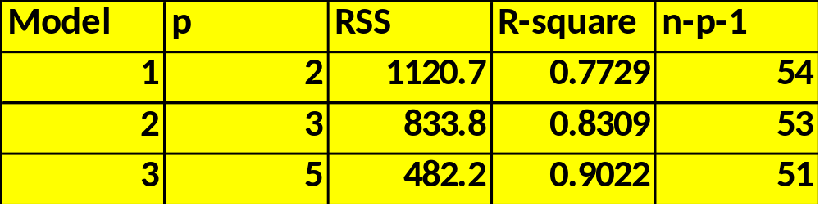
Example – Hotel Energy in Lagos and Singapore

Slide 19
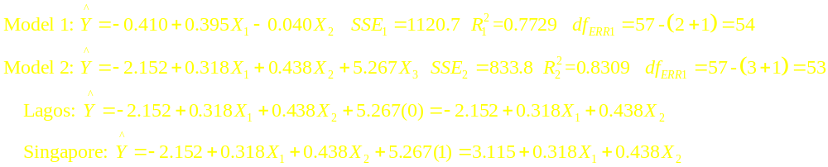
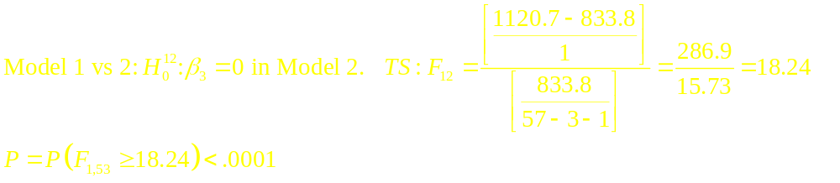
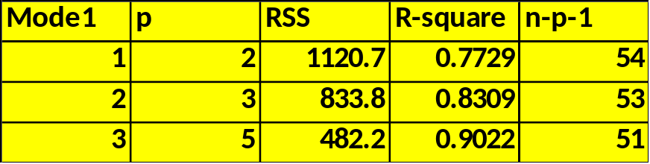
Example – Hotel Energy in Lagos and Singapore
Model 1 vs 2: Test of Singapore effect (different intercepts)

Slide 20
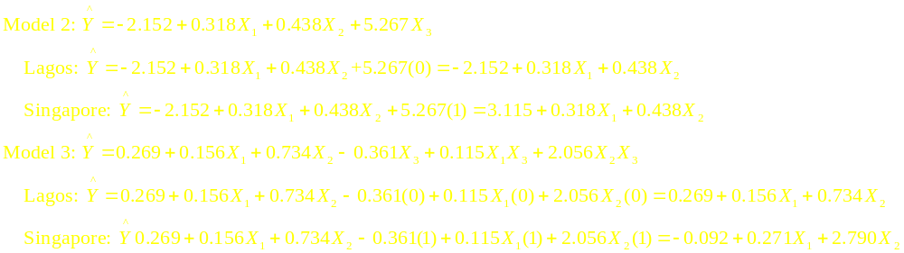
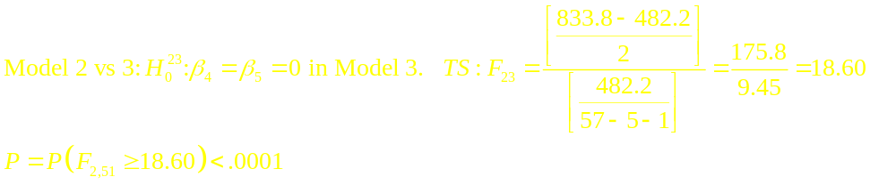
Example – Hotel Energy in Lagos and Singapore
Model 2 vs 3: Different slopes wrt X₁ and X₂ by city

Slide 21
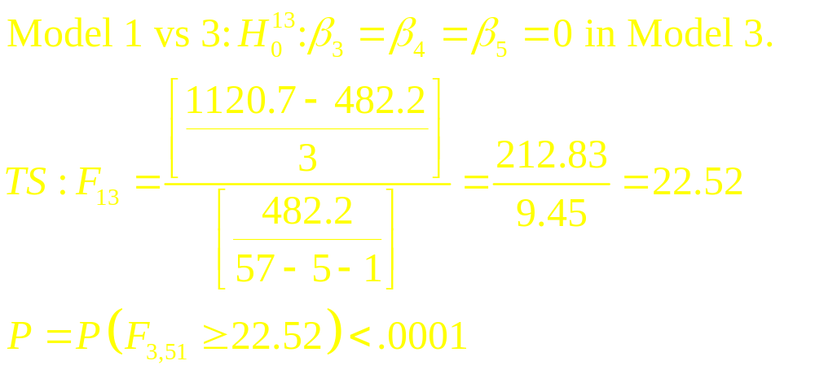
Example – Hotel Energy in Lagos and Singapore
Model 1 vs 3: Same regression equation for each city
(Note that since the previous two F-tests were highly significant, we know this test will reject the null hypothesis)

Slide 22
R Program
nsh.data <- read.csv("E:\\public_html\\data\\nigeria_singapore_hotel.csv")
attach(nsh.data); names(nsh.data)
singapore <- city – 1; year.EC <- year.EC / 1000
flr.area <- flr.area / 1000; employees <- employees / 100
hotel.mod1 <- lm(year.EC ~ flr.area + employees)
summary(hotel.mod1); anova(hotel.mod1)
hotel.mod2 <- lm(year.EC ~ flr.area + employees + singapore)
summary(hotel.mod2); anova(hotel.mod2)
hotel.mod3 <- lm(year.EC ~ flr.area + employees + singapore +
I(flr.area*singapore) + I(employees*singapore))
summary(hotel.mod3); anova(hotel.mod3)
anova(hotel.mod1, hotel.mod2)
anova(hotel.mod2, hotel.mod3)
anova(hotel.mod1, hotel.mod3)

Slide 23
R Partial Output
> anova(hotel.mod1, hotel.mod2)
Model 1: year.EC ~ flr.area + employees
Model 2: year.EC ~ flr.area + employees + singapore
Res.Df RSS Df Sum of Sq F Pr(>F)
1 54 1120.69
2 53 833.76 1 286.93 18.239 8.114e-05 ***
> anova(hotel.mod2, hotel.mod3)
Model 1: year.EC ~ flr.area + employees + singapore
Model 2: year.EC ~ flr.area + employees + singapore + I(flr.area * singapore) +
I(employees * singapore)
Res.Df RSS Df Sum of Sq F Pr(>F)
1 53 833.76
2 51 482.20 2 351.55 18.591 8.627e-07 ***
> anova(hotel.mod1, hotel.mod3)
Model 1: year.EC ~ flr.area + employees
Model 2: year.EC ~ flr.area + employees + singapore + I(flr.area * singapore) +
I(employees * singapore)
Res.Df RSS Df Sum of Sq F Pr(>F)
1 54 1120.7
2 51 482.2 3 638.48 22.51 2.025e-09 ***

