Slide 1
Chapter 1
STA 3180

Slide 2
Data Examples
U.S. Coal Mine Production (2011, Source: EIA)
  Units: Coal Mines Producing > 100,000 short tons (n = 691)
  Response: Production (100K of short tons). Due too skew, will use log(Prod)
  Predictors: Labor Effort (100K hours), Region (Appalachia, Interior, West)
Professional Basketball Players Body Mass Indices (2013-2014)
  Units: Players on Rosters in NBA (Men, n_{M} = 505) and WNBA (Women, n_{F} = 139)
  Response: Gender
  Predictor: Body Mass Index
Women’s Professional Basketball Players (2014)
  Units: Players on WNBA Rosters with > 12 minutes played per game on average
  Variables: Points and Rebounds per 36 minutes

Slide 3
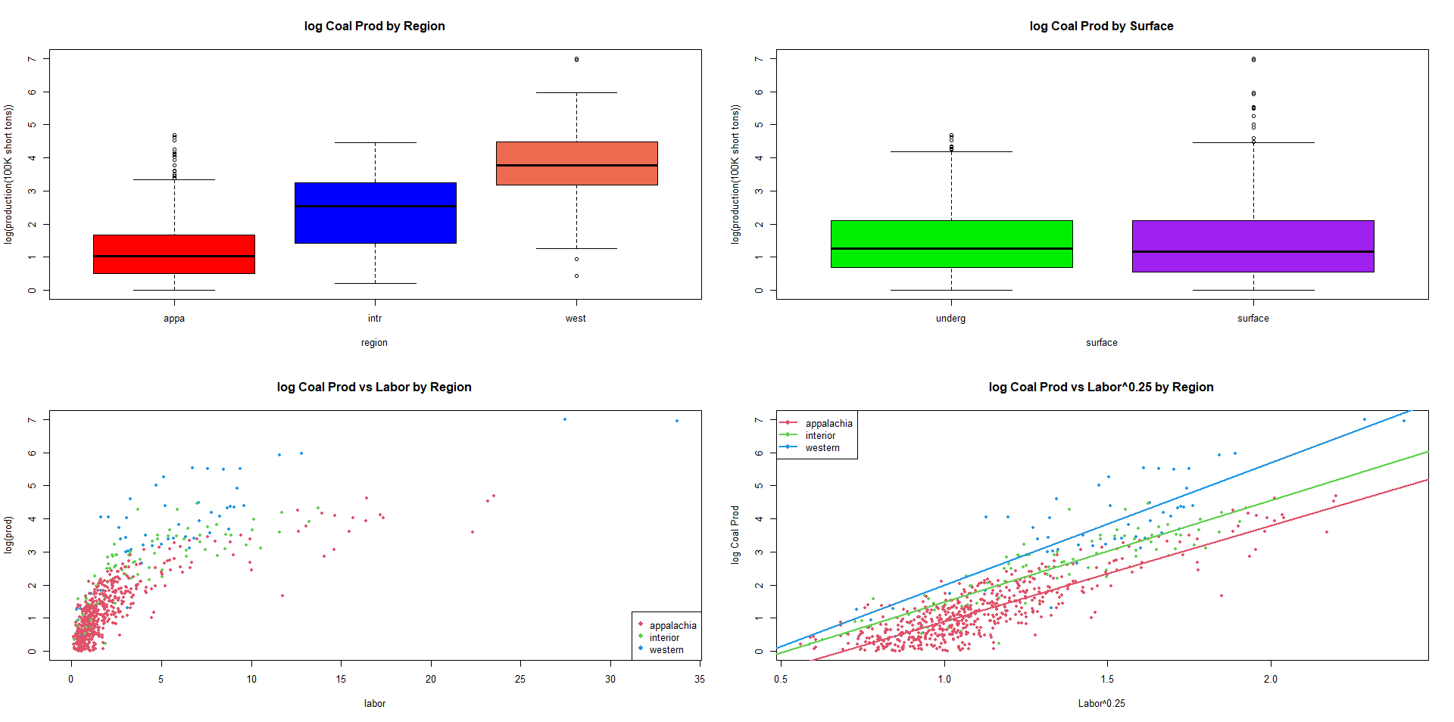
US Coal Mine Production (2011)

Slide 4
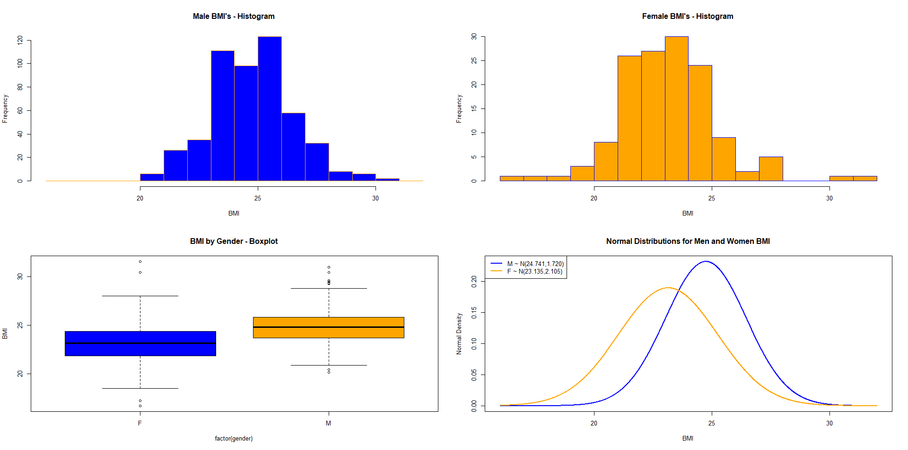
NBA/WNBA by Body Mass Index (2013/2014)

Slide 5
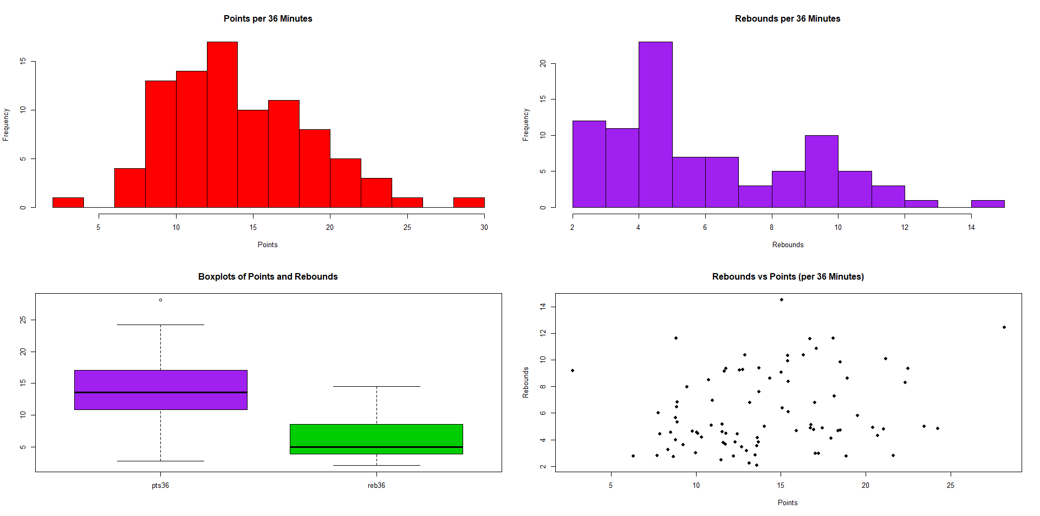
WNBA Points/Rebounds per 36 Minutes (2024)

Slide 6
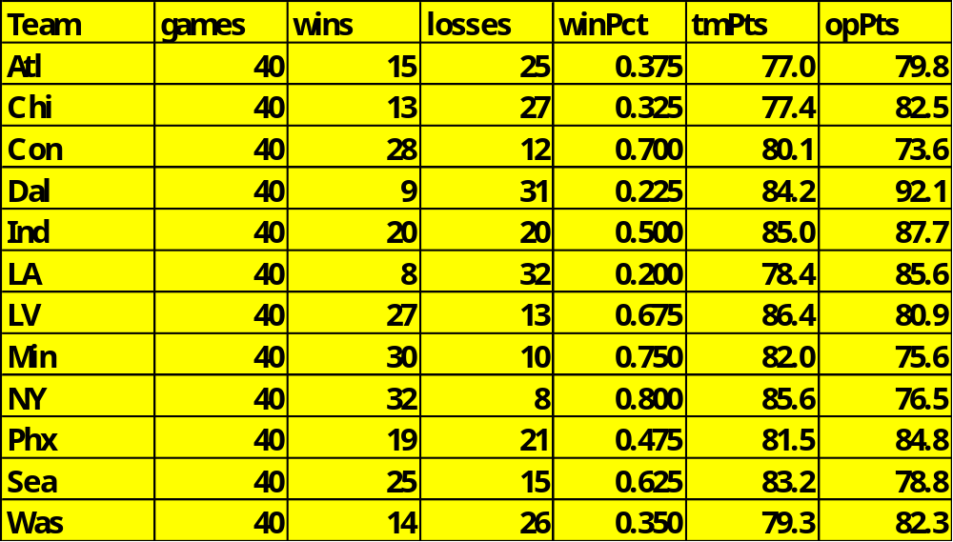
WNBA – 2024 Regular Season
Suppose the response is wins and the predictors are tmPts (team’s points per game) and opPts (opponents’ points per game) . There are n = 12 teams and p = 2 predictors.

Slide 7
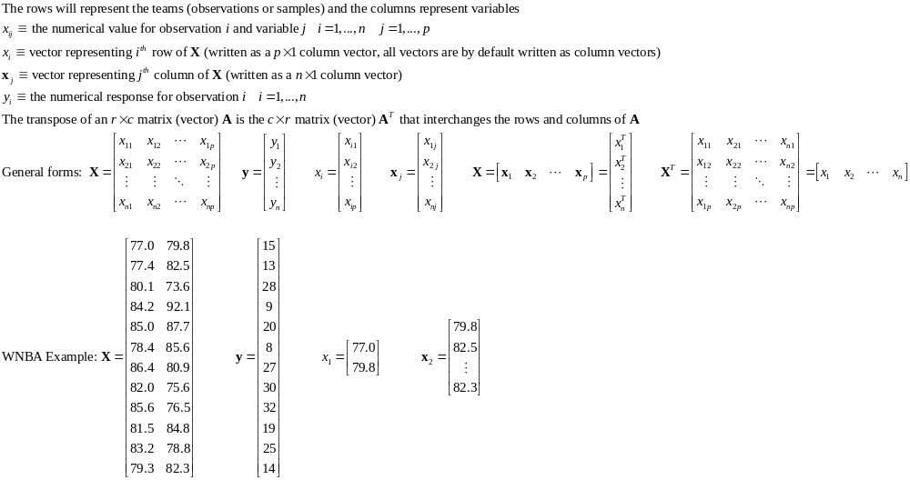
Matrices and Vectors

Slide 8
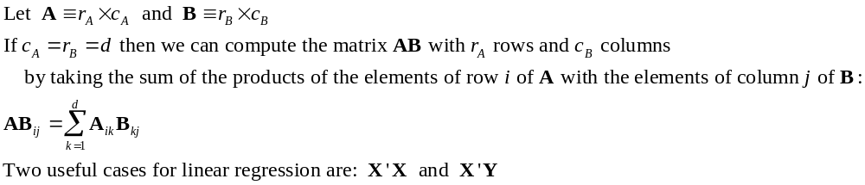
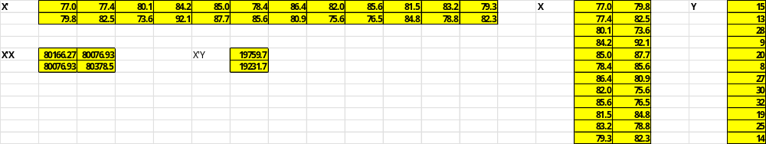
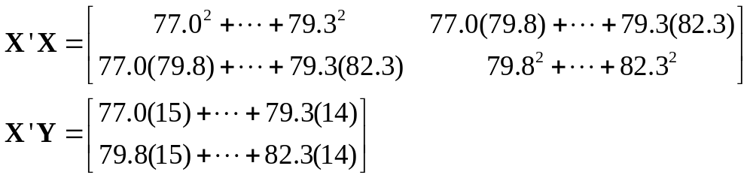
Matrix Multiplication

