Slide 1
Response Surface Model
NASCAR TRACK Top Qualifying Speeds (Through 2009)

Slide 2
Data Description
Units: NASCAR Sprint Cup Tracks
Response Variable: Y=Top Qualifying Speed for NASCAR Sprint Cup Series
Predictor Variables:
  X₁ = Bank of Turns (Degrees)
  X₂ = Length of Track (Miles)
Hypotheses:
  As Bank Top Speed
  As Track Length Top Speed

Slide 3
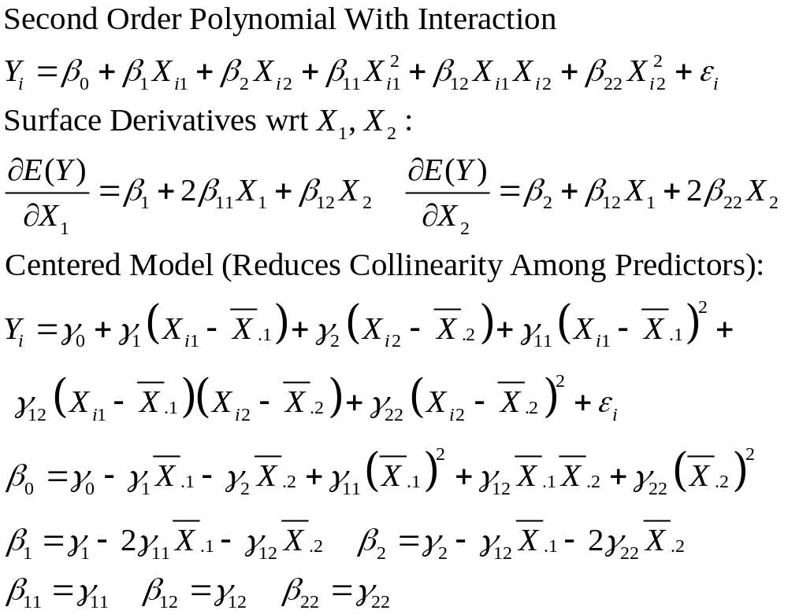
Response Surface Model

Slide 4
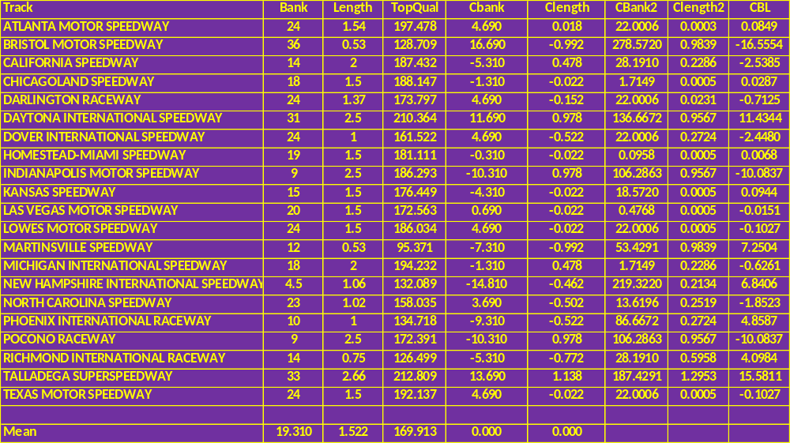
Data
Variables beginning with “C” are centered

Slide 5
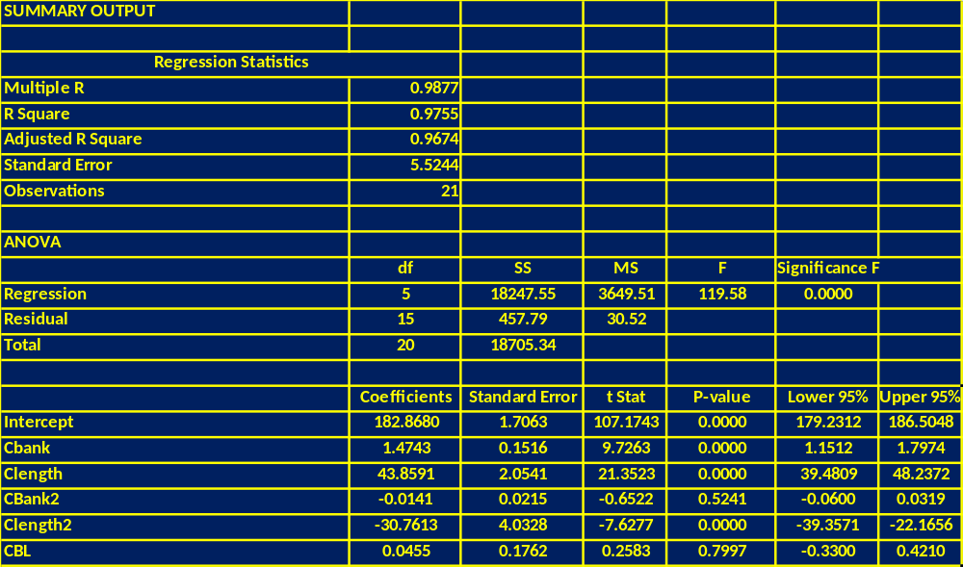
Second-Order Polynomial Fit
Note: Cbank, Clength, and Clength2 are highly significant. Neither the interaction term (CBL) or the quadratic term in Bank (CBank2) appear to be significant

Slide 6
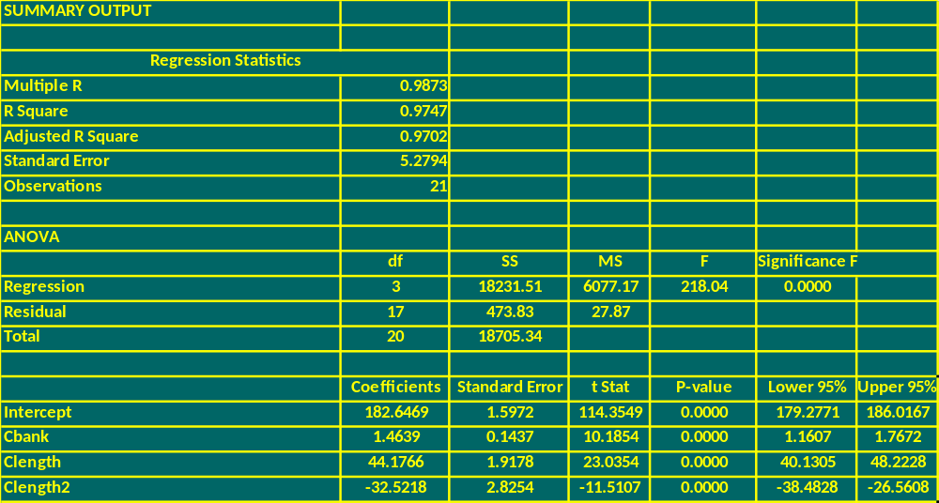
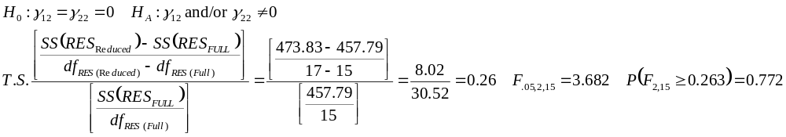
Reduced Model

Slide 7
Plot of Reduced Model (Original Units)

Slide 8
3-D Surface Plot

Slide 9
Contour Plot

