Slide 1
Weighted Least Squares Regression
Dose-Response Study for Rosuvastin in Japanese Patients with High Cholesterol
"Randomized Dose-Response Study of Rosuvastin in Japanese Patients with Hypercholesterolemia" Saito, et al, Journal of Atherosclerosis, 2003, 10:329-336

Slide 2
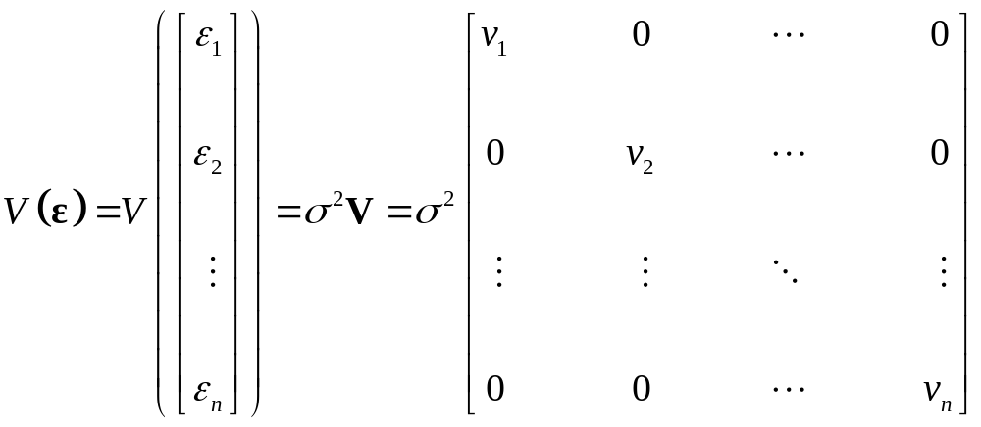
Weighted Least Squares (Independent Case)
Errors are independent
Variance of errors are not all equal (Heteroscedastic)
Variances may be known or estimated
Estimates can be obtained by regression when the variance is a power function of the mean
General case with known variance structure (up to σ²):

Slide 3
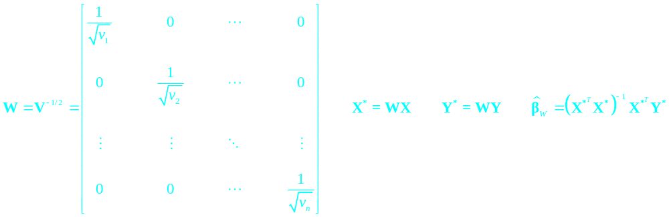
Weighted Least Squares Procedure
Give higher weights to observations with smaller variances
Create a Weight matrix W, that is diagonal with elements equal to reciprocals of square roots of elements of V
Transform the Y vector and the X matrix by pre-multiplying each by W

Slide 4

Properties of WLS Estimator and Fitted Values/Residuals

Slide 5


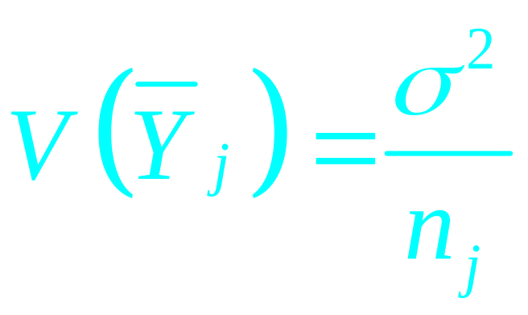
Example – Cholesterol Drug Dose-Response Study
Study of Drug Rosuvastin in Japanese Patients with high cholesterol
6 Doses – 1,2.5,5,10,20,40
Response - % Change in LDL Cholesterol @ week 12
Data Reported – Group Means by Dose
Sample sizes Varied by dose
Assuming equal variance among individual patients:

Slide 6
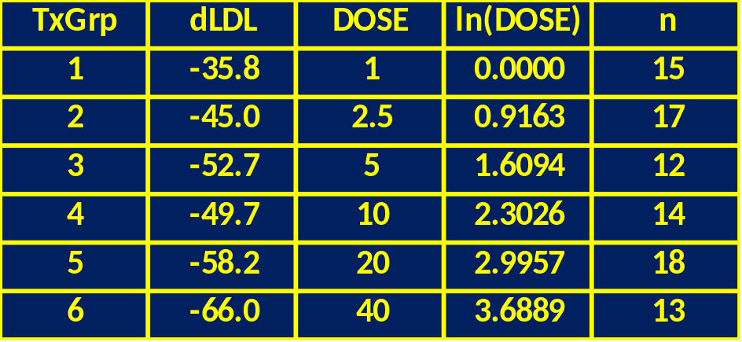
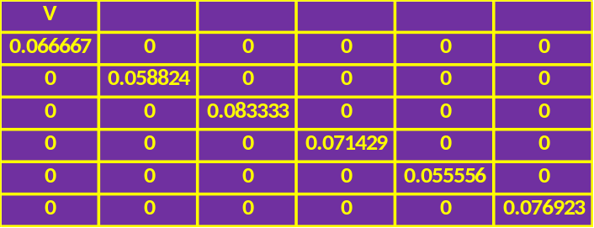
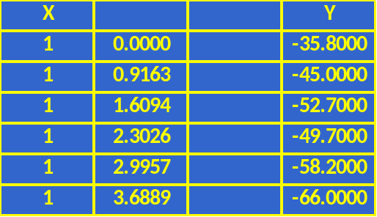
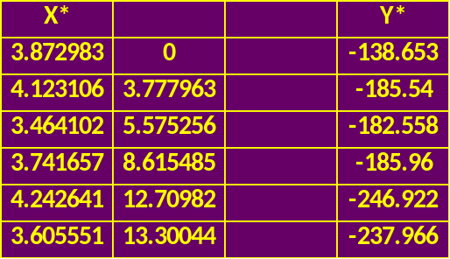
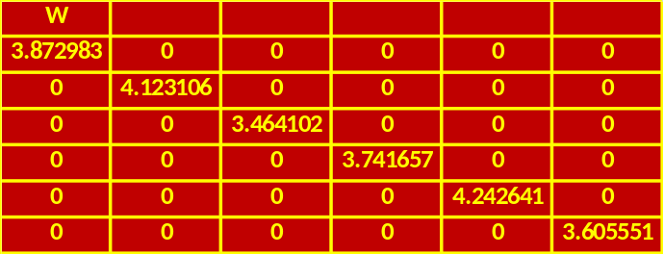
Data and Y,Y*, X,X*, V and W Vectors/Matrices
Note: we will use ln(DOSE) as predictor variable (see plots below)

Slide 7
Plot of Change in LDL vs Dose

Slide 8
Plot of Change in LDL vs ln(Dose)

Slide 9
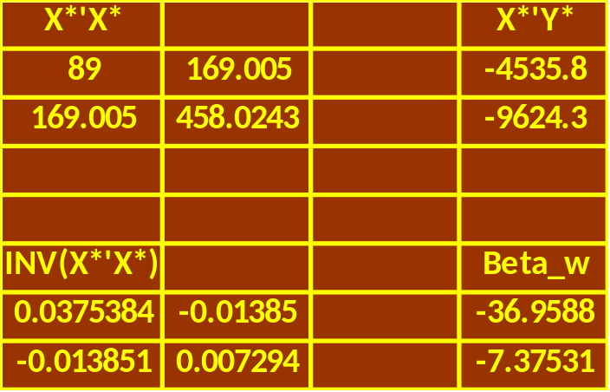
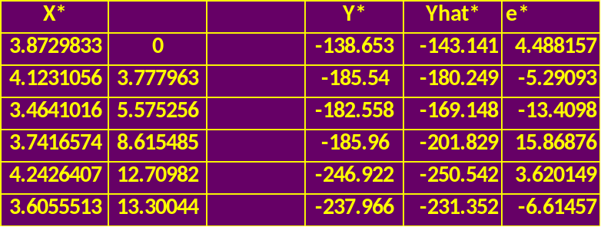
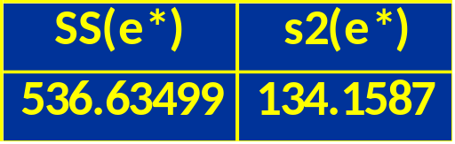
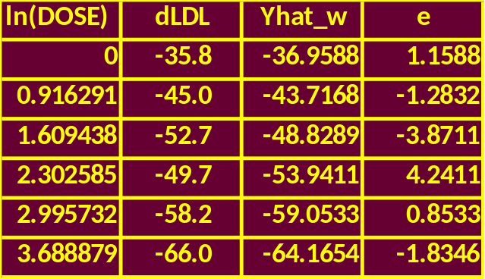
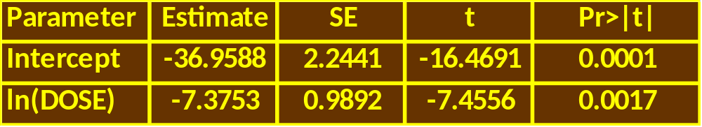
WLS Regression Estimates, Fitted Values, Residuals

Slide 10
Plot of dLDL vs Dose with WLS Regression Line

