Slide 1
Correlation Across and Within Groups
2008 LPGA & PGA Driving Distance and Accuracy

Slide 2
Data Description
Subjects:
  157 LPGA Golfers (Female)
  197 PGA Golfers (Male)
1998 Season (Through November 16)
Measures:
  Average Drive Distance (Yards)
  Drive Accuracy (Percent)

Slide 3
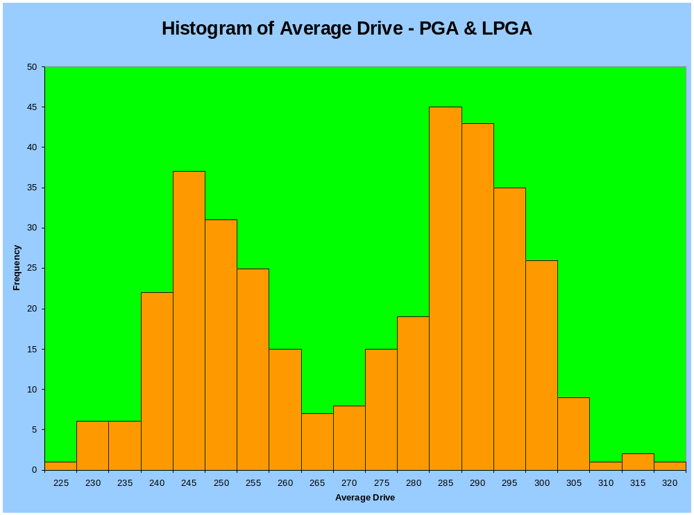
All Golfers – Average Drive Distance (Yards)
Evidence of 2 “Populations” of Golfers for Distance

Slide 4
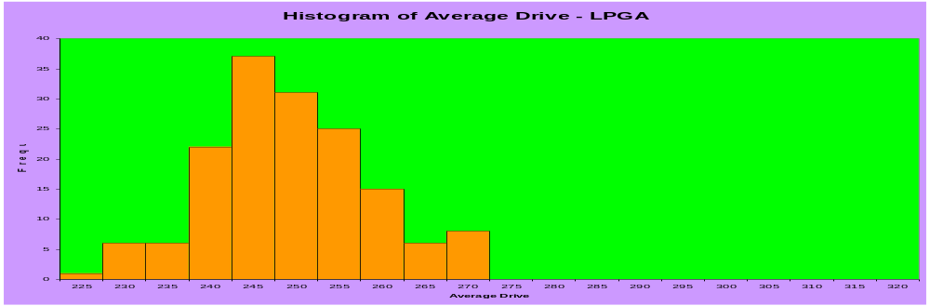
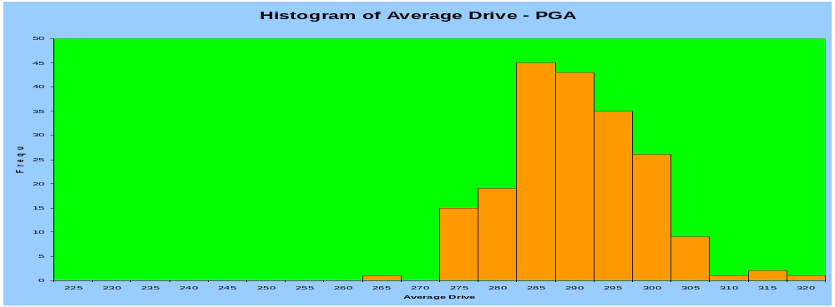
Average Drive Distance by Gender – LPGA/PGA

Slide 5
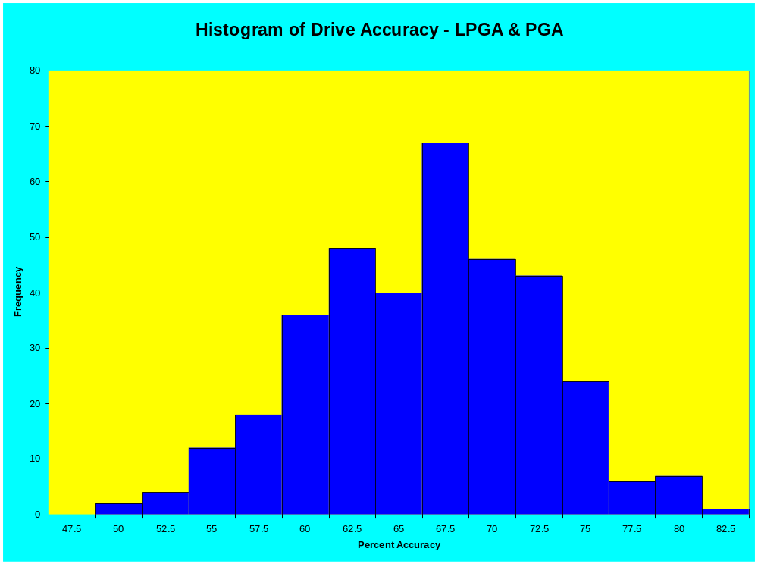
Joint Histogram of Percent Accuracy
Less Evidence of Distinct “Populations” for Accuracy

Slide 6
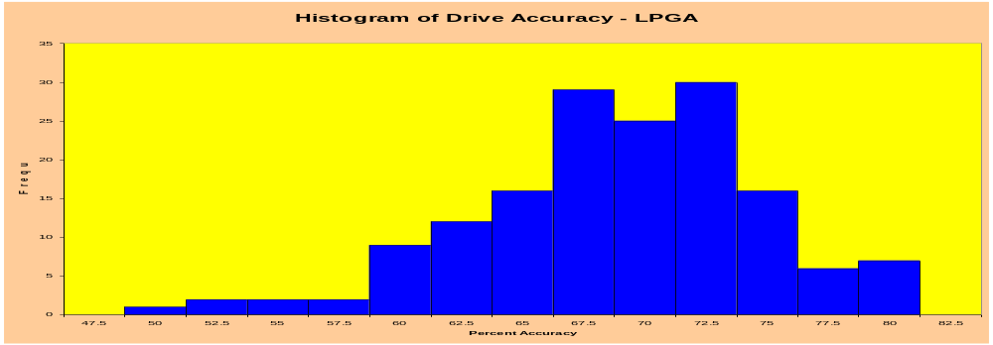
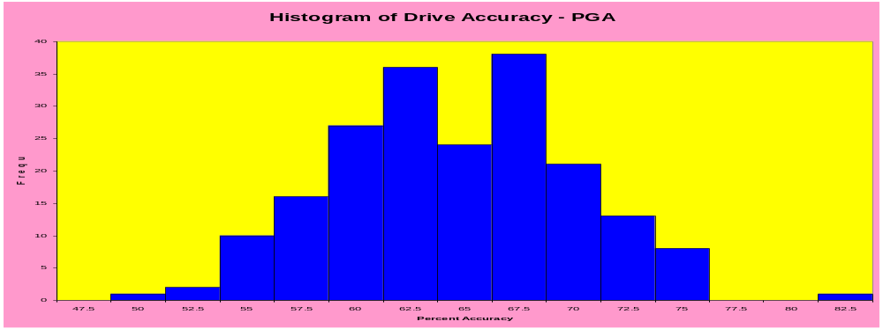
Drive Accuracy by Gender

Slide 7
PGA/LPGA Distributions
Average Drive
  All Golfers: μ=269.5 σ=22.2
  Females: μ_{F} = 246.8 σ_{F} =9.5
  Males: μ_{M}=287.6 σ_{M}=8.6
Drive Accuracy
  All Golfers: μ=65.2 σ=6.0
  Females: μ_{F} = 67.6 σ_{F} =5.8
  Males: μ_{M}=63.4 σ_{M}=5.5

Slide 8
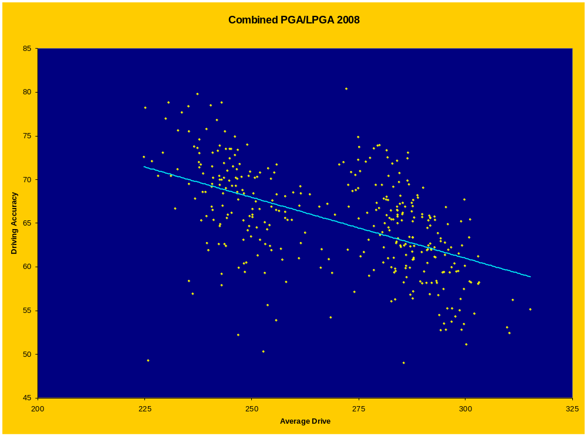
Scatterplot of Driving Accuracy vs Distance
Moderate Negative Correlation: r = -0.52

Slide 9
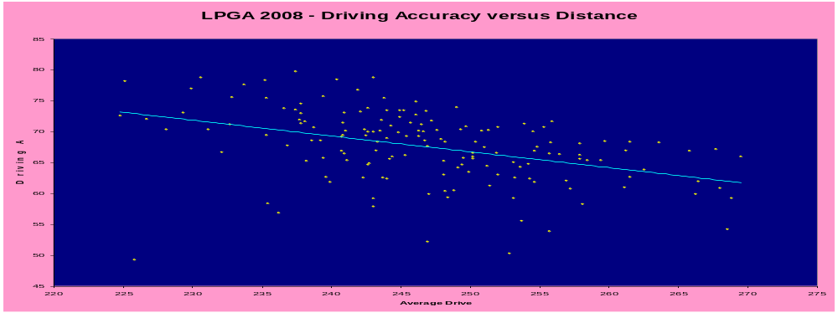
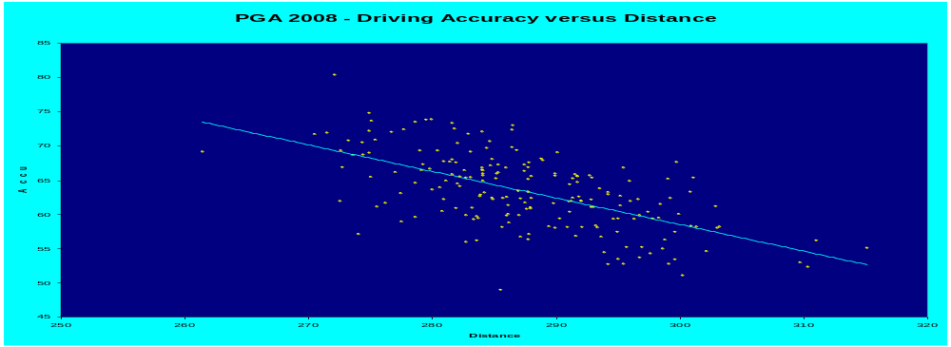
Driving Accuracy vs Distance by Gender
r_{F} = -0.42
r_{M} = -0.61

Slide 10
Summary
Average Drive is well described by Normal Distribution, but differs by Gender (M > F)
Driving Accuracy is mound shaped, but fit to Normal appears weaker than Average Drive. It also differs by Gender, but less so (F > M)
Across groups, there is a moderate negative correlation between Average Drive and Accuracy, when controlling by Gender, the Male association is stronger than Female.
“Smoothed Normal Densities on next two slides.

Slide 11
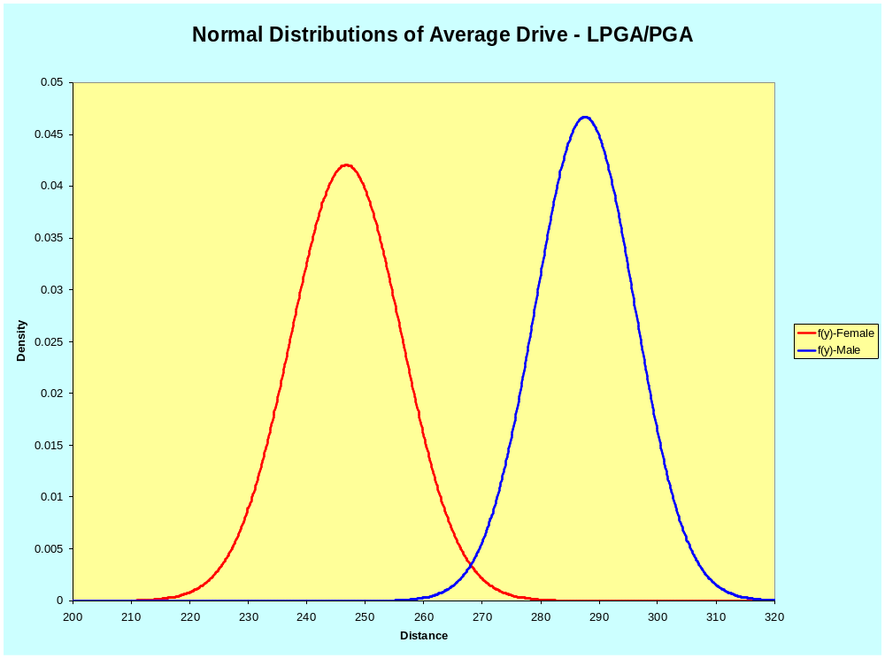
Normal Densities of Average Drive by Gender

Slide 12
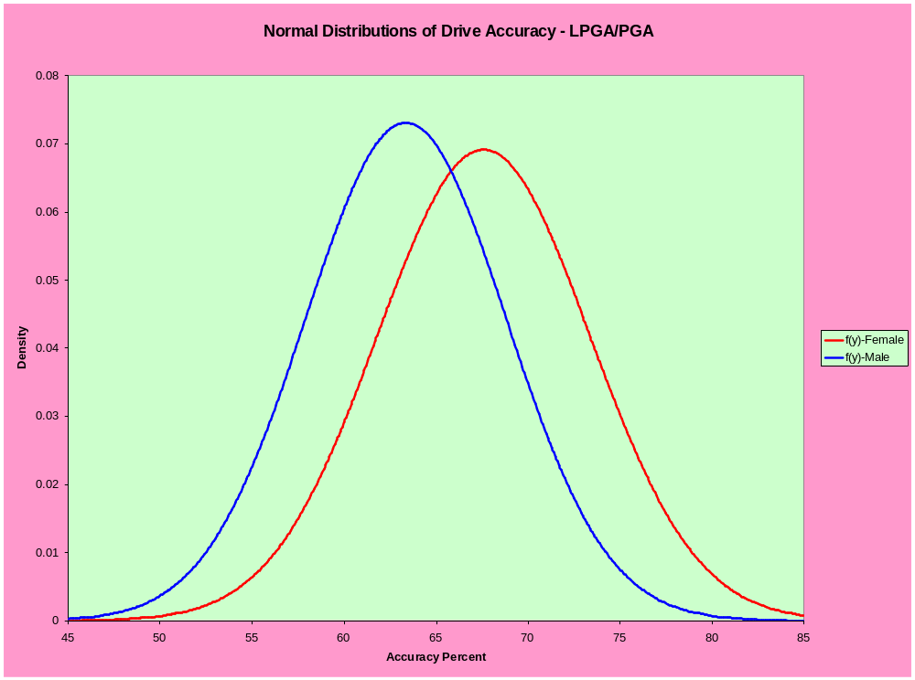
Normal Densities of Drive Accuracy by Gender

