Slide 1
Poisson Regression
Caution Flags (Crashes) in NASCAR Winston Cup Races 1975-1979
L. Winner (2006). “NASCAR Winston Cup Race Results for 1975-2003,” Journal of Statistics Education, Vol.14,#3, www.amstat.org/publications/jse/v14n3/datasets.winner.html

Slide 2
Data Description
Units: NASCAR Winston Cup Races (1975-1979) n=151 Races
Dependent Variable:
  Y=# of Caution Flags/Crashes (CAUTIONS)
Independent Variables:
  X₁=# of Drivers in race (DRIVERS)
  X₂=Circumference of Track (TRKLENGTH)
  X₃=# of Laps in Race (LAPS)

Slide 3
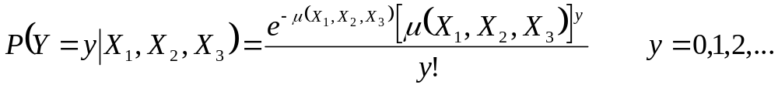
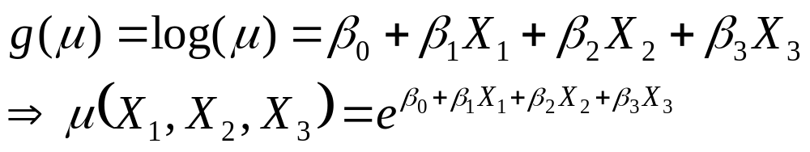
Generalized Linear Model
Random Component:
  Poisson Distribution for # of Caution Flags
Density Function:
Link Function: g(μ) = log(μ)
Systematic Component:

Slide 4
Testing For Overall Model
H₀: β₁ = β₂ = β₃ = 0 (# Cautions independent of all predictors)
H_{A}: Not all β_{j} = 0 (# Cautions associated with at least 1 predictor)
Test Statistic: X_{obs}² = -2(lnL₀-lnL₁)
Rejection Region: X_{obs}² ≥ χ²_{α,3}
P-Value: P(χ²₃ ≥ X_{obs}²)
Where:
  lnL₀ is maximized log likelihood under model H₀
  lnL₁ is maximized log likelihood under model H_{A}

Slide 5
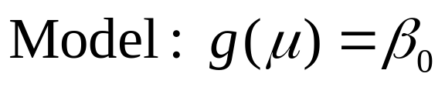
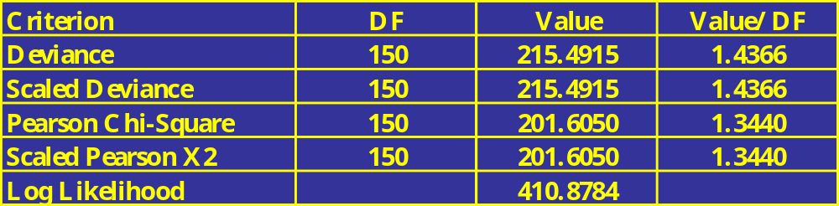
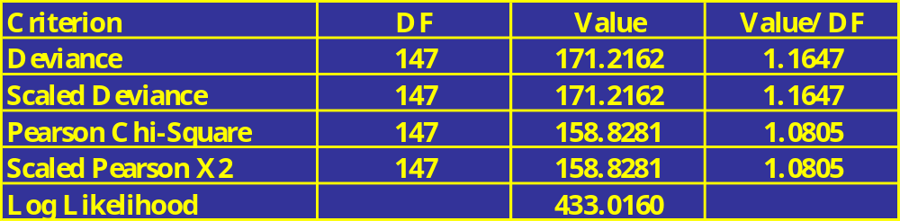
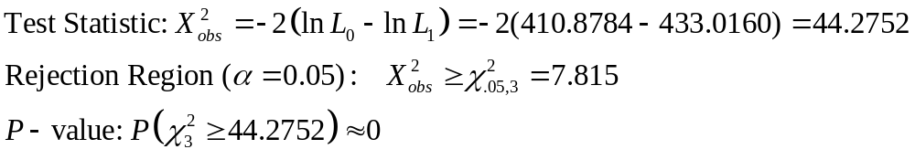
NASCAR Caution Flag Example - I
Statistical output obtained from SAS PROC GENMOD

Slide 6
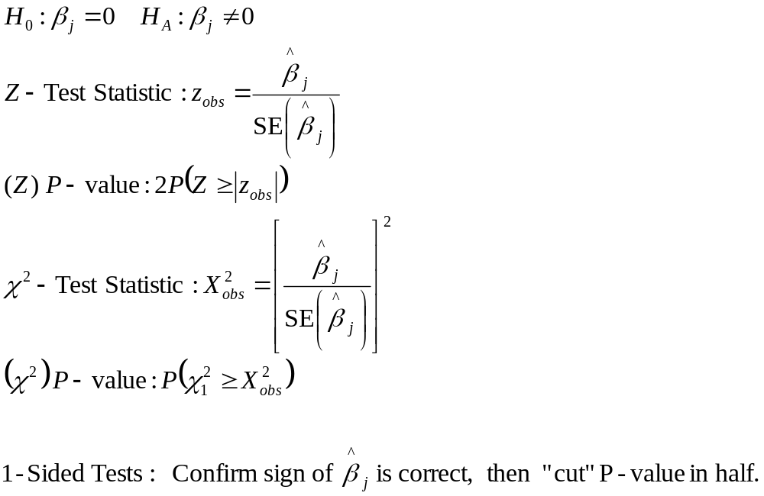
Testing for Individual (Partial) Regression Coefficients

Slide 7
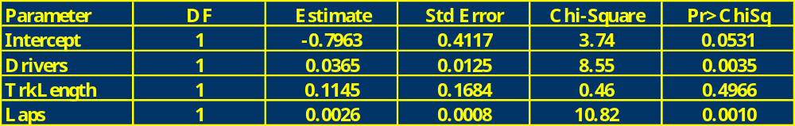
NASCAR Caution Flag Example - II
Conclude the following:
Controlling for Track Length and Laps, as Drivers ↑ Cautions ↑
Controlling for Drivers and Laps, No association between Cautions and Track Length
Controlling for Drivers and Track Length, as Laps ↑ Cautions ↑
Reduced Model: log(Crashes) = -0.6876+0.0428*Drivers+0.0021*Laps

Slide 8
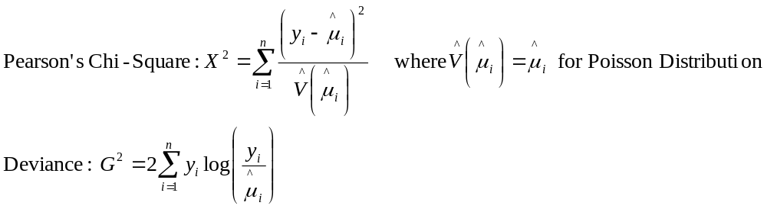
Testing Model Goodness-of-Fit
Two Common Measures of Goodness of Fit:
  Pearson’s Chi-Square
  Deviance
Both measures have approximate Chi-Square Distributions under the hypothesis that the current model is appropriate for fixed number of combinations of independent variables and large counts

Slide 9
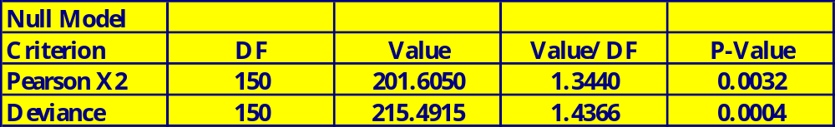
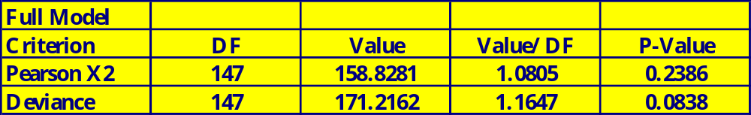
NASCAR Caution Flags Example - III
Note that the null model clearly does not fit well, and the full model fails to reject the null hypothesis of the model being appropriate (however, we have many combinations of Laps, Track Length, and Drivers)

Slide 10
SAS Program
options ps=54 ls=76;
data one;
input serrace 6-8 year 13-16 searace 23-24 drivers 31-32 trklength 34-40 laps 46-48 road 56 cautions 63-64 leadchng 71-72;
cards;
1 1975 1 35 2.54 191 1 5 13
...
151 1979 31 37 2.5 200 0 6 35
;
run;
/* Data set one contains the data for analysis. Variable names and
column specs are given in INPUT statement. I have included ony
first and last observations */
/* The following model fits a Generalized Linear model,
with poisson random component, and a constant mean:
g(mu)=alpha is systematic component,
g(mu)=log(mu) is the link function:
mu=e**alpha */
proc genmod;
model Cautions = / dist=poi link=log;
run;
/* The following model fits a Generalized Linear model,
with poisson random component,
g(mu)=alpha + beta1*drivers + beta2*trkength + beta3*laps is systematic component,
g(mu)=log(mu) is the link function:
mu=e**alpha + beta1*drivers + beta2*trkength + beta3*laps */
proc genmod;
model Cautions = drivers trklength laps / dist=poi link=log;
run;
quit;

Slide 11
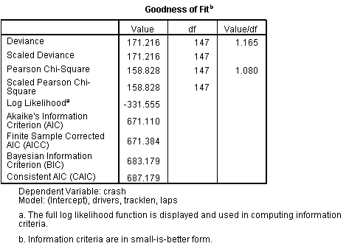
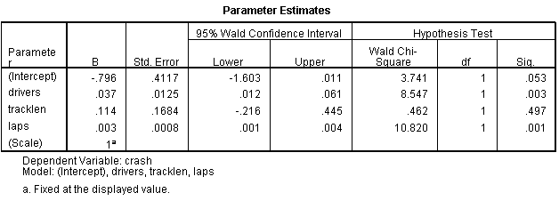
SPSS Output

Slide 12
Goodness-of-Fit Test
Used when there are “many” distinct levels of explanatory variables
Based on “lumping” together cases based on their predicted values into J (often 10 is used) groups
Compares observed and expected counts by group based on Deviance and Pearson residuals. For Poisson model (where obs is observed, exp is expected):
  Pearson: r_{i} = (obs_{i}-exp_{i})/√exp_{i} X²=Σr_{i}²
  Deviance: d_{i} = √(obs_{i}* log(obs_{i}/exp_{i})) G²=2 Σd_{i}²
  Degrees of Freedom: J- p-1 where p=#Predictor Variables

Slide 13
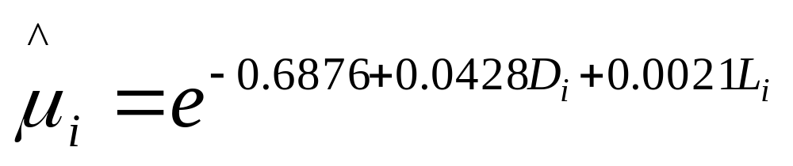
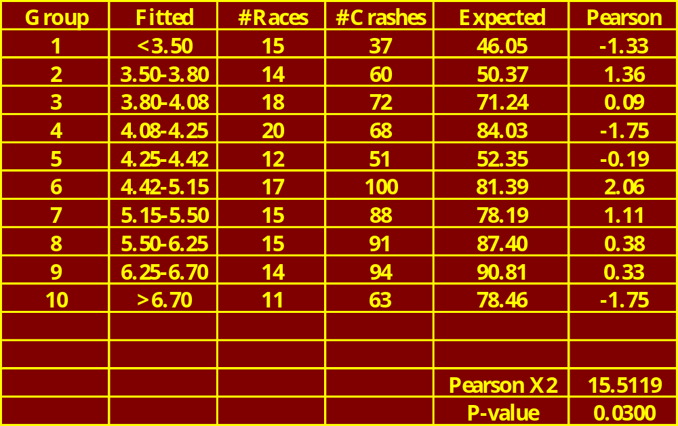
NASCAR Caution Flags Example - IV
Note that there is evidence that the Poisson model does not provide a good fit

Slide 14
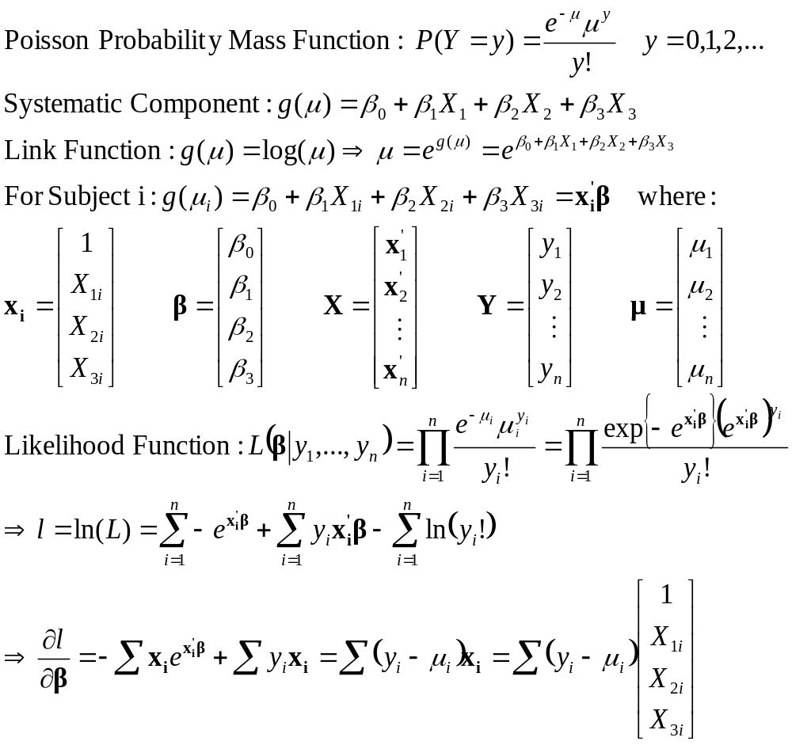
Computational Approach - I

Slide 15
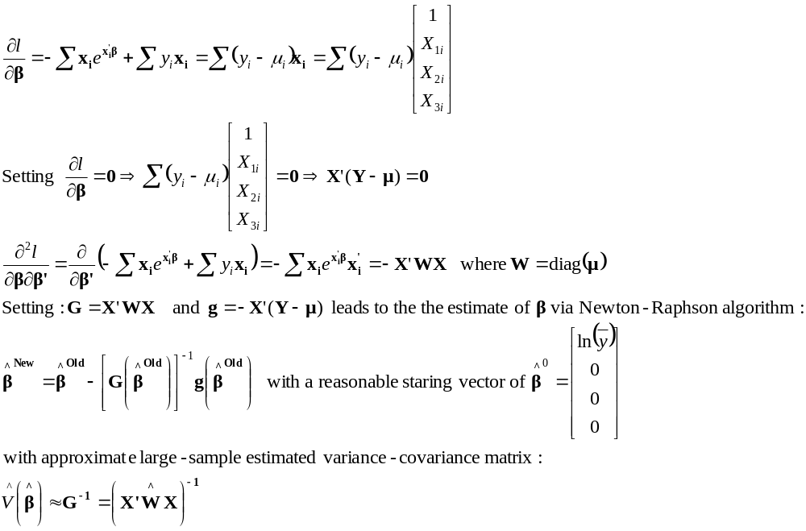
Computational Approach - II

