Slide 1
Linear Regression – General Linear Tests
Cobb-Douglas Production Function (Multiplicative Form)
Source: C.W. Cobb and P.H. Douglas (1928). “A Theory of Production”, American Economic Review Vol. 18 (Supplement) pp. 139-165.

Slide 2
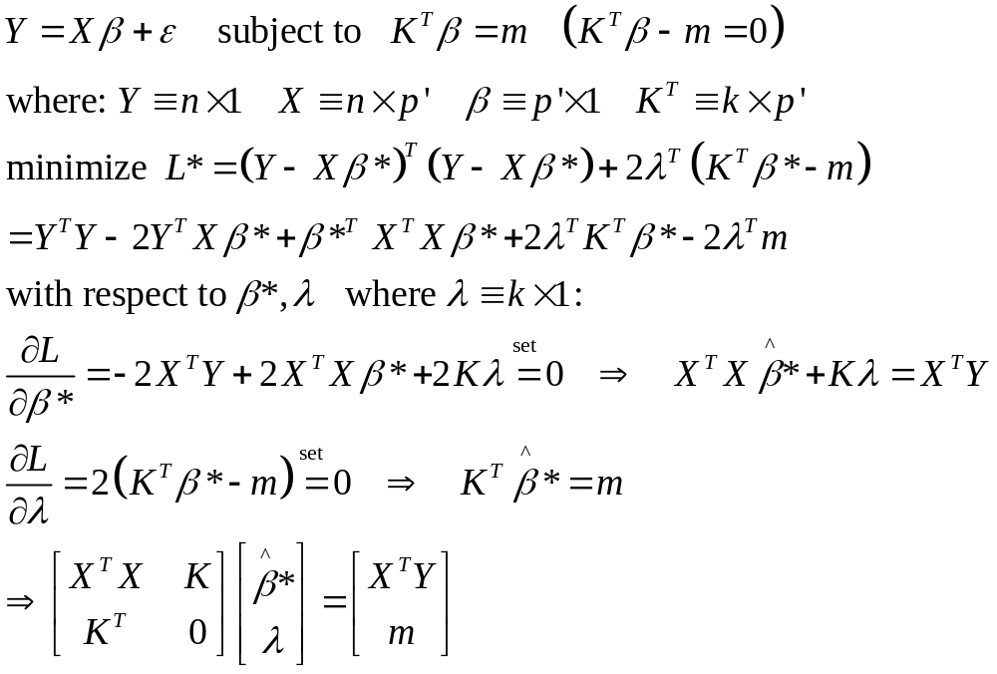
Linear Regression Model with Constraints

Slide 3
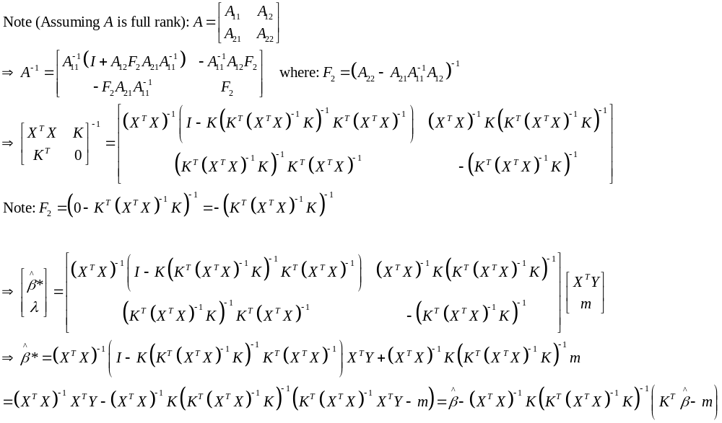
Solving for Constrained Regression Coefficients

Slide 4
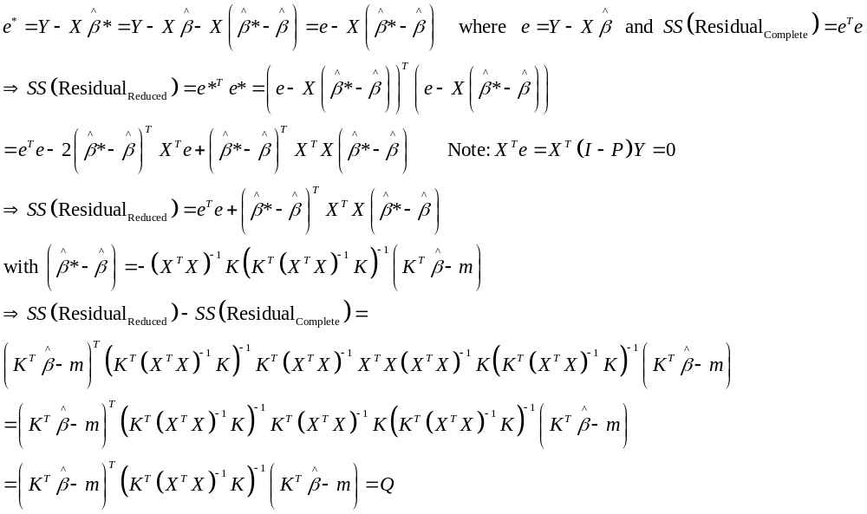
Error Sum of Squares for Constrained Model

Slide 5
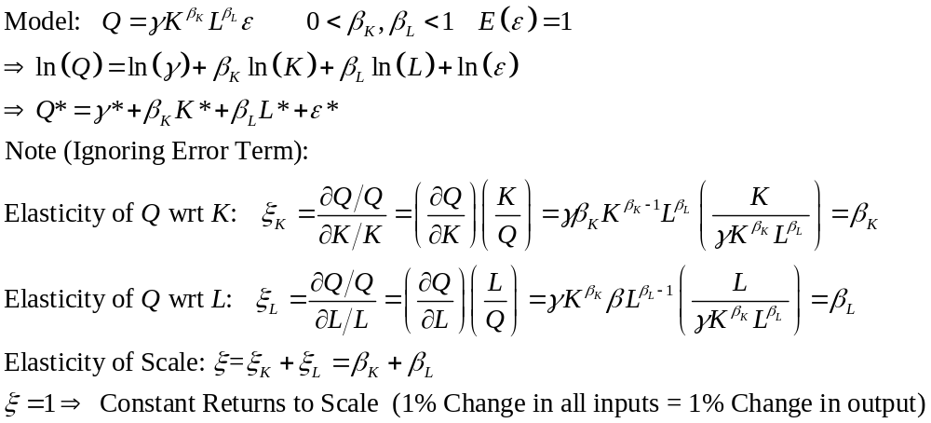
Application to (Multiplicative) Cobb-Douglas Production Function
Annual Data 1899-1922 (Indexed to 1899)
Dependent Variable: Q ≡ Quantity Produced
Independent Variables: K ≡ Capital L ≡ Labor

Slide 6
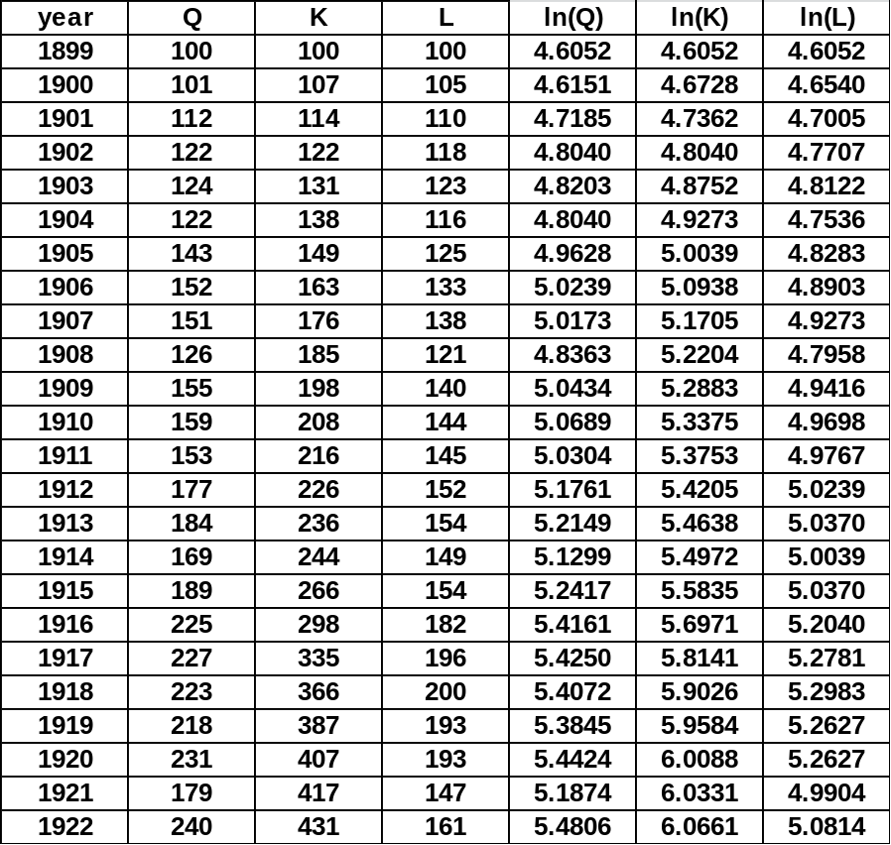
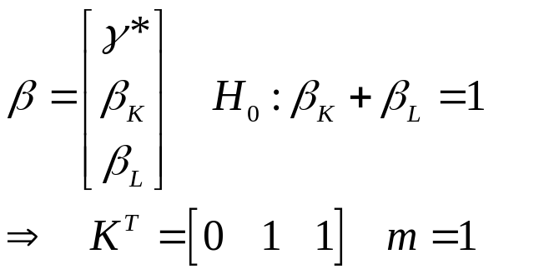
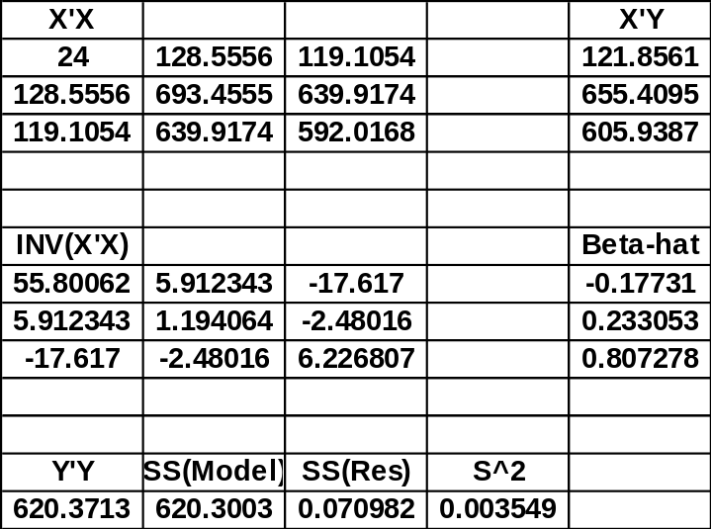
Data, Hypothesis, and OLS Estimator

Slide 7
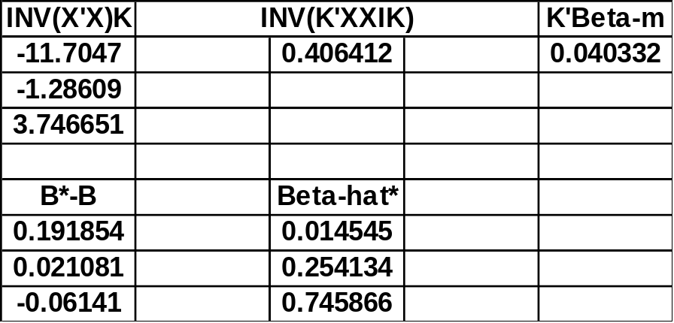
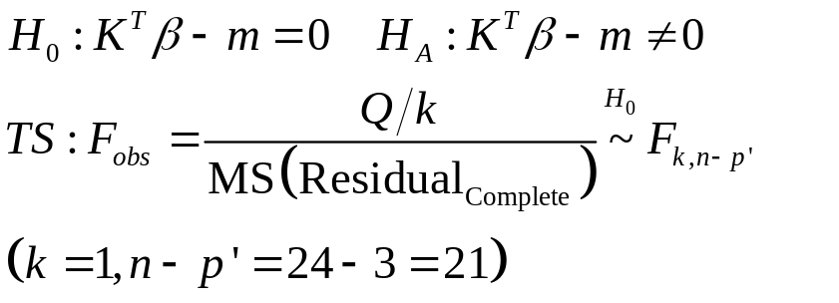
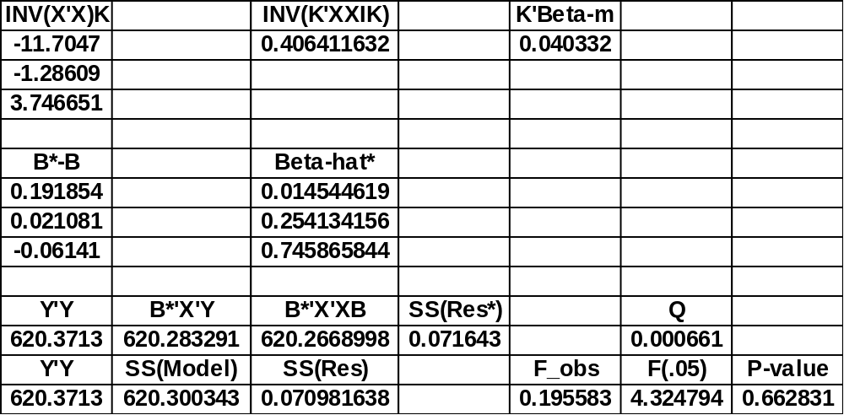
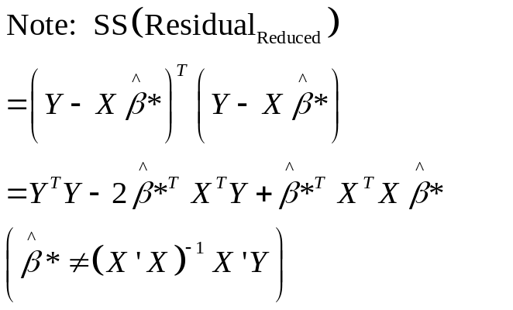
Constrained Estimator and F-test

Slide 8
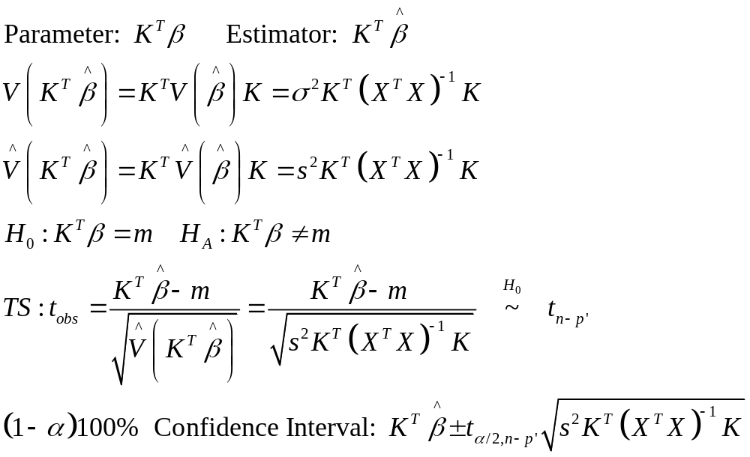
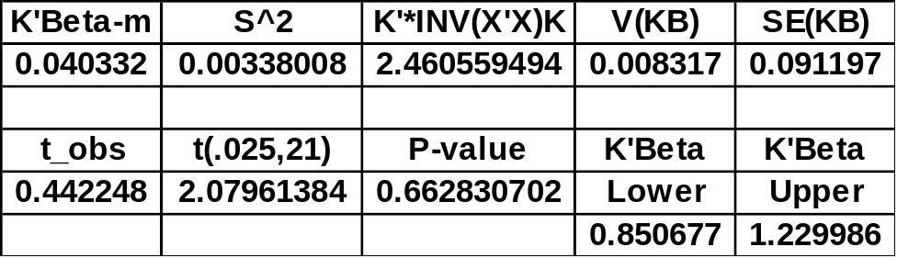
t-test/Confidence Interval (k=1 Hypothesis)

