Slide 1
Trigonometric Regression Models
Tampa/St. Petersburg Hotel Monthly Revenues – 6 Years

Slide 2
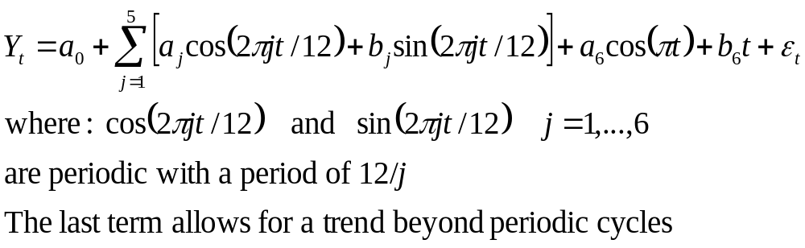
Data/Model
Revenue per Available Room (REVPAR) over 72 months (6 Years)

Slide 3
Plot of Revenue per Available Room by Month

Slide 4
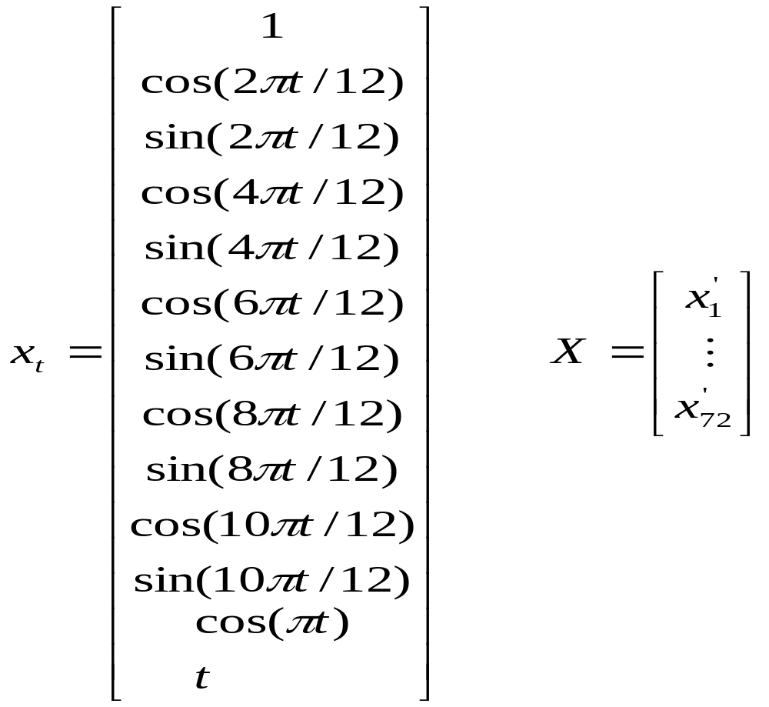
X - Matrix

Slide 5
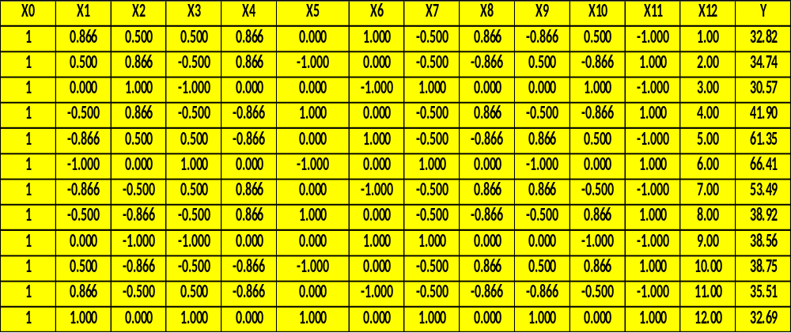
X & Y Matrices – Year 1

Slide 6
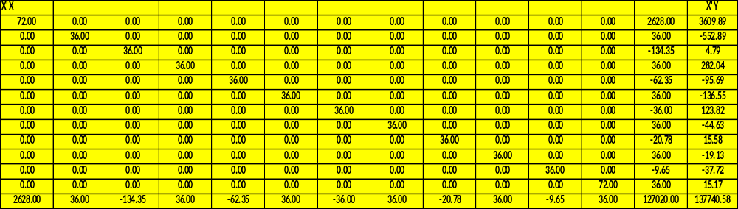
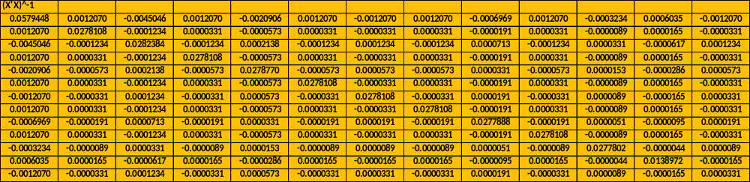
X’X , X’Y , (X’X)⁻¹

Slide 7
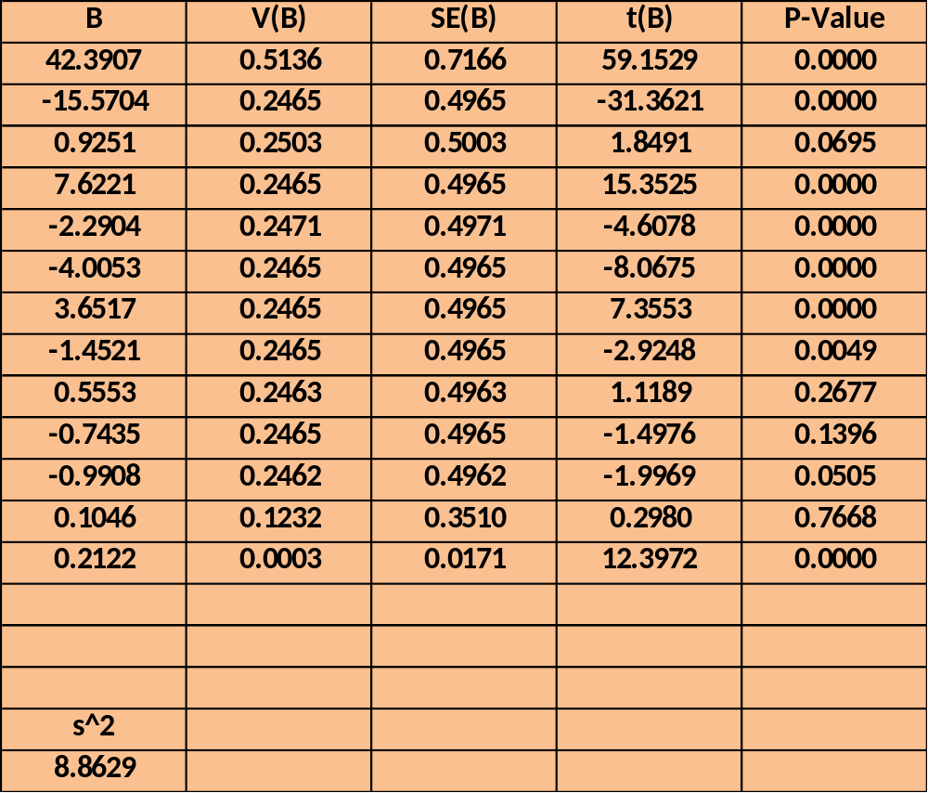
Estimated Regression Coefficients

Slide 8
Observed and Fitted REVPAR – Full Model

Slide 9
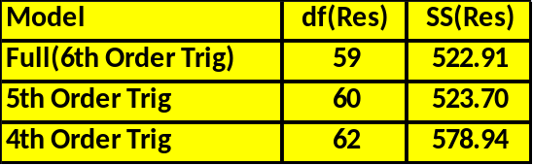
Model Simplification

Slide 10
Data and Fitted Values for Reduced Model

