Slide 1
Hierarchical Bayesian Analysis: Binomial Proportions
Dwight Howard’s Game by Game Free Throw Success Rate – 2013/2014 NBA Season
Data Source: www.nba.com

Slide 2
Data/Model Description
n = 70 NBA games during 2013/14 season that Dwight Howard attempted at least one free throw (aka foul shot)
Assume that for each game, Mr. Howard has an underlying “true” success rate for free throws, π_{i} , which can vary due to many environmental factors (although the actual process is the same: undefended shot 15’ from the frame of the backboard)
For the i^{th} game, Mr. Howard takes n_{i} free throw attempts, successfully making y_{i} attempts
Assume: Random Variable Y_{i} ~ Binomial( n_{i}, π_{i} )

Slide 3
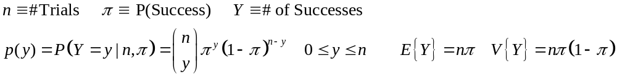
Binomial Likelihood for Y|π
Bin(n=10 , π = 0.25)
Bin(n=10 , π = 0.50)
Bin(n=10 , π = 0.90)

Slide 4
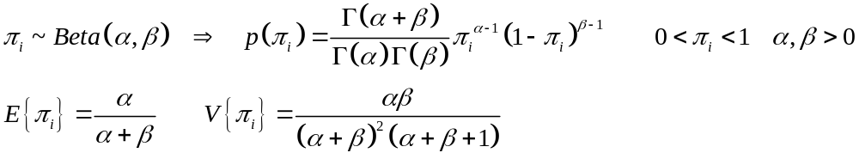
Modeling the Variation in Success Rates - π_{i}
Prior Distribution: Beliefs on possible values of π_{i} and how “likely” they are. Important questions:
  What is the range of possible values? Between 0 and 1
  What is the “expected value”? 0.2? 0.5? 0.8?
  What is a range of values we may want to put most of the density between? (0.025-0.975)? (0.25-0.75)? (0.4-0.8)?
  What is the shape of the distribution? The beta family of densities give a natural (and conjugate) distribution with very much flexibility for the shape of the prior.

Slide 5
Beta Prior for π
Beta(1,1) - Uniform
Beta(3,2)
Beta(5,5)

Slide 6
Prior Distributions for α, β
The parameters of the Beta distribution that acts as the prior distribution for the individual game π_{i} must be specified, or given prior distributions themselves.
The mean of the distribution of the π^{s} is μ = α/(α+β) which can lead to choices for the means of the priors for α and β
Suppose we want to choose distributions for α and β so that the prior mean is around 0.60 (he is a center and tall). We want to allow for a wide range of possibilities, permitting the data to have a larger impact on the posterior densities of the π^{s} and μ
Exponential Distributions: α ~ EXP(0.33) β ~ EXP(0.50)

Slide 7
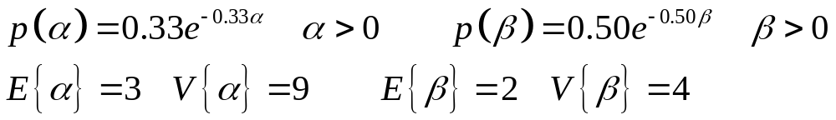
Prior Distributions for α, β

Slide 8
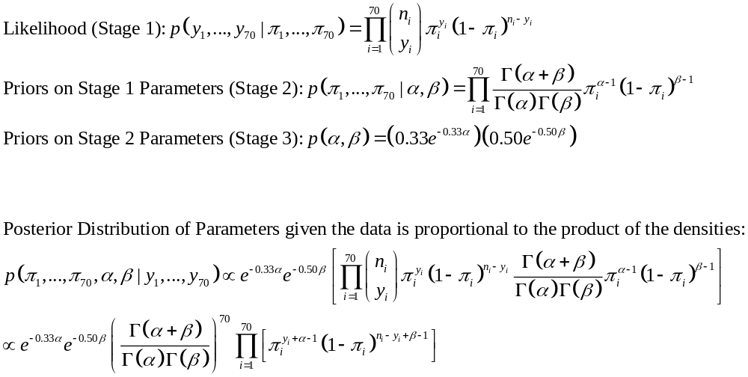
Posterior Distributions of α, β, π₁,…,π_{n}

Slide 9
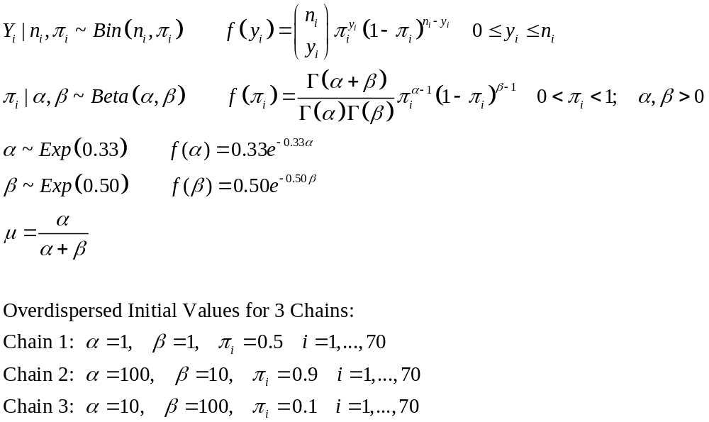
MCMC Implementation in OpenBugs
Assign Distributions and Relations for α, β, μ, {π_{i}}, {Y_{i}}

Slide 10
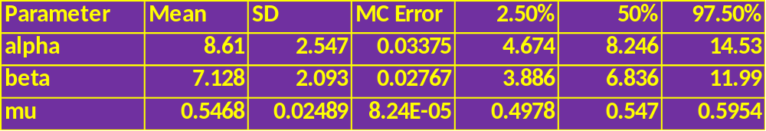
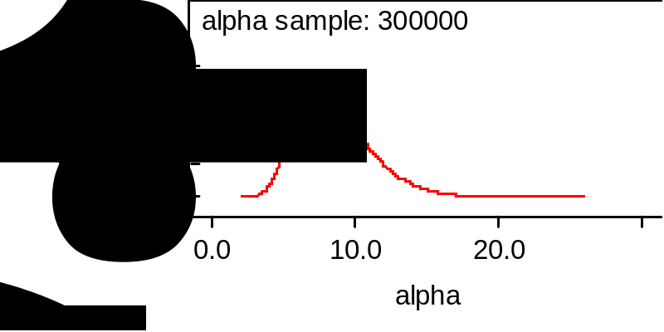
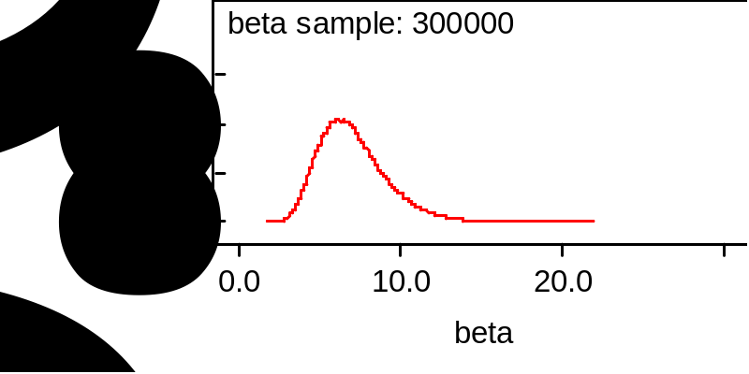
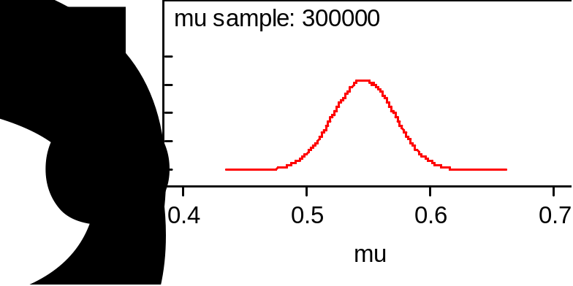
Summary of Results - α, β, μ
Distribution of game specific “true” success rates are centered at 0.55 with a standard deviation of 0.025. A 95% credible set for his true average success rate is 0.50 to 0.60.

Slide 11
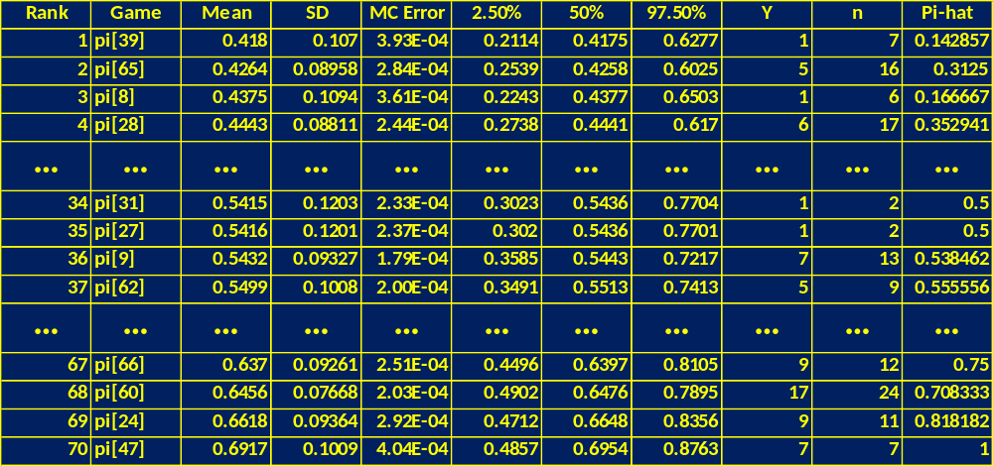
Summary of Results - π_{i}
The table includes Lowest, Middle, and Highest 4 game specific posterior success rates. Note that the lower game specific success rates are increased from the MLE Pi-hat = Y/n to the overall mean (with the amount of shift highest when n_{i} is small). Similarly higher game specific success rates are shrunk toward the overall mean.

Slide 12
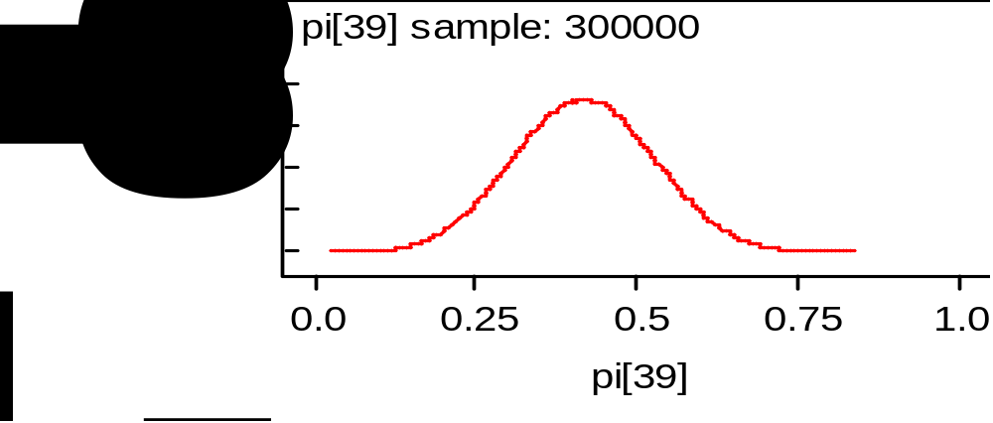
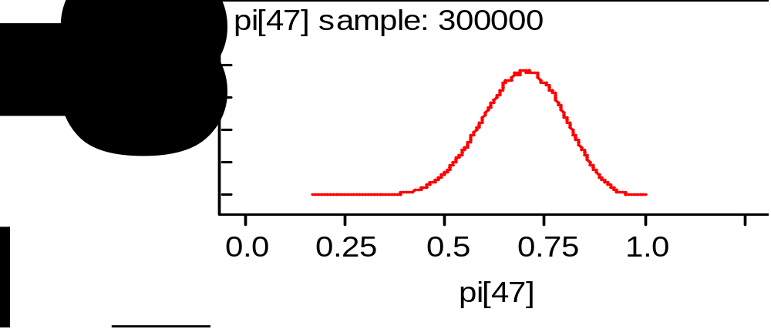
Game with lowest posterior mean success rate
Game with highest posterior mean success rate

