Slide 1
Chevy versus Ford NASCAR Race Effect Size – A Meta-Analysis

Slide 2
Data Description
All 256 NASCAR Races for 1993-2000 Seasons
Race Finishes Among all Ford and Chevy Drivers (Ranks)
  Ford: 5208 Drivers (20.3 per race)
  Chevrolet: 3642 Drivers (14.2 per race)
For each race, Compute Wilcoxon Rank-Sum Statistic (Large-sample Normal Approximation)
Effect Size = Z/SQRT(N_{Ford} + N_{Chevy})

Slide 3
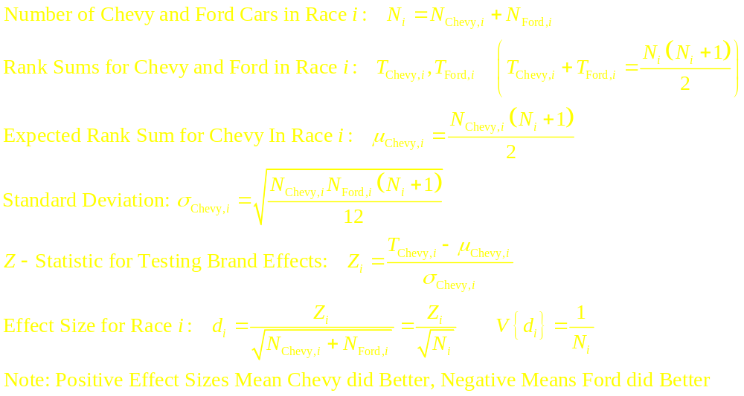
Wilcoxon Rank-Sum Test (Large-Sample)

Slide 4
Evidence that Chevrolet tends to do better than Ford

Slide 5
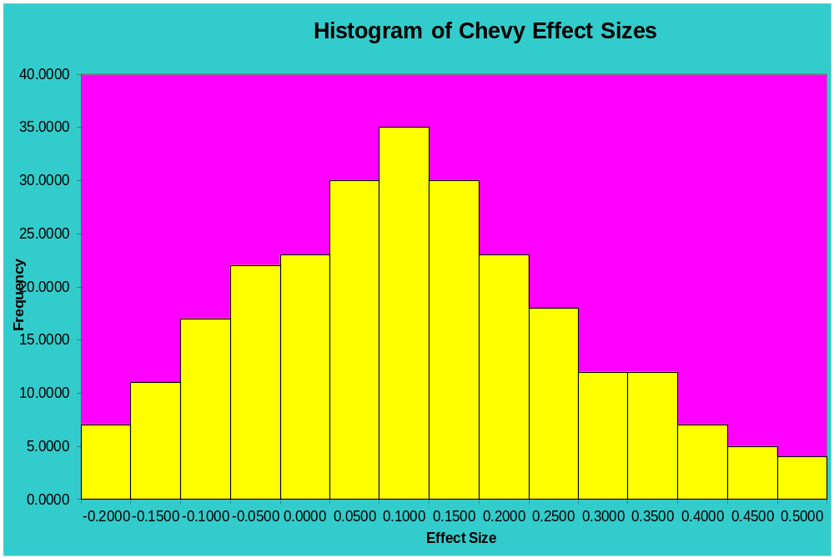
Effect Sizes Appear to be approximately Normal

Slide 6
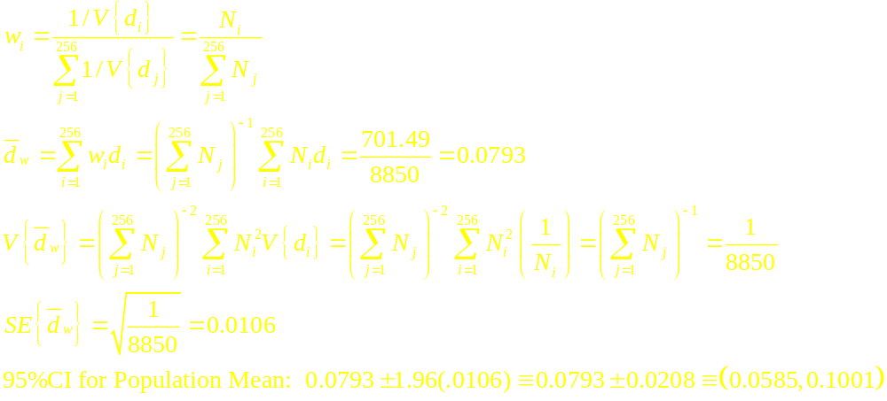
Combining Effect Sizes Across Races
Weighted Average of Race-Specific Effect Sizes
Weight Factor ∝ 1/V{d_{i}} = N_{i} = (N_{Chevy,i}+N_{Ford,i})

Slide 7
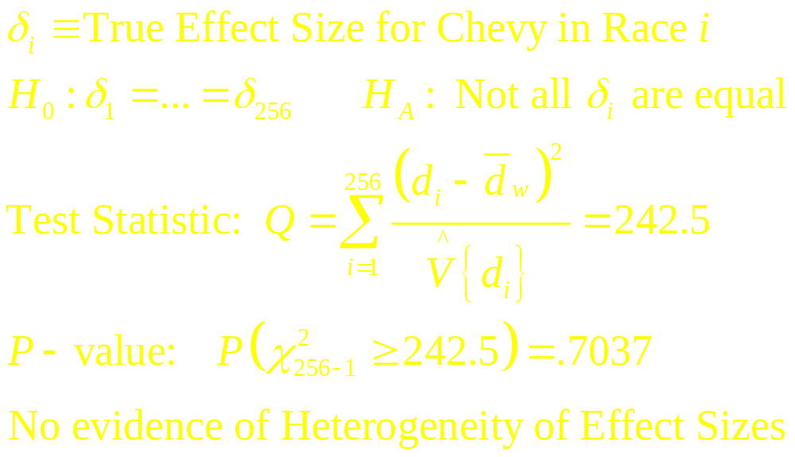
Test for Homogeneity of Effect Sizes

Slide 8
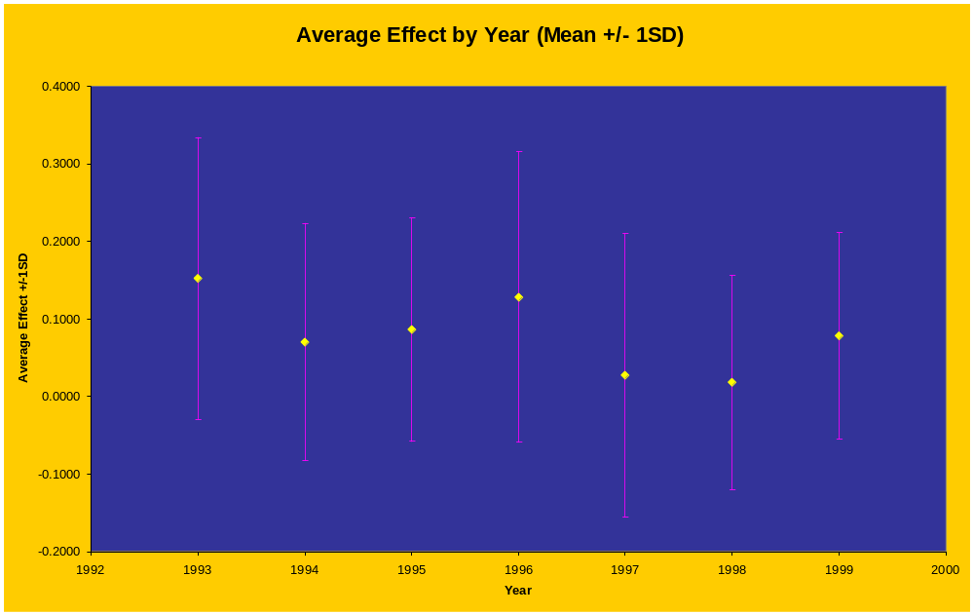

Slide 9
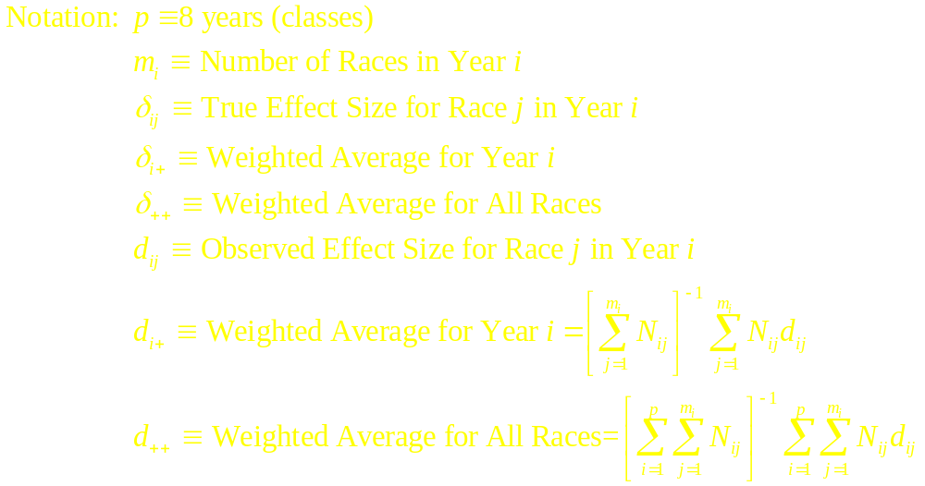
Testing for Year Effects

Slide 10
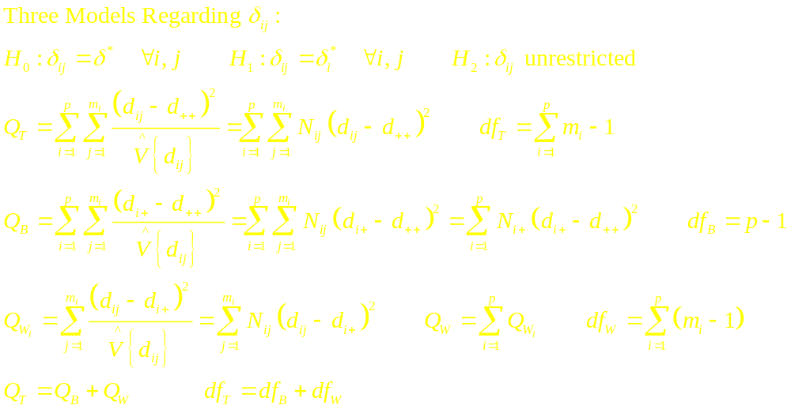
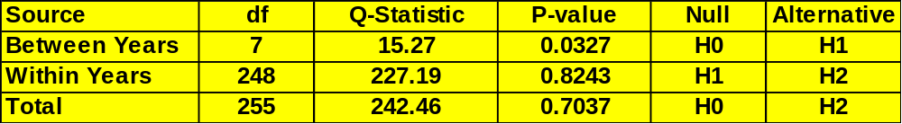
Testing for Year Effects

Slide 11
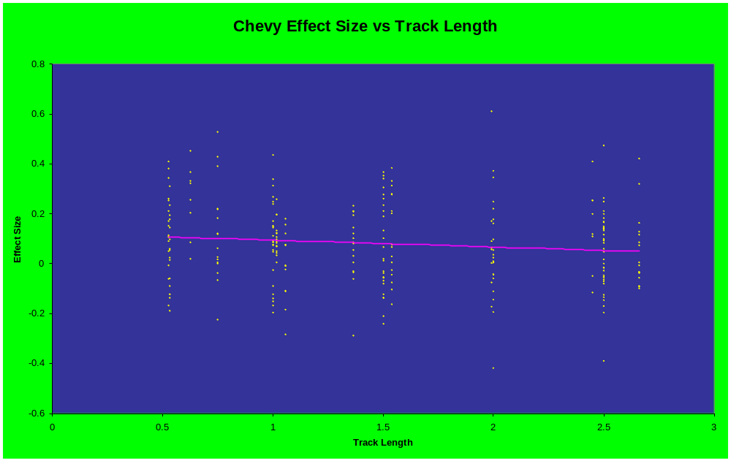

Slide 12
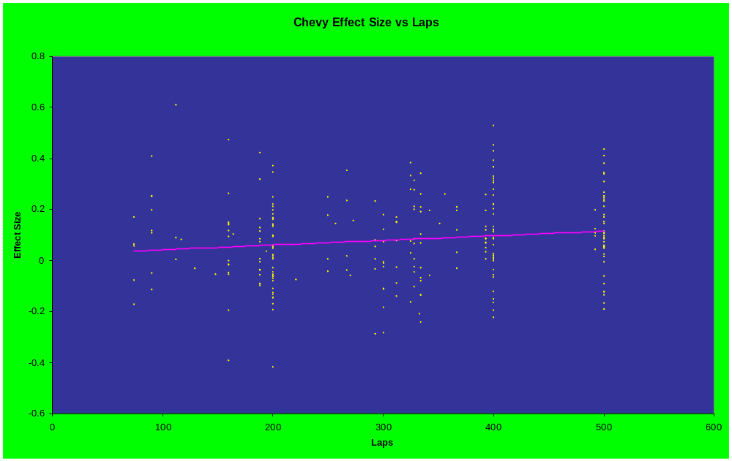

Slide 13
Testing for Year and Race/Track Effects
Regression Model Relating Effect Size to:
  Season (8 Dummy Variables (No Intercept))
  Track Length
  Number of Laps
  Race Length (Track Length x # of Laps)
Weighted Least Squares with weight_{i} = N_{i}

Slide 14
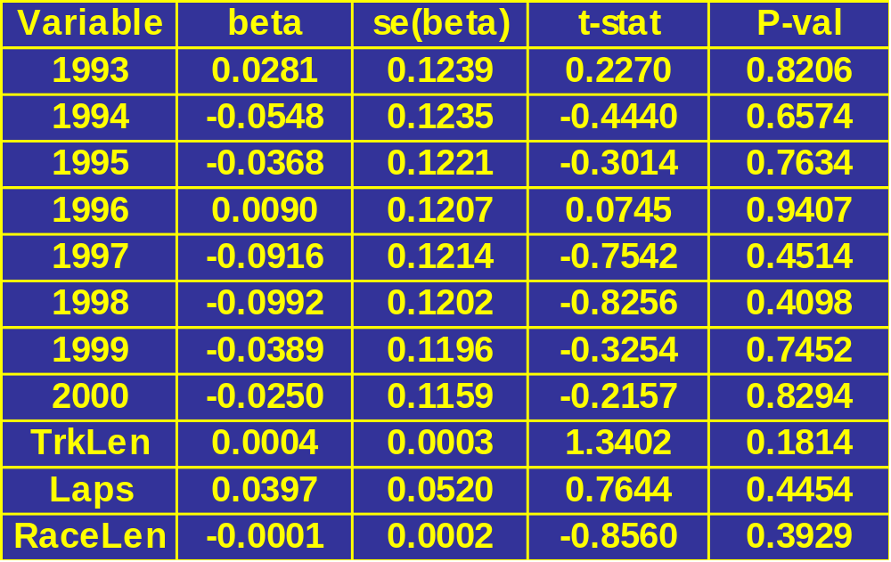
Regression Coefficients/t-tests
Controlling for all other predictors, none appear significant

Slide 15
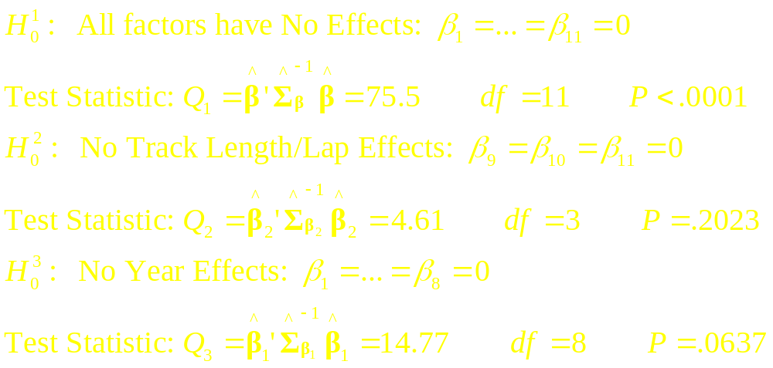
Χ² – Tests for Sub-Models and Overall

Slide 16
Sources
Hedges, L.V. and I. Olkin (1985). Statistical Methods for Meta-Analysis, Academic Press, Orlando, FL.
Winner, L. (2006). “NASCAR Winston Cup Race Results for 1975-2003,” Journal of Statistical Education, Volume 14, #3 www.amstat.org/publications/jse/v14n3/datasets.winner.html

