Slide 1
R for Applied Statistical Methods
Larry Winner
Department of Statistics
University of Florida

Slide 2
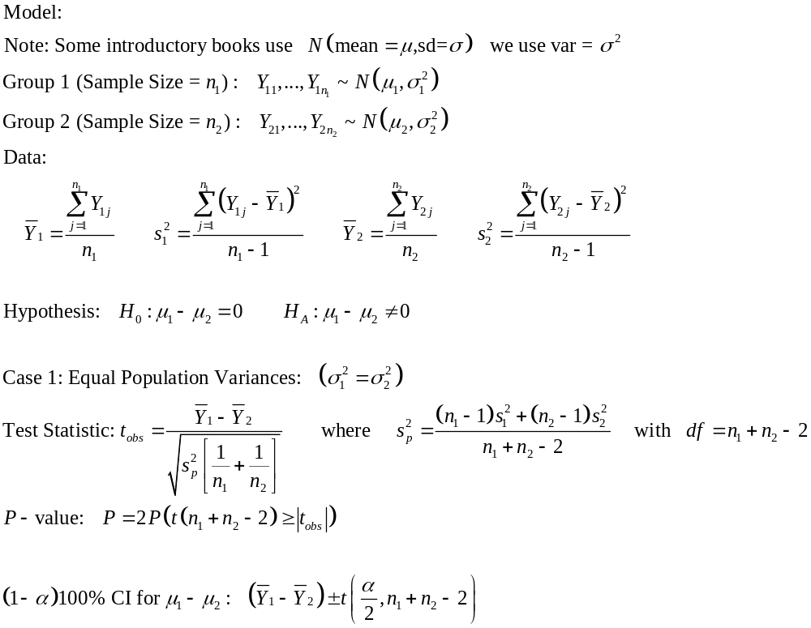
2-Sample t-test (Independent Samples) – Case 1

Slide 3
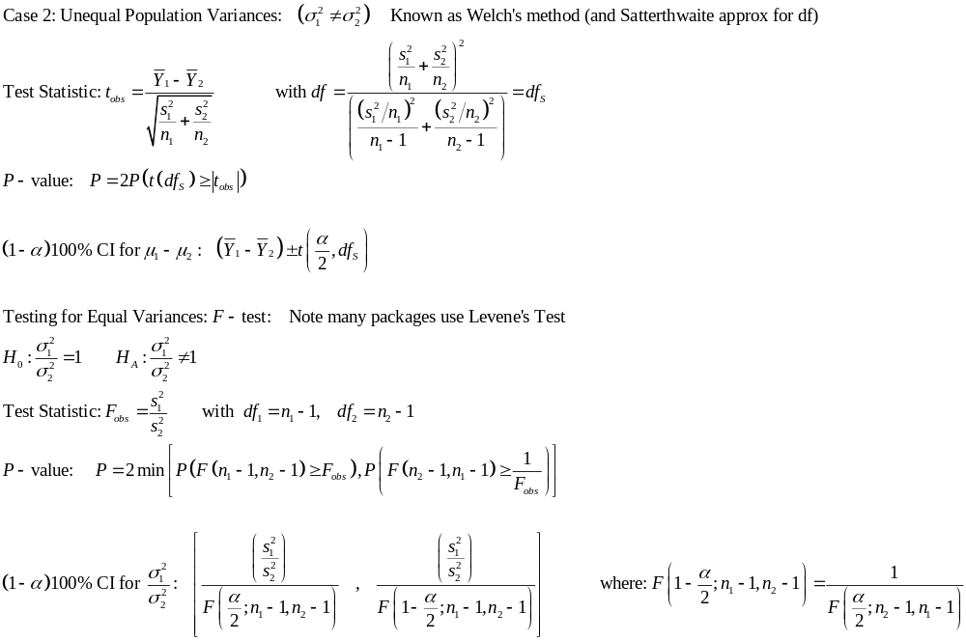
2-Sample t-test– Case 2 and Test of Equal Variances

Slide 4
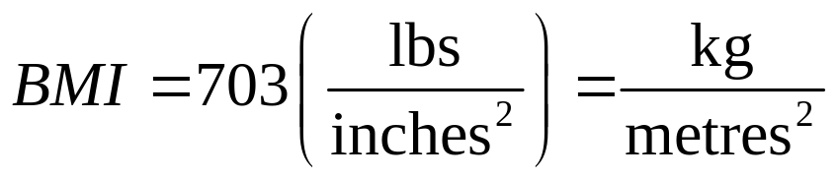
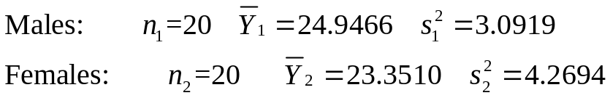
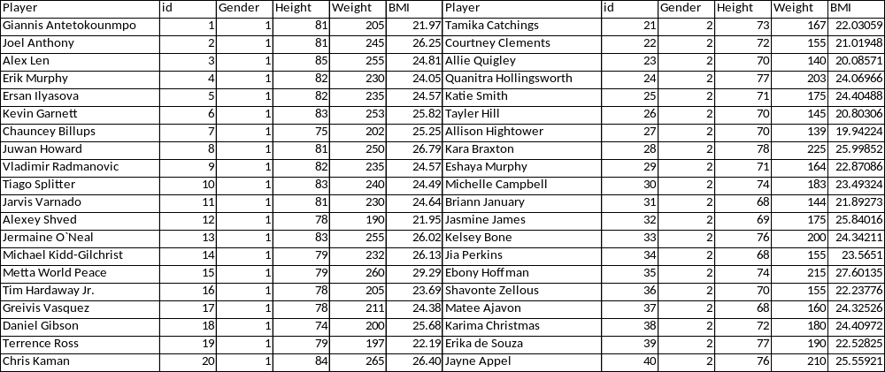
Example – NBA and WNBA Players’ BMI
Groups: Male: NBA(i=1) and Female: WNBA(i=2)
Samples: Random Samples of n₁ = n₂ = 20 from 2013 seasons (2013/2014 for NBA)
Note: Actual data file has males “stacked” over Females.
See next slide.

Slide 5
Data File (.csv)
Player | Gender | Height | Weight | BMI
Giannis Antetokounmpo | 1 | 81 | 205 | 21.9654
Joel Anthony | 1 | 81 | 245 | 26.25133
Alex Len | 1 | 85 | 255 | 24.81176
Erik Murphy | 1 | 82 | 230 | 24.0467
Ersan Ilyasova | 1 | 82 | 235 | 24.56945
Kevin Garnett | 1 | 83 | 253 | 25.81783
Chauncey Billups | 1 | 75 | 202 | 25.24551
Juwan Howard | 1 | 81 | 250 | 26.78708
Vladimir Radmanovic | 1 | 82 | 235 | 24.56945
Tiago Splitter | 1 | 83 | 240 | 24.49122
Jarvis Varnado | 1 | 81 | 230 | 24.64411
Alexey Shved | 1 | 78 | 190 | 21.95431
Jermaine O`Neal | 1 | 83 | 255 | 26.02192
Michael Kidd-Gilchrist | 1 | 79 | 232 | 26.13299
Metta World Peace | 1 | 79 | 260 | 29.28697
Tim Hardaway Jr. | 1 | 78 | 205 | 23.68754
Greivis Vasquez | 1 | 78 | 211 | 24.38083
Daniel Gibson | 1 | 74 | 200 | 25.67568
Terrence Ross | 1 | 79 | 197 | 22.19051
Chris Kaman | 1 | 84 | 265 | 26.40235
Tamika Catchings | 2 | 73 | 167 | 22.03059
Courtney Clements | 2 | 72 | 155 | 21.01948
Allie Quigley | 2 | 70 | 140 | 20.08571
Quanitra Hollingsworth | 2 | 77 | 203 | 24.06966
Katie Smith | 2 | 71 | 175 | 24.40488
Tayler Hill | 2 | 70 | 145 | 20.80306
Allison Hightower | 2 | 70 | 139 | 19.94224
Kara Braxton | 2 | 78 | 225 | 25.99852
Eshaya Murphy | 2 | 71 | 164 | 22.87086
Michelle Campbell | 2 | 74 | 183 | 23.49324
Briann January | 2 | 68 | 144 | 21.89273
Jasmine James | 2 | 69 | 175 | 25.84016
Kelsey Bone | 2 | 76 | 200 | 24.34211
Jia Perkins | 2 | 68 | 155 | 23.5651
Ebony Hoffman | 2 | 74 | 215 | 27.60135
Shavonte Zellous | 2 | 70 | 155 | 22.23776
Matee Ajavon | 2 | 68 | 160 | 24.32526
Karima Christmas | 2 | 72 | 180 | 24.40972
Erika de Souza | 2 | 77 | 190 | 22.52825
Jayne Appel | 2 | 76 | 210 | 25.55921

Slide 6
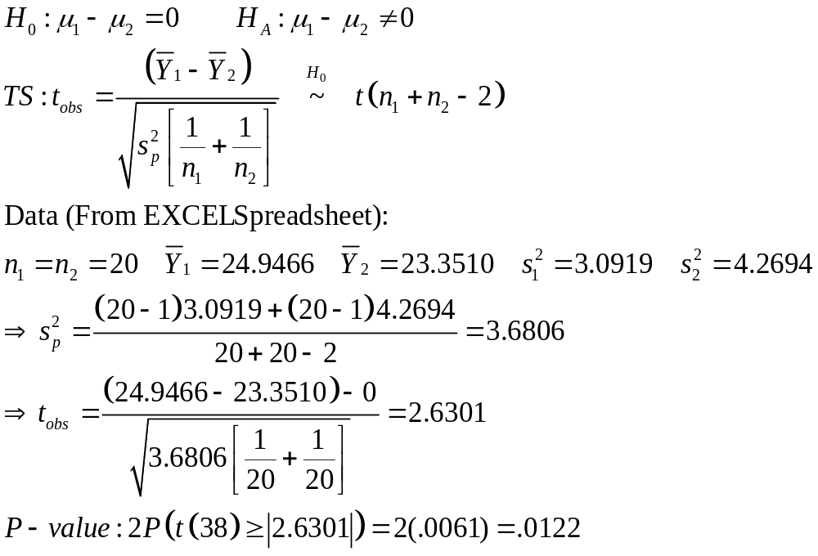
t-test for NBA vs WNBA BMI – Equal Variances

Slide 7
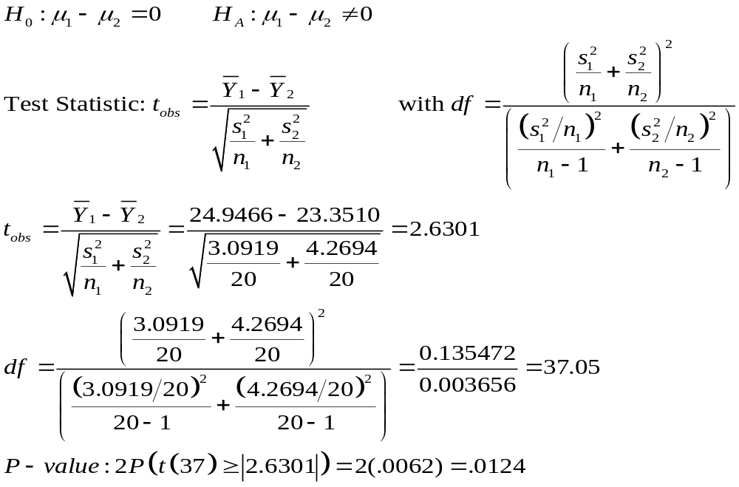
t-test for NBA vs WNBA BMI – Unequal Variances
Note: the test statistics are the same (n₁ = n₂) and the degrees of freedom very close (s₁≈ s₂)

Slide 8
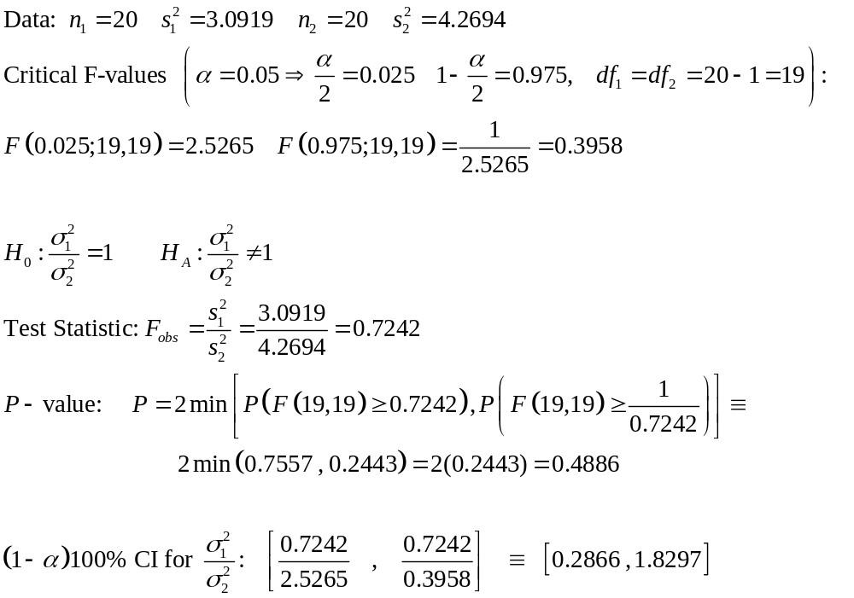
Test for Equal Variances for WNBA vs NBA BMI

Slide 9
Small Sample Test to Compare Two Medians – Non-Normal Populations
Two Independent Samples (Parallel Groups)
Procedure (Wilcoxon Rank-Sum Test):
  Null hypothesis: Population Medians are equal H₀: M₁ = M₂
  Rank measurements across samples from smallest (1) to largest (n₁+n₂). Ties take average ranks.
  Obtain the rank sum for group with smallest sample size (T )
  1-sided tests: Conclude H_{A}: M₁ > M₂ if T > T_{U}
  Conclude: H_{A}: M₁ < M₂ if T < T_{L}
  2-sided tests: Conclude H_{A}: M₁ ≠ M₂ if T > T_{U} or T < T_{L}
  Values of T_{L} and T_{U} are given in tables for various sample sizes and significance levels (Some tables use T=Rank sum for larger Group).
  This test gives equivalent conclusions as Mann-Whitney U-test

Slide 10
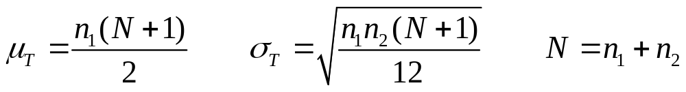
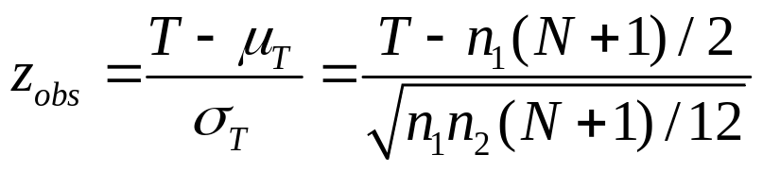
Rank-Sum Test: Normal Approximation
Under the null hypothesis of no difference in the two groups (let T be rank sum for group 1):
A z-statistic can be computed and P-value (approximate) can be obtained from Z-distribution
Note: When there are many ties in ranks, a more complex formula for σ_{T} is often used, with little effect unless there are many ties.

Slide 11
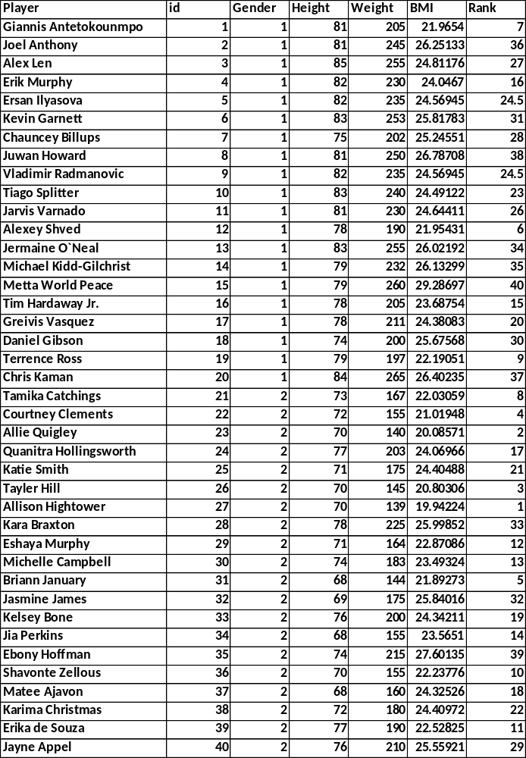
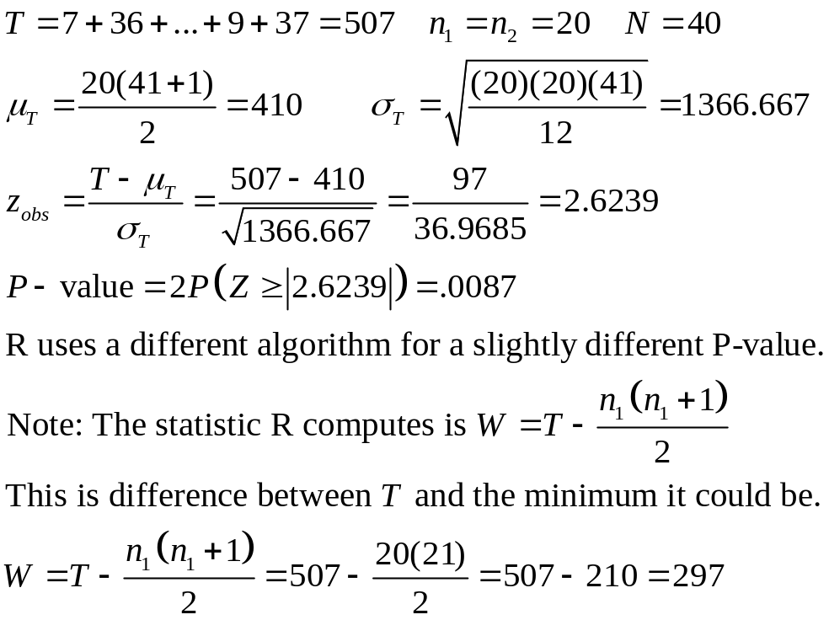
WNBA/NBA BMI Data – Wilcoxon Rank-Sum Test

Slide 12
R Program and Output
bmi1 <- read.csv("http://www.stat.ufl.edu/~winner/data/wnba_nba_bmi.csv",header=T)
attach(bmi1); names(bmi1)
tapply(BMI,Gender,mean) # Obtain mean BMI by Gender
tapply(BMI,Gender,var) # Obtain variance of BMI by Gender
tapply(BMI,Gender,length) # Obtain sample size of BMI by Gender
t.test(BMI~Gender,var.equal=T) # t-test with Equal Variances
t.test(BMI~Gender) # t-test with Unequal Variances
var.test(BMI~Gender) # F-test for Equal Variances
wilcox.test(BMI~Gender) # Wilcoxon Rank-Sum Test
#################################
> tapply(BMI,Gender,mean) # Obtain mean BMI by Gender
1 2
24.94665 23.35099
> tapply(BMI,Gender,var) # Obtain variance of BMI by Gender
1 2
3.091871 4.269420
> tapply(BMI,Gender,length) # Obtain sample size of BMI by Gender
1 2
20 20

Slide 13
R Output (Continued)
> t.test(BMI~Gender,var.equal=T) # t-test with Equal Variances
Two Sample t-test
data: BMI by Gender
t = 2.6301, df = 38, p-value = 0.01226
alternative hypothesis: true difference in means is not equal to 0
95 percent confidence interval:
0.3674868 2.8238189
sample estimates:
mean in group 1 mean in group 2
24.94665 23.35099
> t.test(BMI~Gender) # t-test with Unequal Variances
Welch Two Sample t-test
data: BMI by Gender
t = 2.6301, df = 37.052, p-value = 0.01236
alternative hypothesis: true difference in means is not equal to 0
95 percent confidence interval:
0.3664539 2.8248518
sample estimates:
mean in group 1 mean in group 2
24.94665 23.35099

Slide 14
R Output (Continued)
> var.test(BMI~Gender) # F-test for Equal Variances
F test to compare two variances
data: BMI by Gender
F = 0.7242, num df = 19, denom df = 19, p-value = 0.4885
alternative hypothesis: true ratio of variances is not equal to 1
95 percent confidence interval:
0.2866432 1.8296302
sample estimates:
ratio of variances
0.7241899
> wilcox.test(BMI~Gender)
Wilcoxon rank sum test with continuity correction
data: BMI by Gender
W = 297, p-value = 0.009042
alternative hypothesis: true location shift is not equal to 0
Warning message:
In wilcox.test.default(x = c(21.96540162, 26.25133364, 24.81176471, :
cannot compute exact p-value with ties

Slide 15
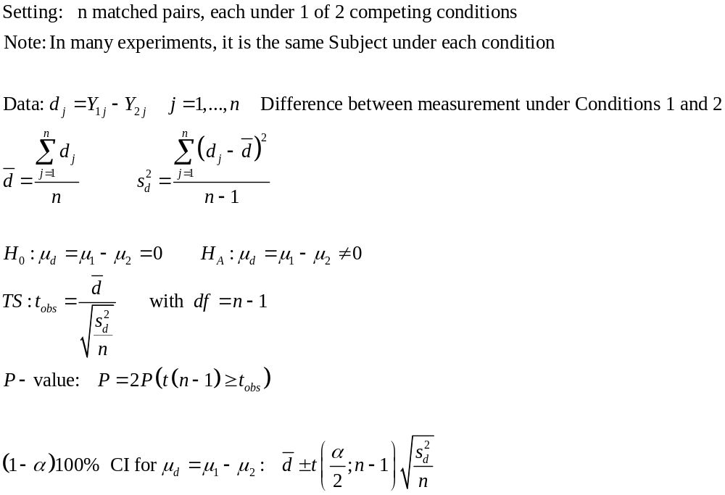
Paired t-test

Slide 16
Example: English Premier League Football - 2012
Interested in Determining if there is a home field effect
  League has 20 teams, all play all 19 opponents Home and Away (190 “pairs” of teams, each playing once on each team’s home field). No overtime.
  We are treating each “pair of teams” as a unit
  Y₁ is the Total Score for the Home Teams, Y₂ is for Away
Note: d represents combined Home Goals – Combined Away Goals for the Pair of teams (“units”)
No home effect should mean μ_{d} = 0
Programming Note: In Independent Sample t-test, we had a Variable for Treatment/Group and another variable for Response (Y). Here we have Y₁ and Y₂ as separate variables, with each row as a unit

Slide 17
Portion of Data File (.csv). Note n =190
Team1 | Team2 | Home | Away
Arsenal | Aston Villa | 2 | 1
Arsenal | Chelsea | 3 | 3
Arsenal | Everton | 1 | 1
Arsenal | Fulham | 3 | 4
Arsenal | Liverpool | 2 | 4
Arsenal | Manchester City | 1 | 3
Arsenal | Manchester United | 3 | 2
Arsenal | Newcastle United | 7 | 4
Arsenal | Norwich City | 4 | 1
Arsenal | Queens Park Rangers | 1 | 1
Arsenal | Reading | 6 | 6
Arsenal | Southampton | 7 | 2
Arsenal | Stoke City | 1 | 0
Arsenal | Sunderland | 0 | 1
Arsenal | Swansea City | 0 | 4
Arsenal | Tottenham Hotspur | 7 | 3
Arsenal | West Bromwich Albion | 3 | 2
Arsenal | West Ham United | 6 | 4
Arsenal | Wigan Athletic | 4 | 2
Aston Villa | Chelsea | 9 | 2

Slide 18
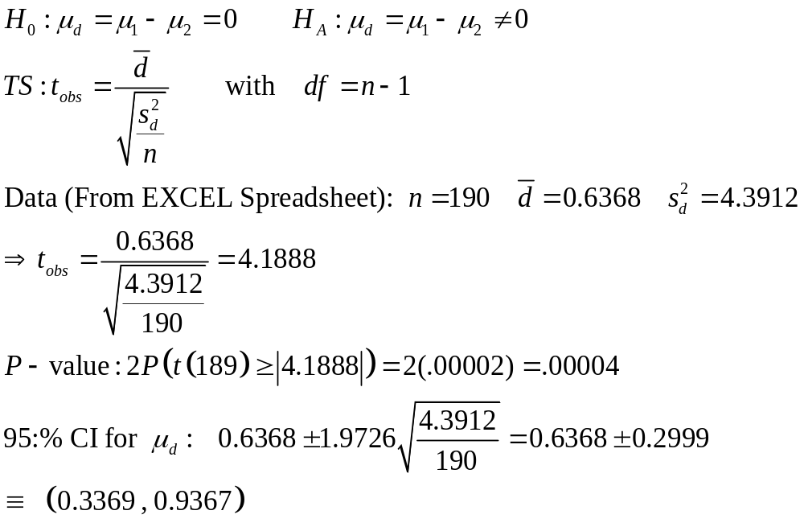
Paired t-test for EPL 2012 Home vs Away Goals

Slide 19
R Program / Output
epl.2012 <- read.csv("http://www.stat.ufl.edu/~winner/data/epl_2012_home.csv",
header=T)
attach(epl.2012); names(epl.2012)
t.test(Home,Away,paired=T)
wilcox.test(Home,Away,paired=T)
#######################
> t.test(Home,Away,paired=T)
Paired t-test
data: Home and Away
t = 4.1891, df = 189, p-value = 4.294e-05
alternative hypothesis: true difference in means is not equal to 0
95 percent confidence interval:
0.3369575 0.9367267
sample estimates:
mean of the differences
0.6368421

Slide 20
Small-Sample Test For Nonnormal Data
Paired Samples (Crossover Design)
Procedure (Wilcoxon Signed-Rank Test)
  Compute Differences d_{i} (as in the paired t-test) and obtain their absolute values (ignoring 0^{s}). n= number of non-zero differences
  Rank the observations by |d_{i}| (smallest=1), averaging ranks for ties
  Compute T₊ and T₋ , the rank sums for the positive and negative differences, respectively
  1-sided tests:Conclude H_{A}: M₁ > M₂ if T=T₋ ≤ T₀
  2-sided tests:Conclude H_{A}: M₁ ≠ M₂ if T=min(T₊ , T₋ ) ≤ T₀
  Values of T₀ are given in various tables for various sample sizes and significance levels. Some tables give the upper tail cut-off T₀ values
  P-values are printed by statistical software packages.

Slide 21
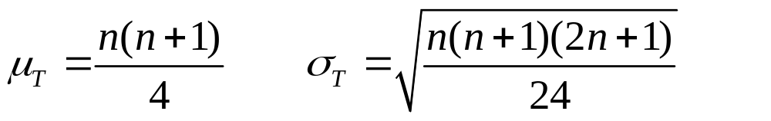
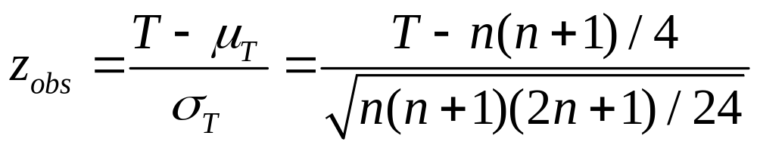
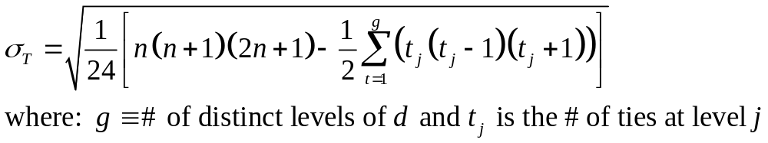
Signed-Rank Test: Normal Approximation
Under the null hypothesis of no difference in the 2 groups: Let T = T⁺
Z-Statistic computed and approximate P-value can be obtained from:
When there are ties (many common d^{s}) as in soccer data, σ_{T} is reduced and is of form:

Slide 22
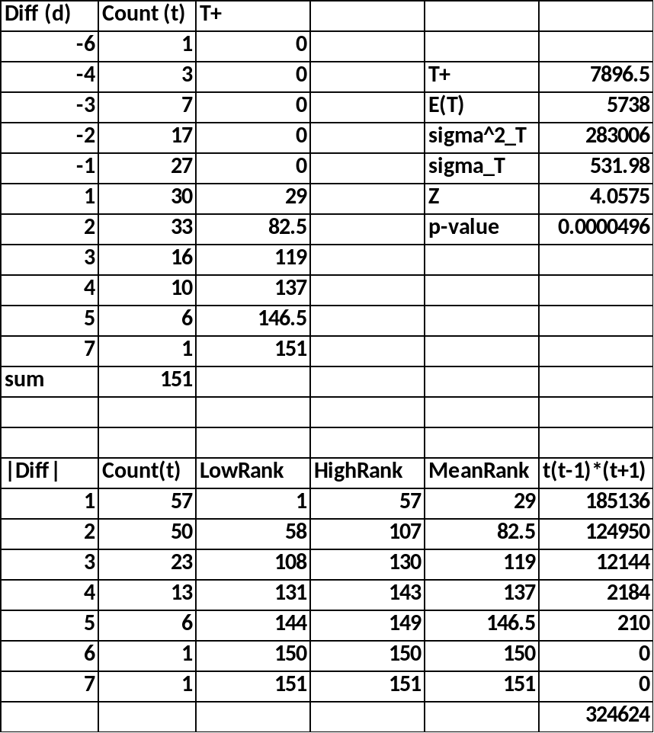
EPL Home Field Advantage
Zero differences have been removed
The Differences and their Counts are at top left
Absolute differences and their counts and average ranks are at bottom
T+ is the sum of the products of the counts and the T+ columns (e.g. There are 30 cases with d=+1, each getting rank=29)
The Z is large and P-value is small
R Labels T+ as V

Slide 23
R Output
> wilcox.test(Home,Away,paired=T)
Wilcoxon signed rank test with continuity correction
data: Home and Away
V = 7896.5, p-value = 4.981e-05
alternative hypothesis: true location shift is not equal to 0

Slide 24
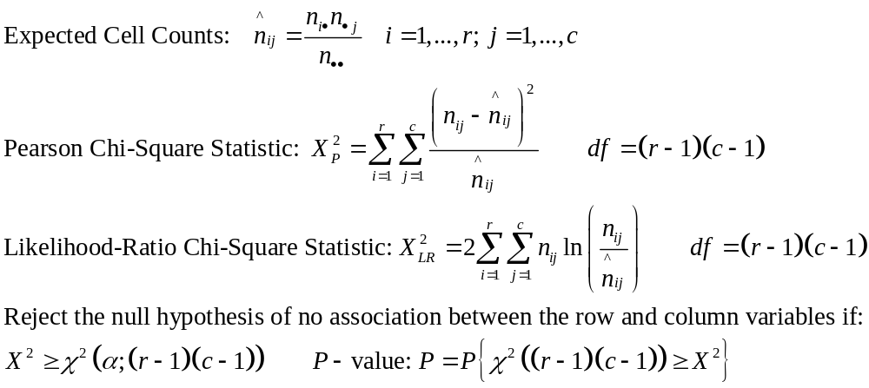
Test for Association for Categorical Variables
Counts | Col 1 | Col 2 | … | Col c | Total
Row 1 | n₁₁ | n₁₂ | … | n_{1c} | n_{1•}
Row 2 | n₂₁ | n₂₂ | … | n_{2c} | n_{2•}
… | … | … | … | … | …
Row r | n_{r1} | n_{r2} | … | n_{rc} | n_{r•}
Total | n_{•1} | n_{•2} | … | n_{•c} | n••

Slide 25
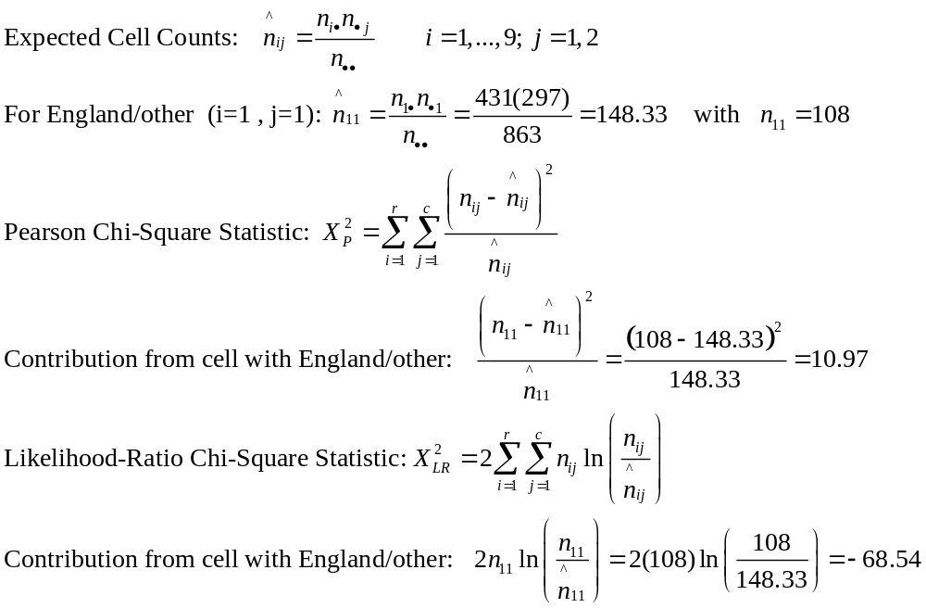
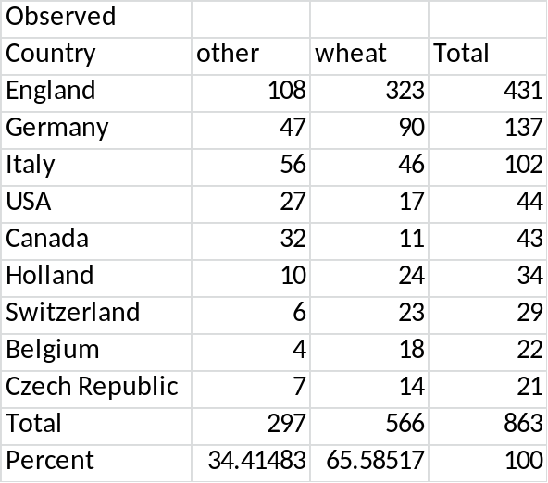
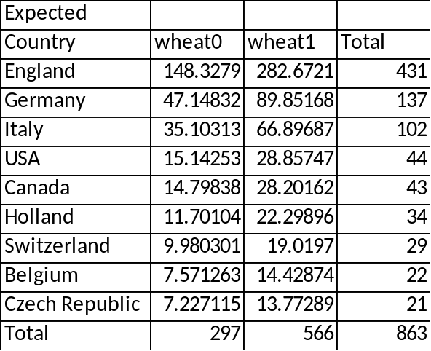
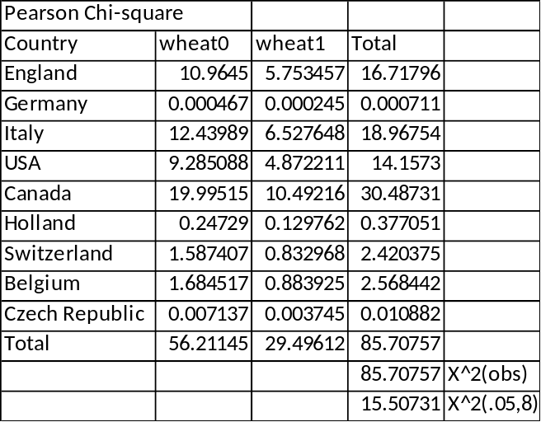
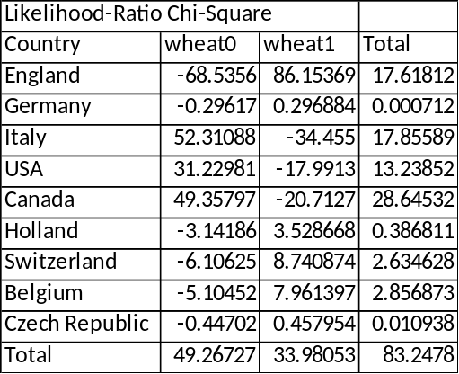
Example: Crop Circles by Country and Field Type
Both tests are highly significant.

Slide 26
R Program – Uses the vcd Package
cc <- read.csv("http://www.stat.ufl.edu/~winner/data/crop_circle",header=T)
attach(cc); names(cc)
(wheat.country <- table(Country,wheat))
chisq.test(wheat.country)
install.packages("vcd")
library(vcd)
assocstats(wheat.country)
barplot(wheat.country,
col=c("blue","green","pink","purple","red",
"yellow","orange","cornflowerblue","beige"),
main="Wheat by Country",xlab="Wheat",ylab="Count")
labs <- rownames(wheat.country)
legend(locator(1),labs,fill=c("blue","green","pink","purple","red",
"yellow","orange","cornflowerblue","beige"))
barplot(wheat.country,beside=T,
col=c("blue","green","pink","purple","red",
"yellow","orange","cornflowerblue","beige"),
main="Wheat by Country",xlab="Wheat",ylab="Count")
labs <- rownames(wheat.country)
legend(locator(1),labs,fill=c("blue","green","pink","purple","red",
"yellow","orange","cornflowerblue","beige"))

Slide 27
R Output
> (wheat.country <- table(Country,wheat))
wheat
Country 0 1
Belgium 4 18
Canada 32 11
Czech 7 14
England 108 323
Germany 47 90
Holland 10 24
Italy 56 46
Swiss 6 23
USA 27 17
##################################################
> assocstats(wheat.country)
X^2 df P(> X^2)
Likelihood Ratio 83.248 8 1.0880e-14
Pearson 85.708 8 3.4417e-15
Phi-Coefficient : 0.315
Contingency Coeff.: 0.301
Cramer's V : 0.315

Slide 28
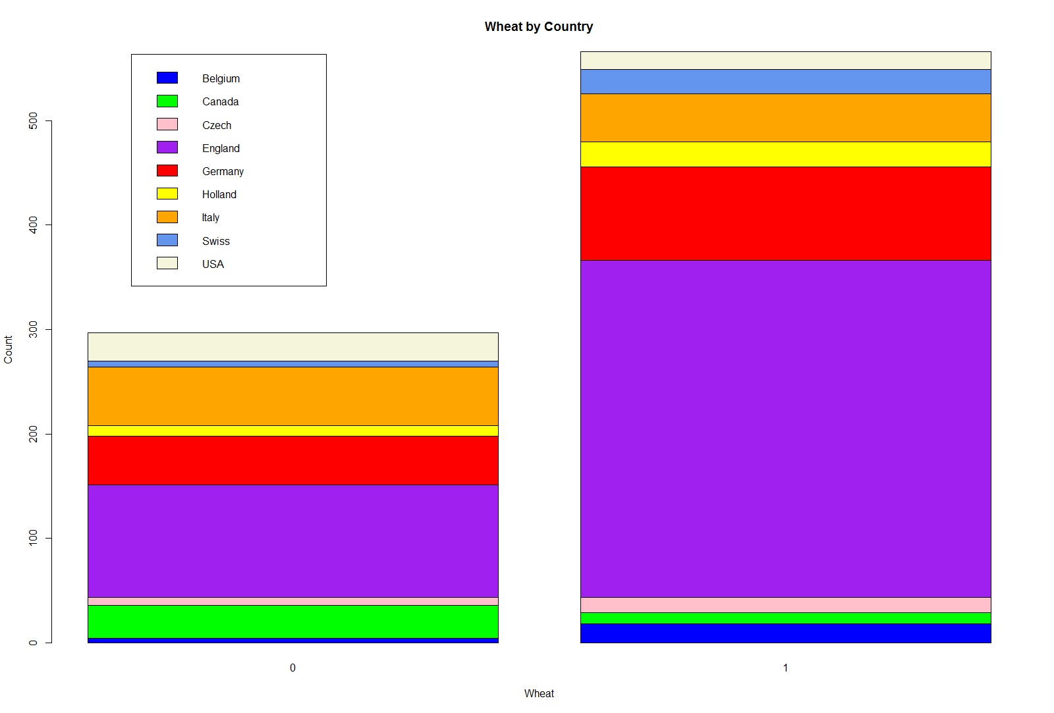

Slide 29
