Slide 1
Multivariate Linear Regression

Slide 2
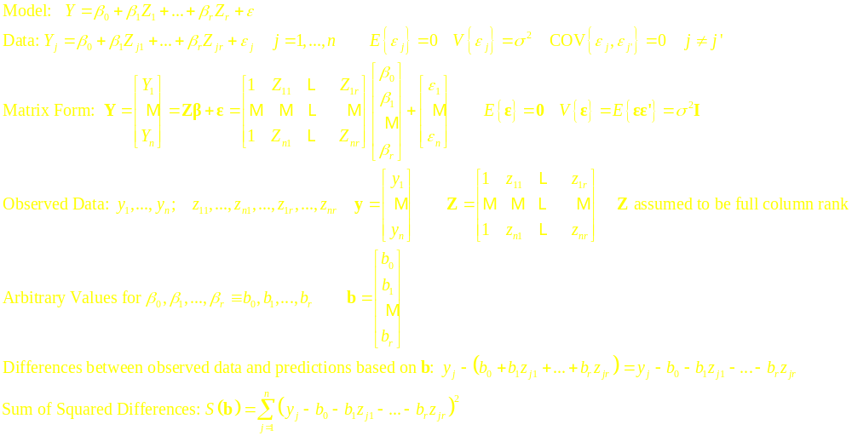
Multiple Regression with a Single Response and r Predictors

Slide 3
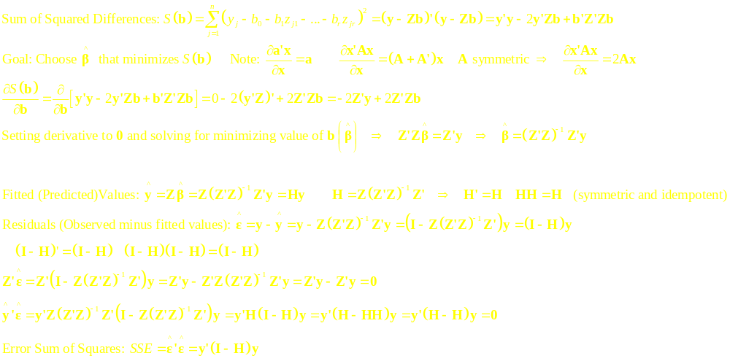
Least Squares Estimation (No Linear Dependencies among Predictors)

Slide 4
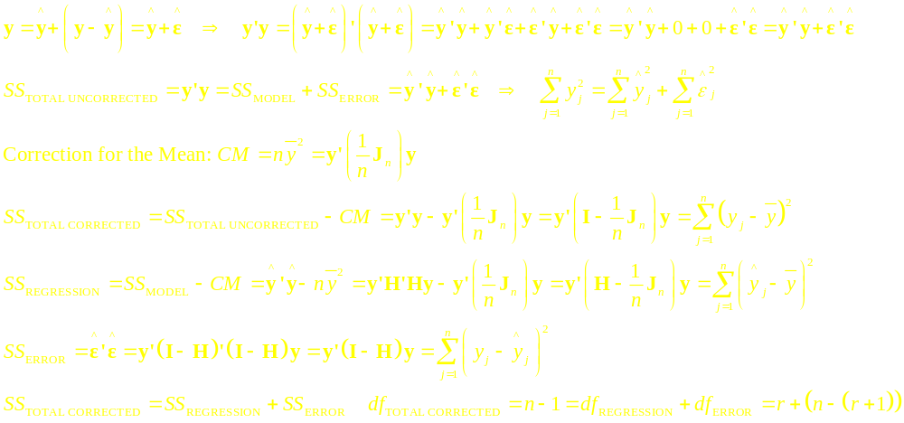
Sums of Squares Decomposition

Slide 5
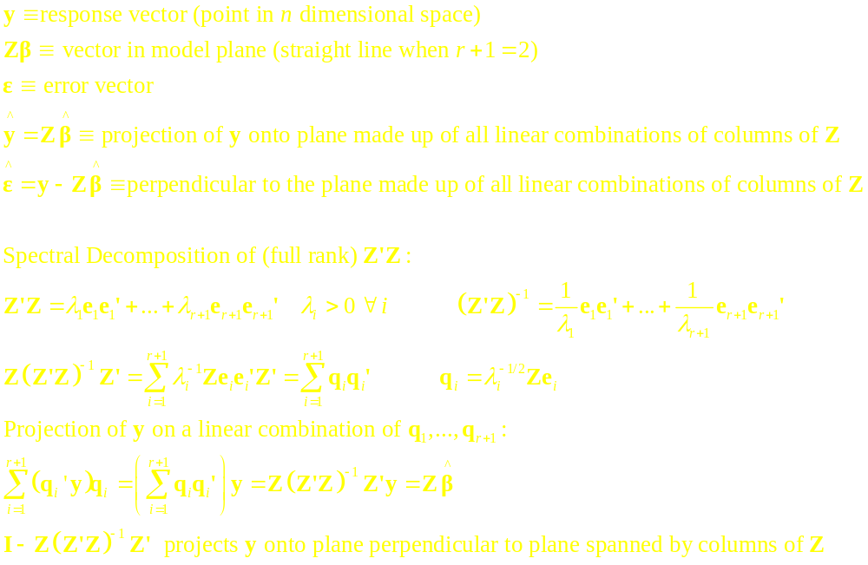
Geometry of Least Squares

Slide 6
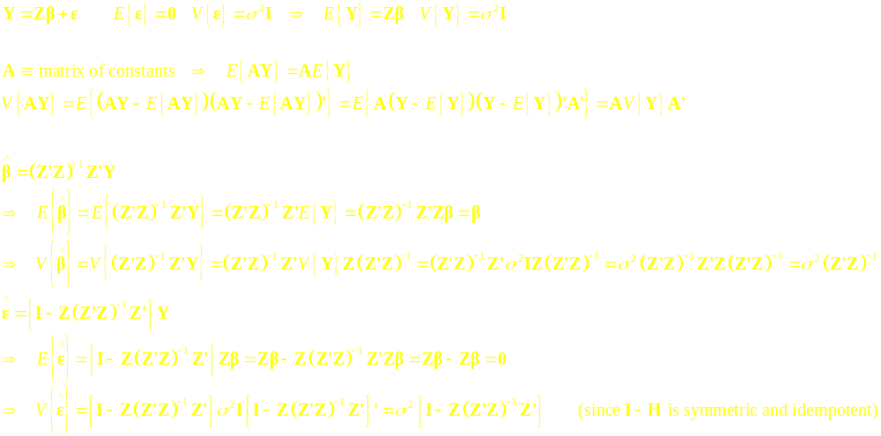
Least Squares Estimators – Sampling Properties - I

Slide 7
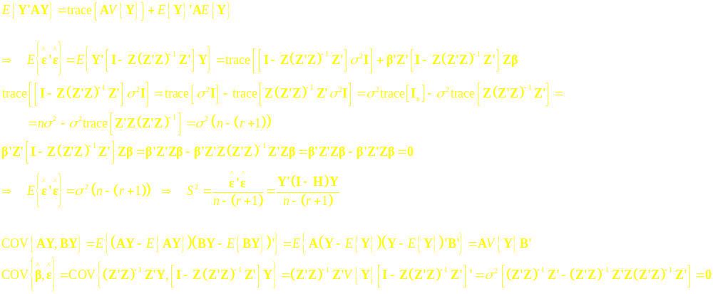
Least Squares Estimators – Sampling Properties - II

Slide 8
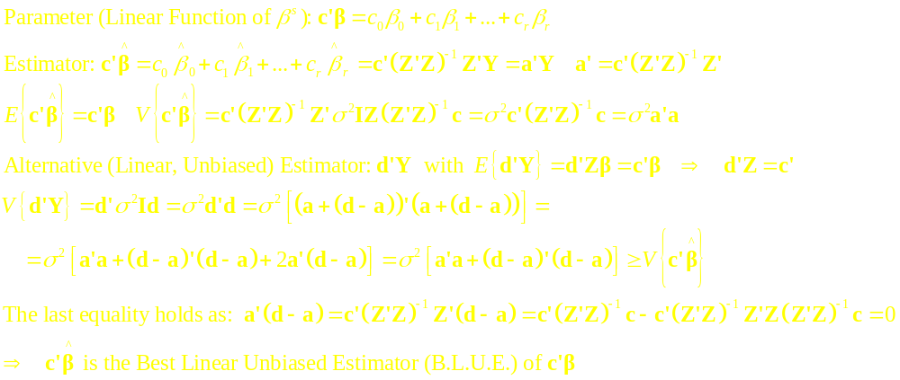
Gauss’ Theorem

Slide 9
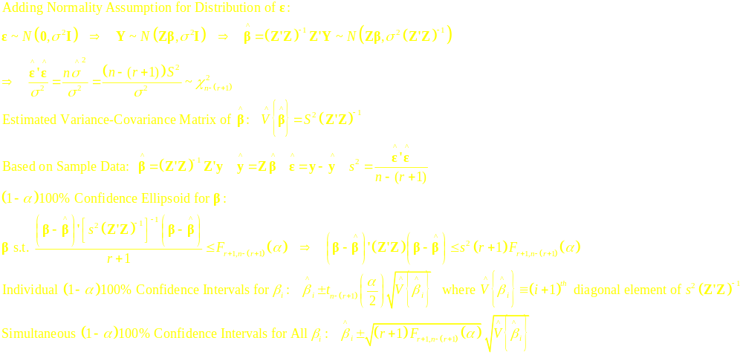
Inferences Based on Normality of Errors - I

Slide 10
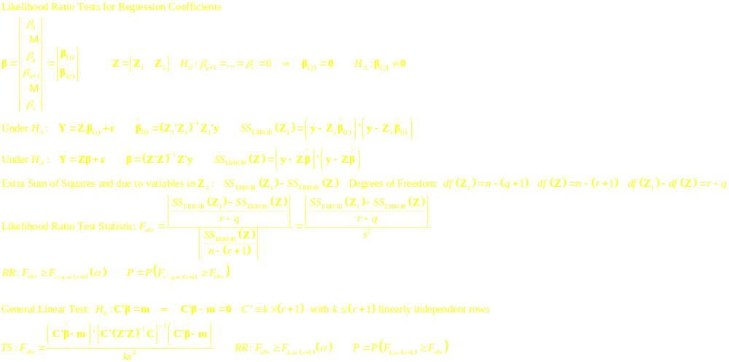
Inferences Based on Normality of Errors - II

Slide 11
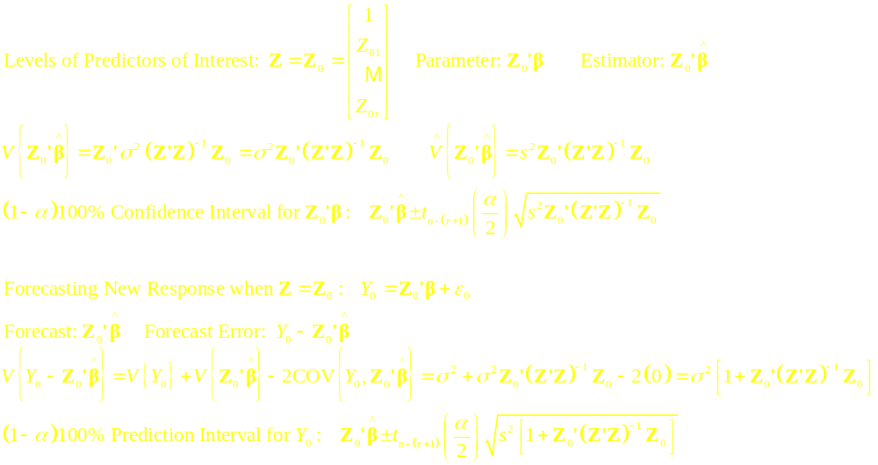
Estimating the Mean and Predicting New Observations

Slide 12
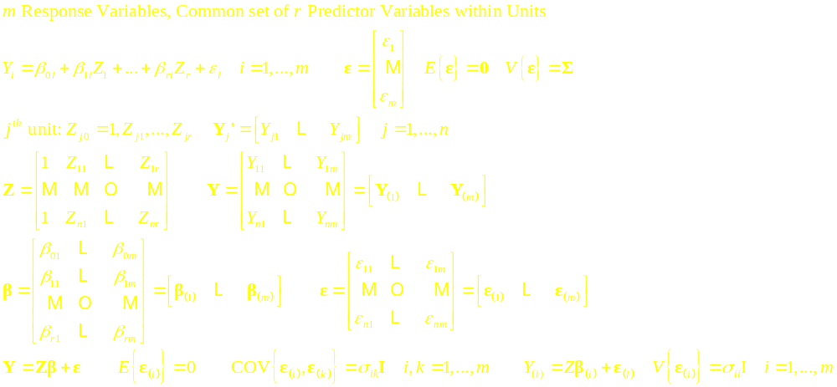
Multivariate Multiple Regression – m Response Variables

Slide 13
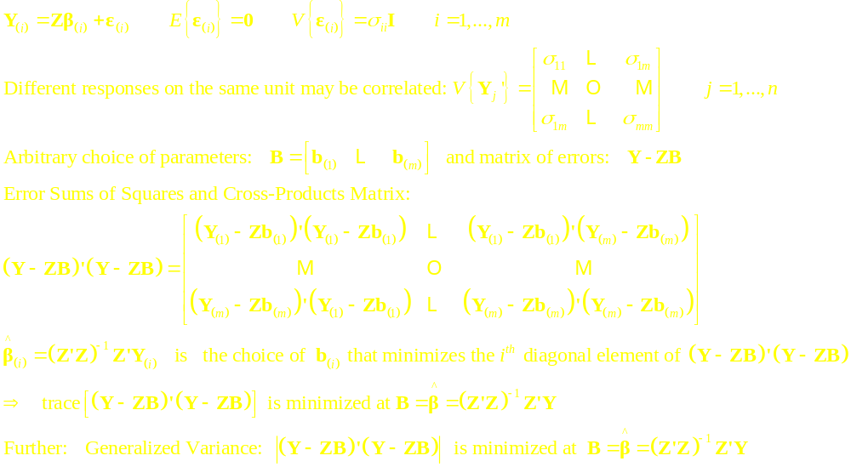
Least Squares Estimation and Sums of Squares and Cross-Products

Slide 14
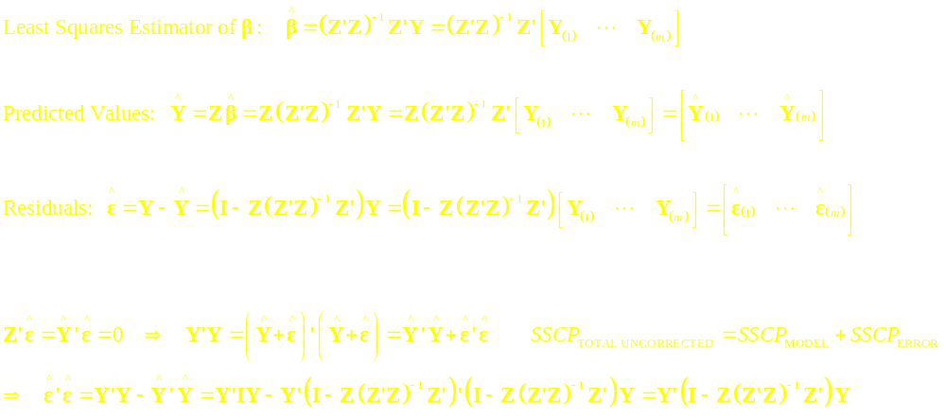
Predicted Values, Residuals, and SSCP Matrices

Slide 15
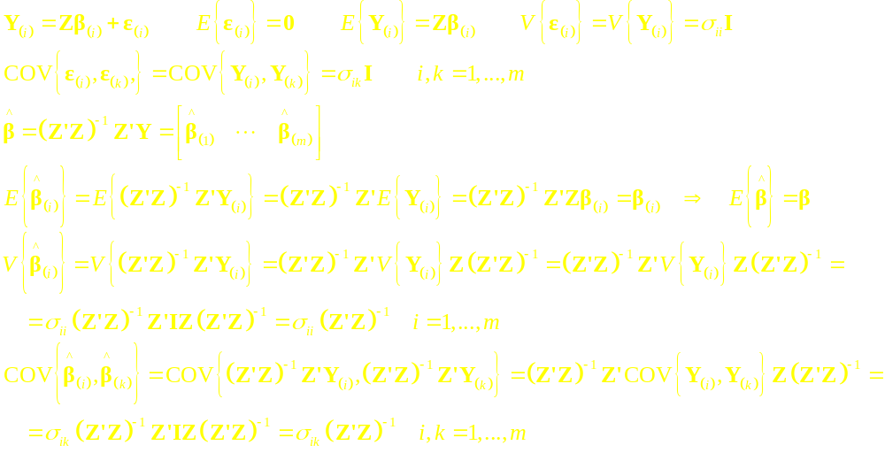
Mean and Variance/Covariance Structure of Least Squares Estimator

Slide 16
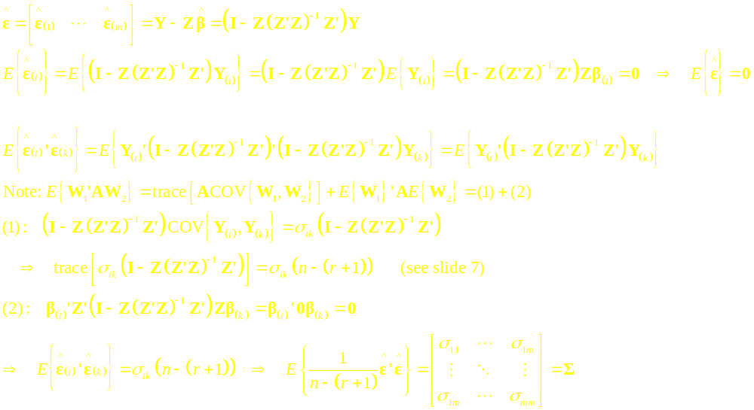
Properties of Residuals and SSCP_{ERROR} Matrix

Slide 17
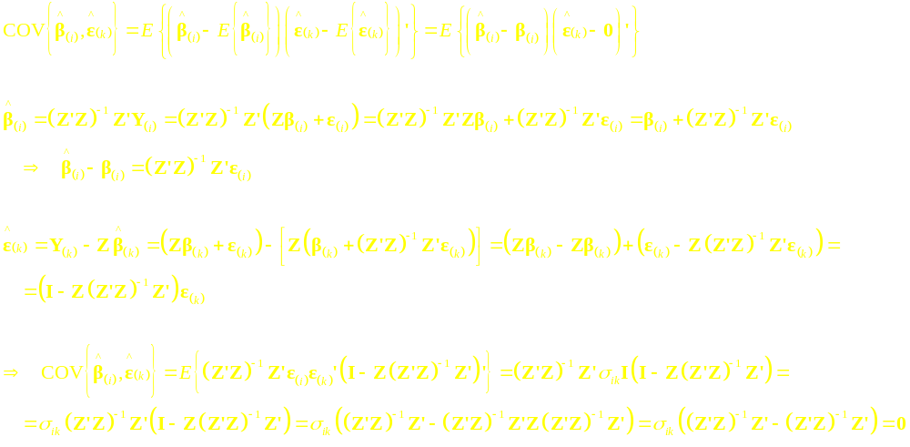
Covariance of Regression Coefficients and Residuals

Slide 18
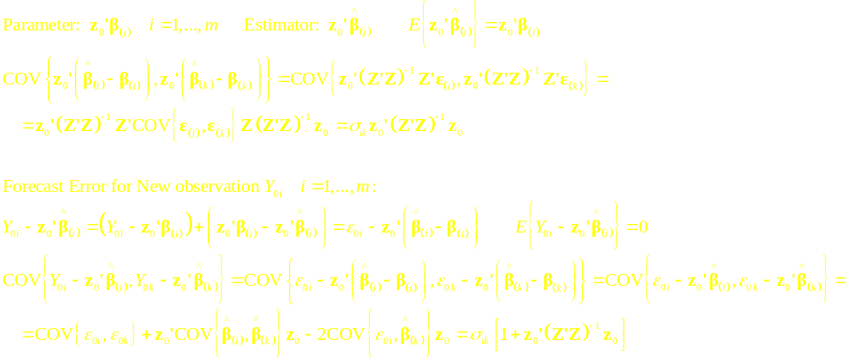
Estimating Mean Responses and Forecasting New Responses at z₀

Slide 19
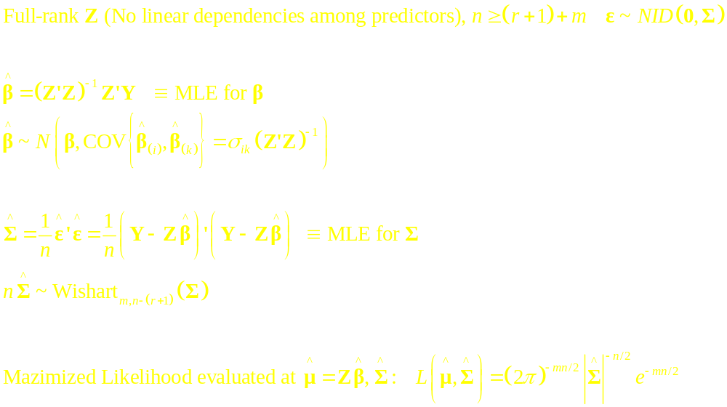
Model with Normal Distribution for Errors

Slide 20
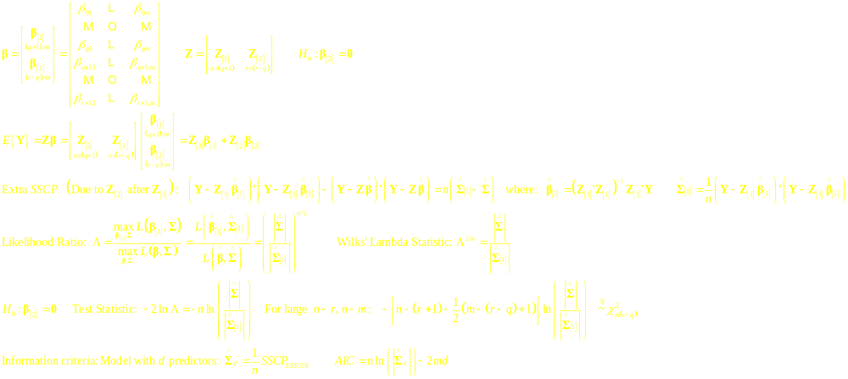
Likelihood Ratio Tests for Regression Coefficients

Slide 21
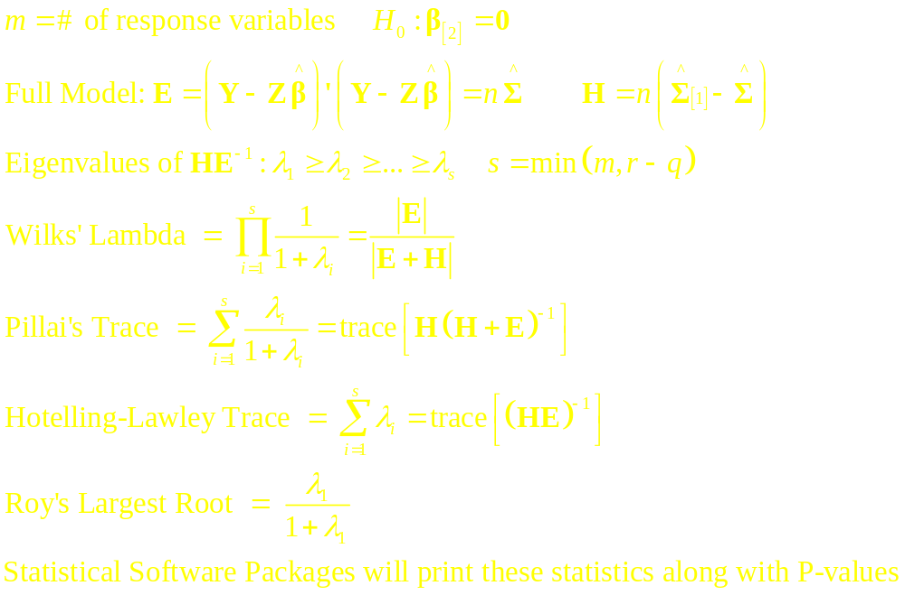
Alternative Test Statistics

Slide 22
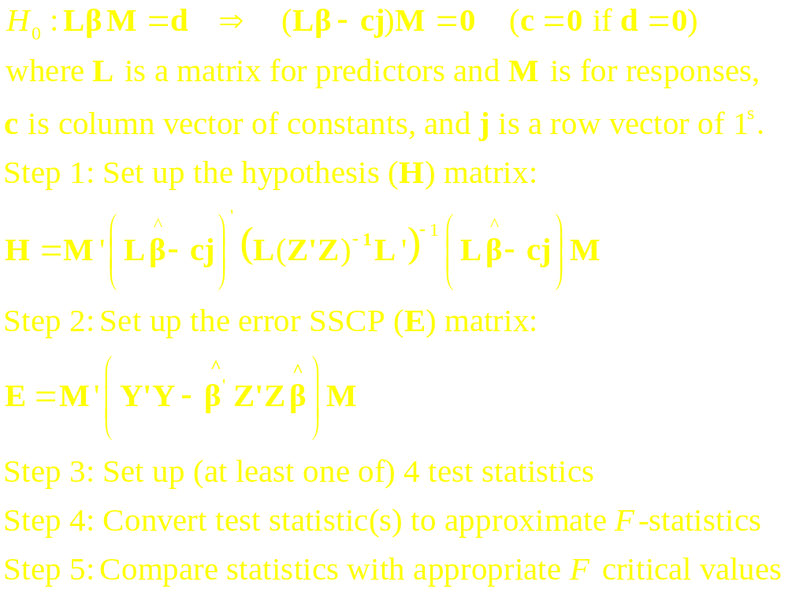
Multivariate Multiple Regression Tests - I

Slide 23
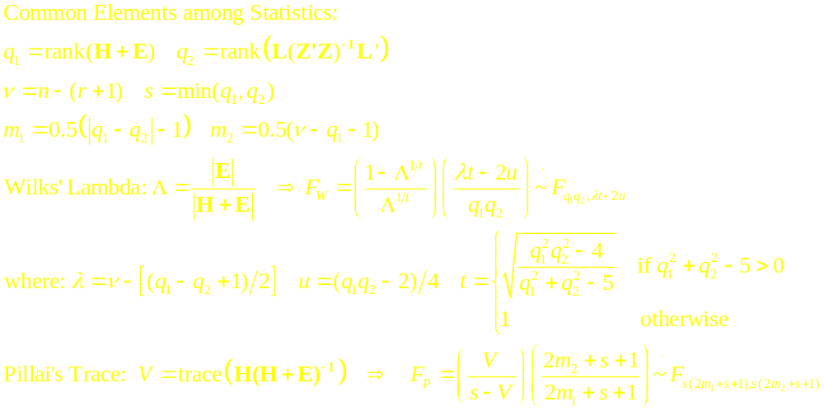
Multivariate Multiple Regression Tests - II

Slide 24
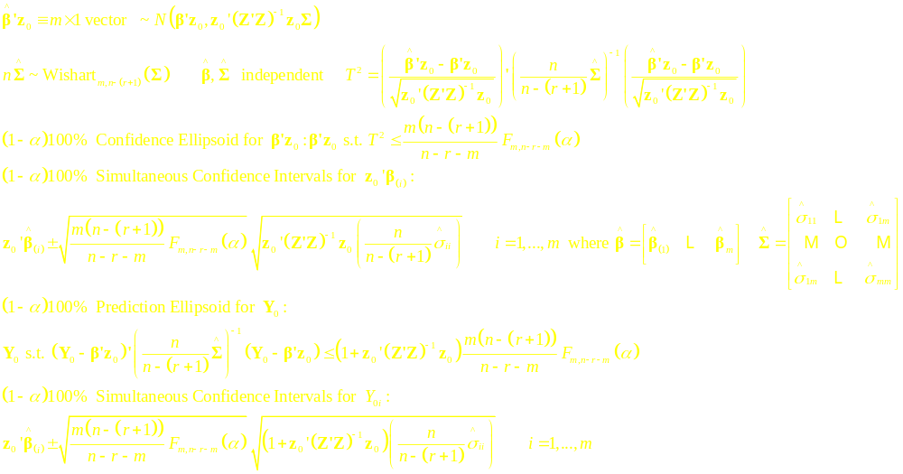
Inference Regarding Predictions

Slide 25
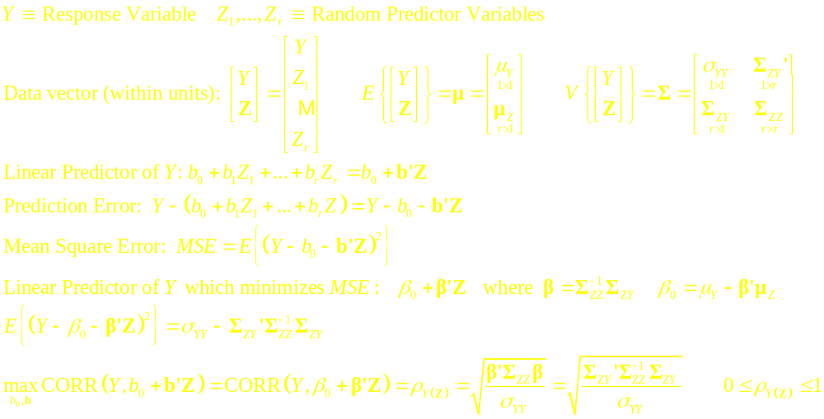
Classical Regression Model – Univariate Response

Slide 26
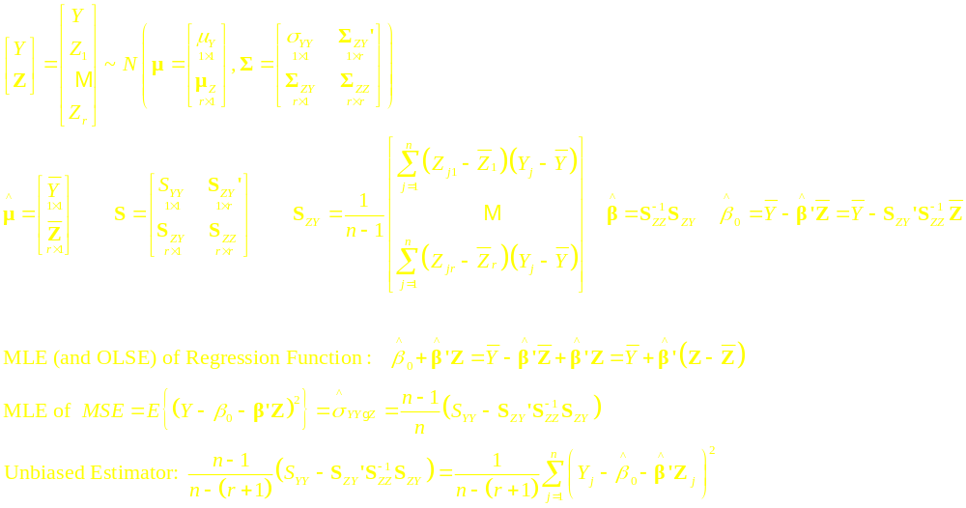
Classical Regression Model – Univariate Response - Estimators

Slide 27
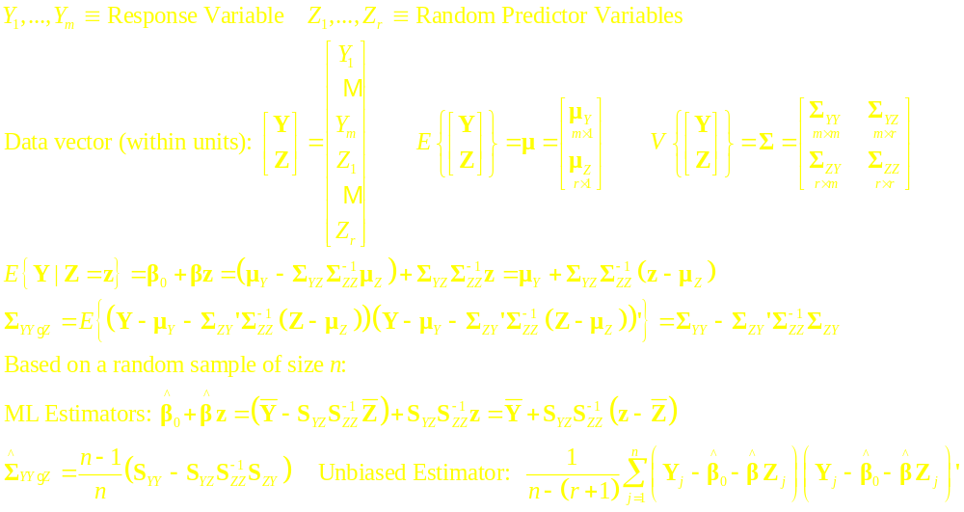
Classical Regression Model – Multivariate Response

Slide 28
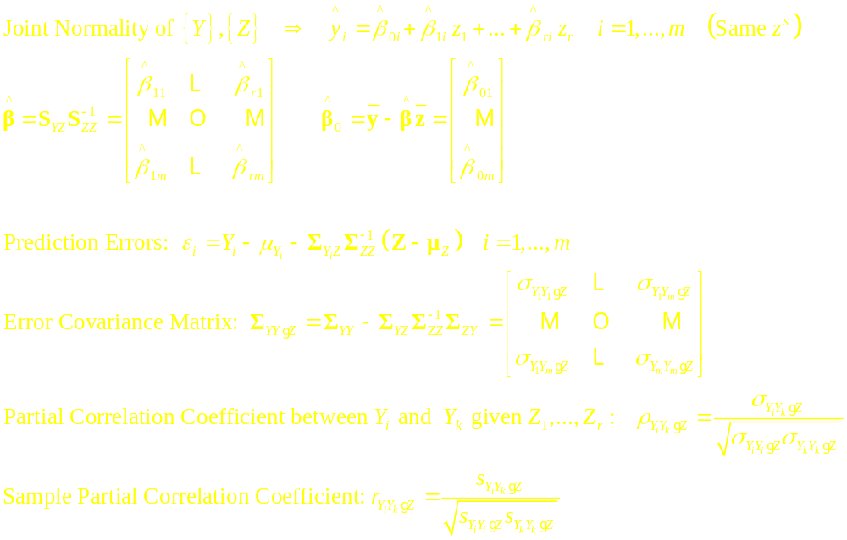
Predictions and Partial Correlation Coefficients

